Slide 1

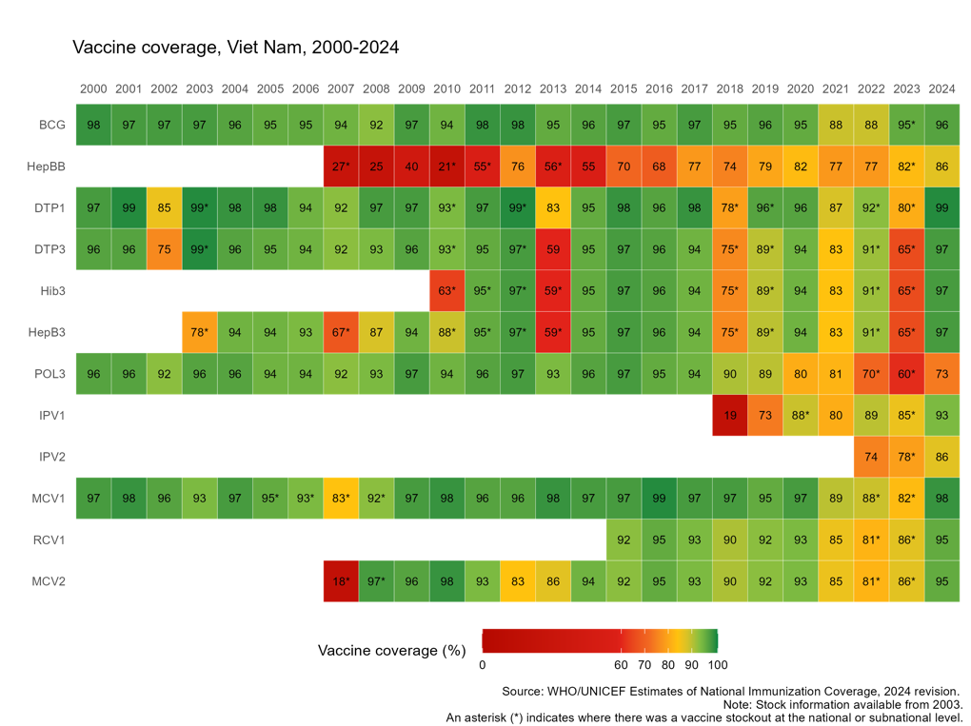


Vietnam
Sustaining and Strengthening Immunization Coverage
in Middle-Income Countries
Tashkent, Uzbekistan, 07-09 October 2025
Priority drivers of persistent coverage challenges
Sustain and strengthen the capacity of the subnational workforce in planning, implementing, and monitoring essential activities, while effectively navigating ongoing administrative restructuring. Timely and adequate operational funding key to supporting outreach, supervision, and routine immunization activities. Streamlining procurement and supply systems can help avoid stockouts and improve timeliness of vaccine delivery. Clarifying ownership and management of digital systems, such as NIIS, can enhance data use and coordination across levels. Persistent vaccine hesitancy and misinformation, especially in underserved or remote areas, affect uptake despite high national averages.
Priority needs to optimize coverage (as of 2026)
Build sustained provincial capacity for planning, budgeting, and monitoring to deliver tailored, equity-focused immunization strategies. Secure predictable, flexible domestic financing through a dedicated national vaccine budget line and streamlined operational fund disbursement. Advance governance and system integration by finalizing NIIS transition to MOH ownership and aligning digital systems with broader health sector reforms
Approaches implemented (incl. year(s))
Launched targeted outreach and mop-up campaigns in underserved southern and highland provinces Transitioning ownership of the National Immunization Information System (NIIS) to the MOH to improve system sustainability and integration Updated national immunization guidelines and SOPs to align with health system reforms and strengthen routine delivery, especially in the absence of a vertical immunization program. Revised law and policies to secure central budget allocations and enabled centralized vaccine procurement for essential immunization activities
Successes and lessons learned
Strong national leadership and technical capacity enabled recovery Catch-up campaigns and data-driven microplanning effective in identifying and reaching missed children Integration of immunization into primary health care supports long-term sustainability but requires continued investment in local ownership and coordination.

