Slide 1

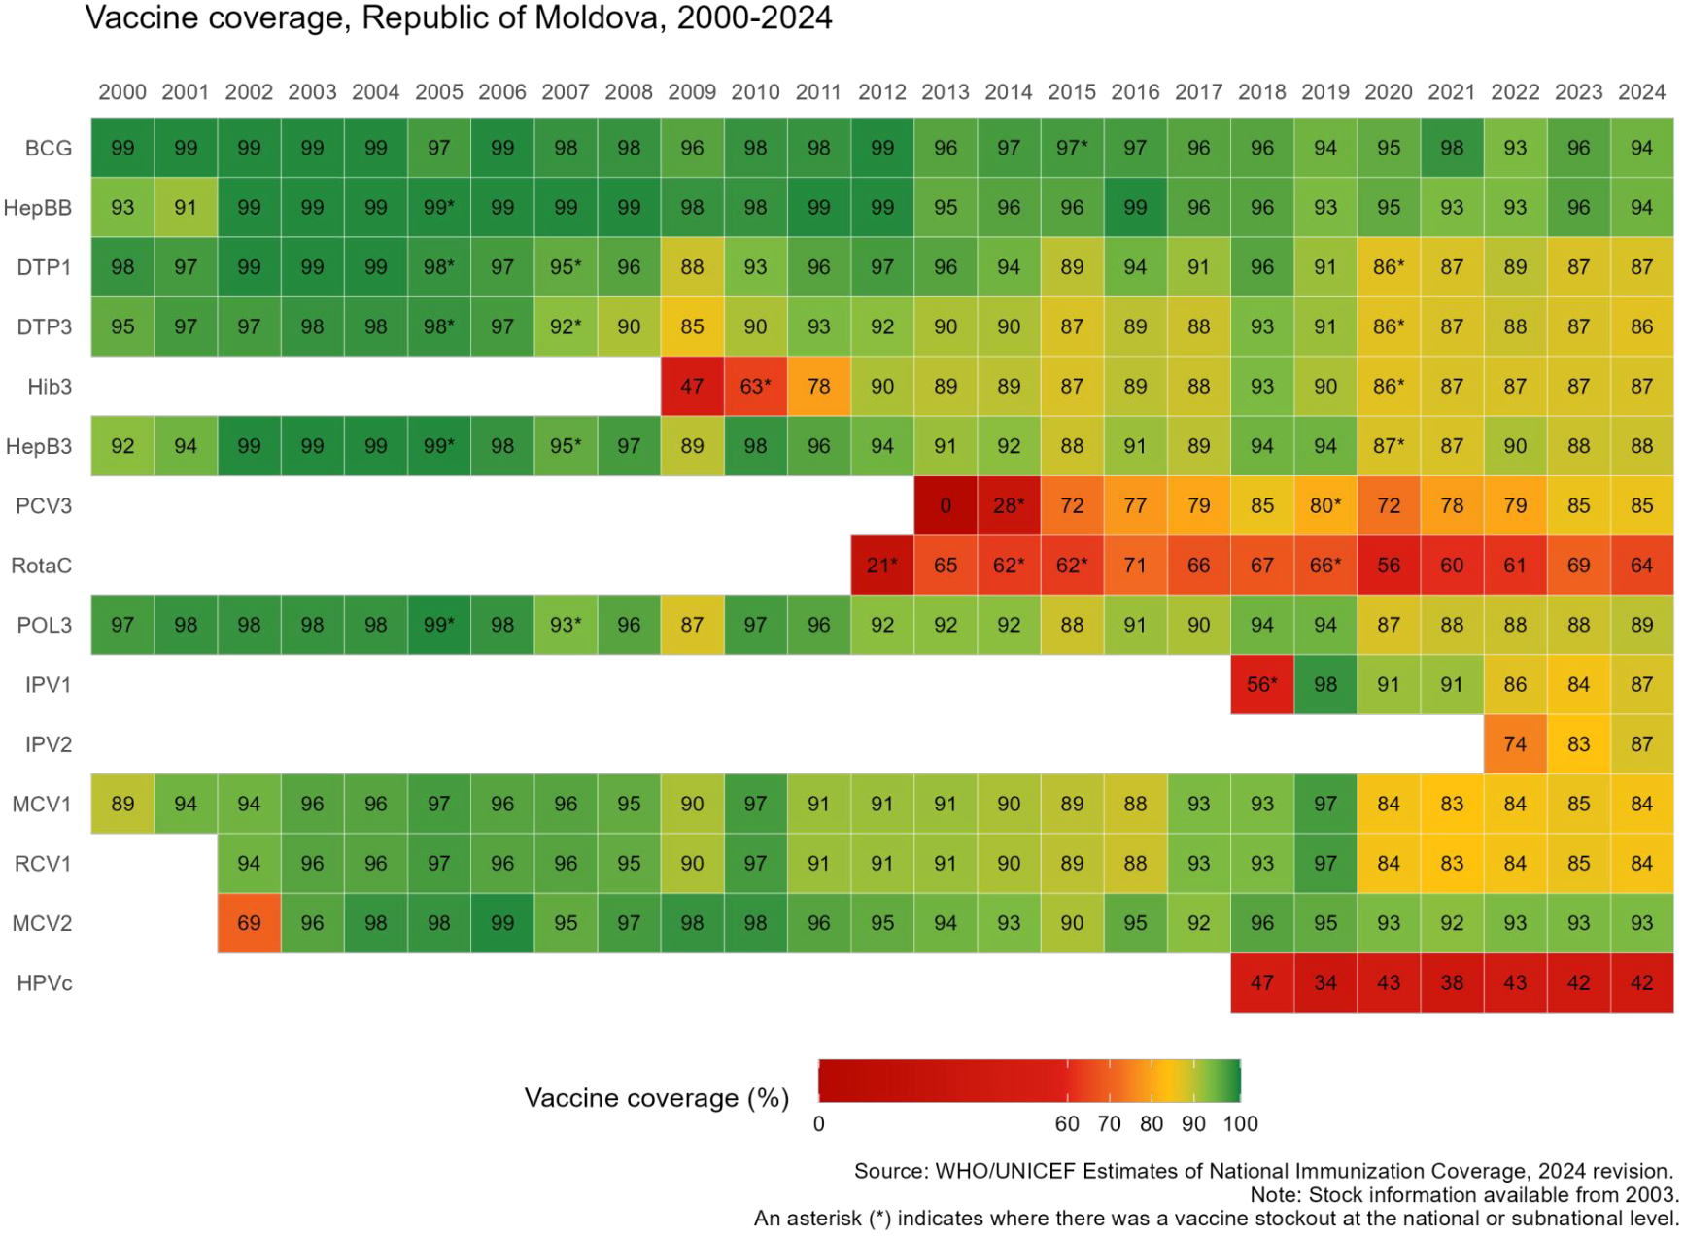


Moldova
Sustaining and Strengthening Immunization Coverage
in Middle-Income Countries
Tashkent, Uzbekistan, 07-09 October 2025
Priority drivers of persistent coverage challenges
Unjustified contraindications from private practitioners, specialist doctors, neonatologists leading to delayed immunisation Poor immunisation communication skills among PHC workers Limited immunisation data analysis by family doctors, performance monitoring at facility level, supportive supervision from Public Health Policy limitations (opt-in policy, immunisation is not part of the PHC accountability framework, weak enforcement of mandatory immun.) Vaccination refusal from religious and cultural (Roma) subgroups. Online and offline misinformation leading to mistrust in routine vaccination
Priority needs to optimize coverage (as of 2026)
Engage religious and Roma leaders in targeted interventions Strengthen capacities in immunization counselling for medical and social workers, including community mediators for Roma and refugee communities Implement the Social Listening and Media Monitoring for immunisation initiative Enhancing data collection and reporting systems to ensure real-time data Strengthen the supervision system for primary healthcare facilities Promote community engagement activities in rural areas & integrate vaccination subject into the education curricula.
Approaches implemented (2023-2025)
Comprehensive root cause analysis of barriers to vaccination in Balti district, developing and implementation of targeted interventions (2023) Community Engagement for Immunisation (2023-2024): Multicomponent, multisectoral interventions in 10 rayons and 14 suburbs of Chisinau including consensus building, educational, communication and awareness raising events with the target groups. Evidence generation and coverage and equity assessment, and development of Social and Behaviour Change Action Plan 2023-2027 Integration of Interpersonal communication skills on immunization Module into in-service and pre-service national curricula Social listening and countering misinformation Support PHC workers in the vaccination process through the establishment of a Methodological Centre for Vaccination, MCH Institute.
Successes and lessons learned
Following tailored actions & community engagement, uptake rose by 35% for DTP3, 29% for MMR, 63% for HPV in Bălți, and by 3–5% in several rayons (Cahul, Căușeni, Comrat, Râșcani, Ștefan Vodă). HPV coverage among 15-y increased by 40% in some suburbs of Chișinău and by 5–10% in rayons such as Călărași, Căușeni, Ceadîr-Lunga, and Comrat. With support from the Methodological Centre for Immunization, over 500 previously unvaccinated children received vaccines The Social Listening initiative was institutionalized within the National Agency for Public Health, and the SBC Action Plan was approved and integrated into the EPI. The IPC Module was integrated into 10 in-service and pre-service curricula at Medical Colleges, and into 9 programs at the University of Medicine. Lessons learned: Tailored, evidence-based interventions are essential to address specific barriers. Community engagement is key to building trust and acceptance of vaccines.

