Slide 1

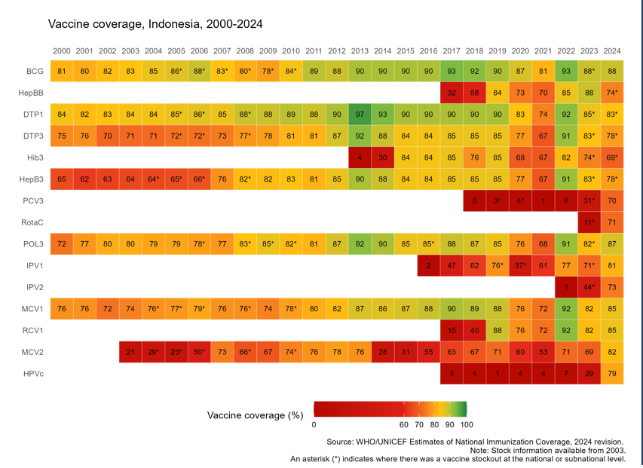


INDONESIA
Sustaining and Strengthening Immunization Coverage
in Middle-Income Countries
Tashkent, Uzbekistan, 07-09 October 2025
Priority drivers of persistent coverage challenges
Governance & Leadership: Multisectoral coordination remains suboptimal, particularly in reaching remote and hard-to-reach areas. Financing: Limited budget to support programming, esp. at subnational level Human Resources: High turnover, uneven capacity, unequal distribution, and multiple roles among health workers Service Delivery: Sub- optimal integration with other programs Vaccine and logistics: Interrupted vaccine supply Data and Information: RR transition from manual to digital, vaccine hesitancy
Priority needs to optimize coverage (as of 2026)
Advocate local government to allocate budget for immunization program Strengthen HR capacity and multisectoral collaboration, including private sector Developing multi-year planning for vaccine and logistics Integrating the immunization registry and vaccine logistics system Optimize the implementation of the Sustainable Outreach Services (SOS) Improve the adaptation and implementation of immunization communication strategies at subnational level
Successes and lessons learned
Districts that conducted detailed costing and resource mapping were better able to align partner support and mobilize local funds for outreach and service delivery. Engaging health cadres, PKK (Family Welfare Movement), and community/religious leaders, and other local partners proved effective in rebuilding trust and increasing community acceptance in hesitant or underserved areas. Peer-to-peer exchanges across districts enabled practical learning and adaptation of successful approaches, especially in areas with similar geographic or demographic profiles. PIRI/PENARI has administered over 1 million doses of catch-up immunizations across two rounds in 2025 (May and August), with an additional round planned for November.
Approaches implemented
Developed National Immunization Strategy (NIS) 2025 - 2029 (2024-2025) Ongoing advocacy and regular monitoring, complemented by incentives through PIRI/PENARI CSO engagement to support defaulter tracking and reaching zero dose children through INEY2 initiative (2024 - now) Communication strategy implementation, inc. engagement w/ social media influencers and professional organizations to counter misinformation Optimize electronic immunization logistics (SMILE) to ensure real-time visibility of vaccine stocks & storage conditions (2023-now) Enhance health worker competencies, including in the private sector, through diverse training methods such as in-person training and MOOCs

