Slide 1

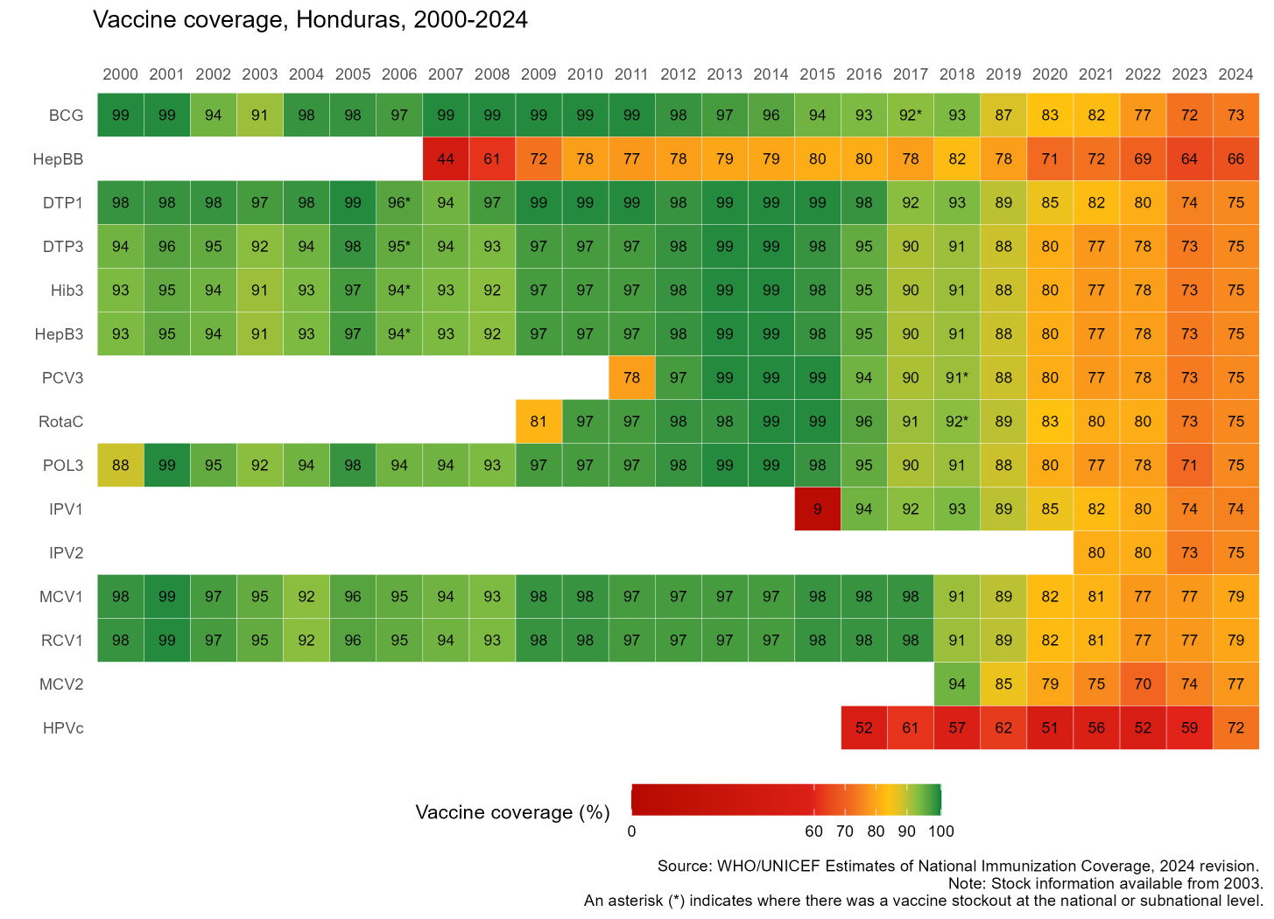


Honduras
Sustaining and Strengthening Immunization Coverage
in Middle-Income Countries
Tashkent, Uzbekistan, 07-09 October 2025
Country Flag
Priority drivers of persistent coverage challenges
Human resource limitations including high staff turnover and limited technical, operational and leadership capacity at the various levels. The lack of complete and timely information at both individual and population levels hinders effective decision making and strategic planning. Population displacement mainly due to migration and social unrest is disrupting healthcare service access and operations. Economic downturns and political instability have led to reduced financial support, impacting vaccine procurement and distribution.
Priority needs to optimize coverage (as of 2026)
Training and capacity building to increase knowledge and capacity, including through strengthening leadership and intra-ministerial coordination. Focus on establishing stable capacity at the EPI and Health Networks Unit. Digital information systems and strengthened microplanning at the local level should be fully in place to ensure evidence-based strategic planning and more effective targeting of population with pending immunizations. Mobile units providing door to door vaccination in rural and hard to reach areas to ensure universal access. National Action Planning and budget planning considering various components and activities of the immunization program is critical.
Approaches implemented
Communication Strategy involving high political level was very successful in engaging society and mobilizing partners and community. Mobile brigades for vaccination during the COVID-19 pandemic were very successful in reaching target population. Projects supported and engaging partners very important, including World Bank Reshape project, PAHO microplanning, and UNICEF communication strategy and cold chain inventory.
Successes and lessons learned
Importance of well-structured communication strategy with strong political support. Interagency coordination and communication can be enhanced to optimize partner engagement and communication with country teams. NITAG well structured and involved in technical decision-making process based in evidence.

