Slide 1

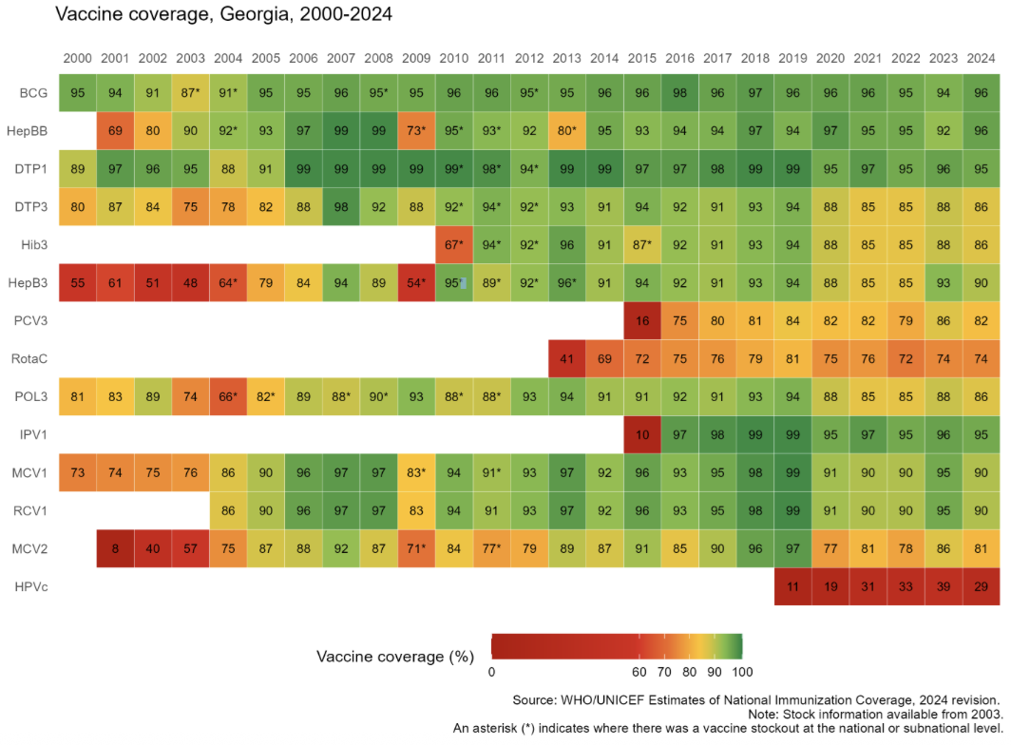
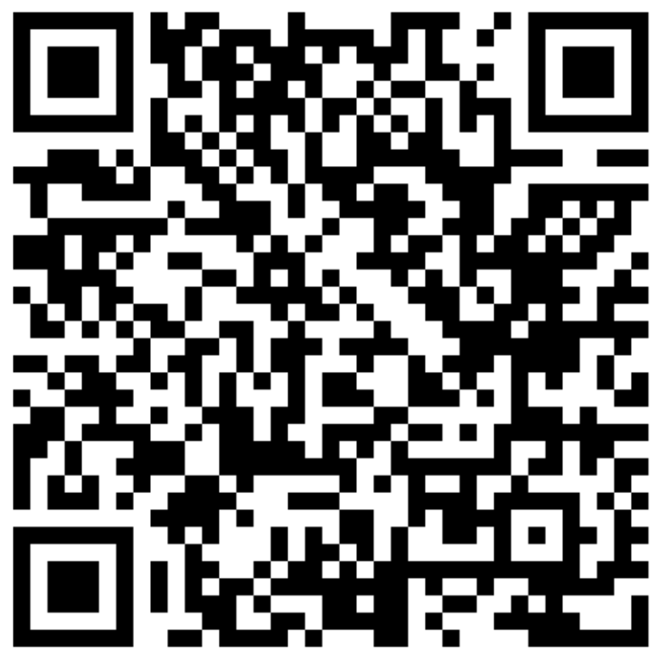


Georgia
Sustaining and Strengthening Immunization Coverage
in Middle-Income Countries
Tashkent, Uzbekistan, 07-09 October 2025
Priority drivers of persistent coverage challenges
Late registration of children at urban PHC, leading to late initiation and delayed vaccination (root causes: no patronage system, no urban geographical catchment areas, Electronic Information systems interoperability issues leading to information gap on newborns in catchment area) Private Insurance liability (child supervision responsibilities incl. imm.) & data sharing issues Poor linkages across different state-funded schemes leading to uncertainty on target population at facility level Inadequate performance feedback from public health to PHC and from PHC management to health care workers Low capacity of PHC doctors, nurses in effective immunization communication.
Priority needs to optimize coverage (as of 2026)
Enforced policies ensuring newborns timely registration at PHC for proactive actions EIR modification (incl. automatic SMS notifications), Improving linkages between electronic systems, expanding EIR access to private practitioners Policies to ensure private insurance takes responsibilities on child supervision and shares data on covered children population lists.
Approaches implemented
Government resolution (2022) obliging PHC to register newborn within 7 days after birth. Government resolution (2025) introducing performance indicators linked to bonus payments (including MMR1 coverage) from 2026. Improvement plans developed based on several studies 2023-25: 1)Identifying un & under-vaccinated children & developing microplans in the regions of Georgia (2023-24, WHO); 2) JEE of IHR core capacities (2024, CDC,WHO); 3) Rota & PCV coverage evaluation (2024,WHO); 4) Coverage and Equity assessment with Root Cause Analysis of Backsliding and Zero Doses in 3 districts (2024,UNICEF,CIF); 5) Qual. study to inform routine vaccination interventions (2023, WHO); Follow-up actions: 1) Monitoring impact of interventions to address immunization inequities (2025, WHO); 2) Addressing Vaccination Backsliding in Rustavi, Gori, and Marneuli (2025, UNICEF, Caritas Czech Republic, Gov. of Korea)
Successes and lessons learned
Ongoing activities: Targeted catch-up vaccinations among underserved population Online meetings with public health centers regarding immunization program challenges Immunization program monitoring in the selected districts Medical personnel capacity building (trainings, job-aids) Dissemination of educational video and other materials in health facilities to raise public awareness
Link to educational video

