Slide 1
Gavi-Linked Learning Forum: Sustaining and Strengthening Immunisation Coverage
DAY 3
9 October 2025

Slide 2
Reflections

Slide 3
Understanding to what extent interventions and support to improve coverage have been successful – why or why not – and what can we learn from these successes and failures about the needs of countries going forward

Slide 4
Session 5: Opportunities for the future

Slide 5
Global insights: impact and lessons learned from multi-country technical assistance
PATH | Linked Learning Forum
9 October 2025

Slide 6
Outline
Background
Civil society organizations and communications
Budget tool insights
Microplanning tool lessons learned
Strategy and perceptions tools updates
Project reflections
Discussion

Slide 7
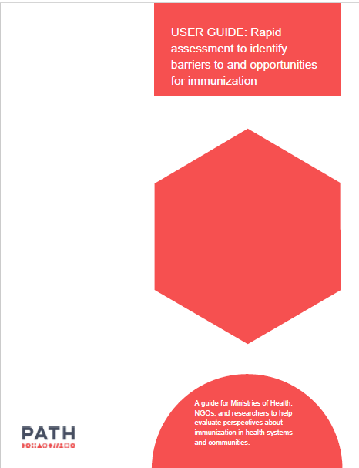
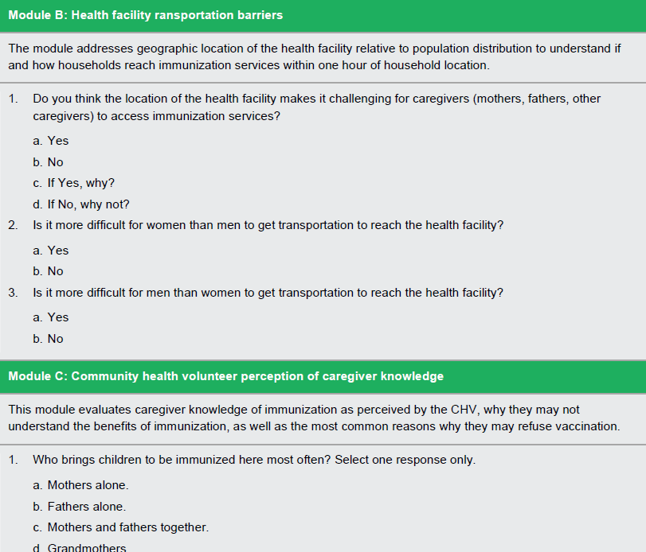
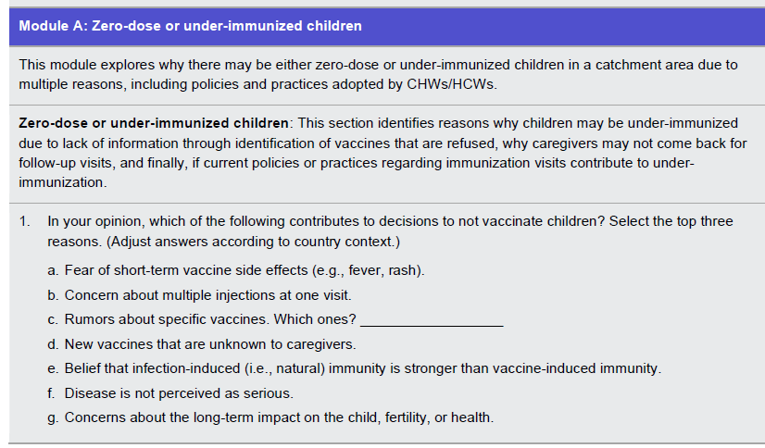
How we started

Slide 8
Civil Society Organization Capacity Building
&
Communications

Slide 9
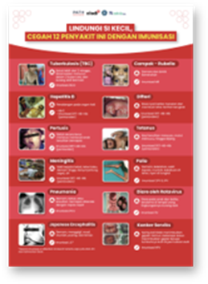
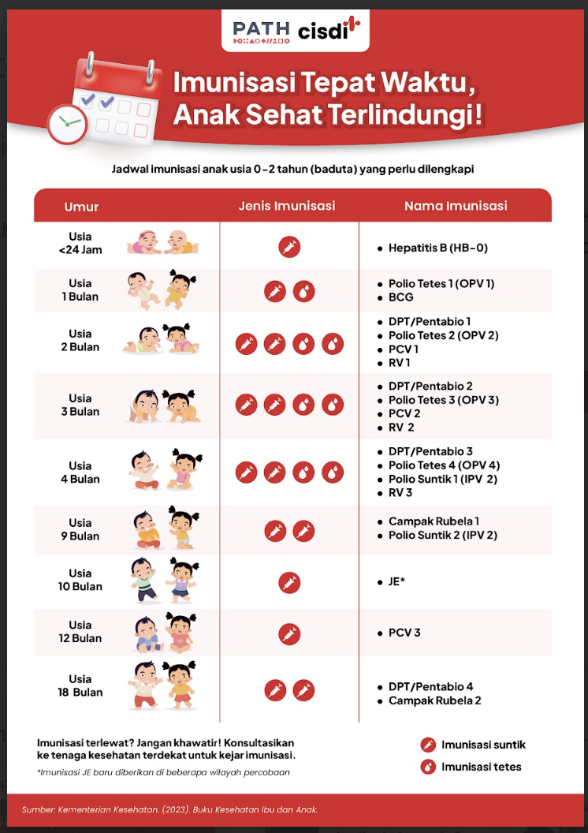
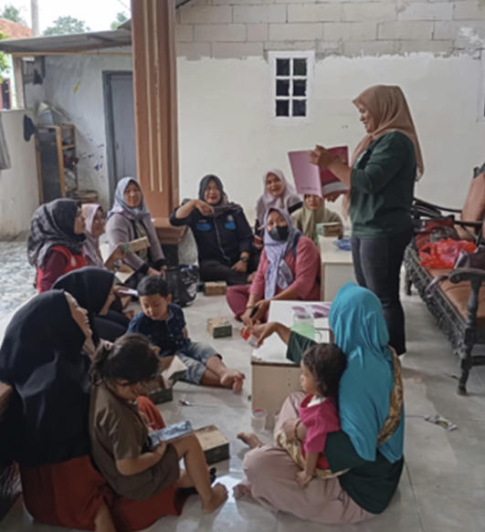
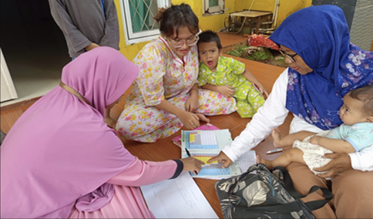
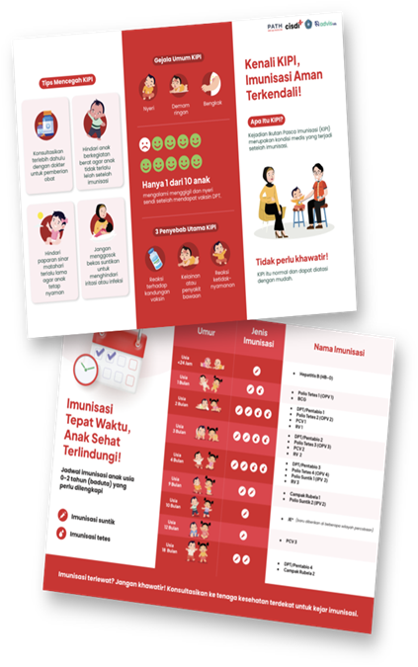
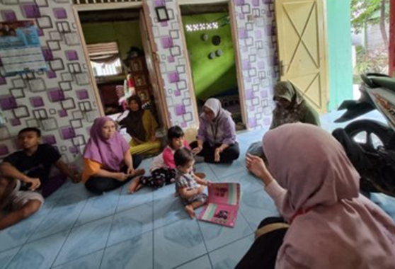
Civil society organizations drive community change in Indonesia

Slide 10
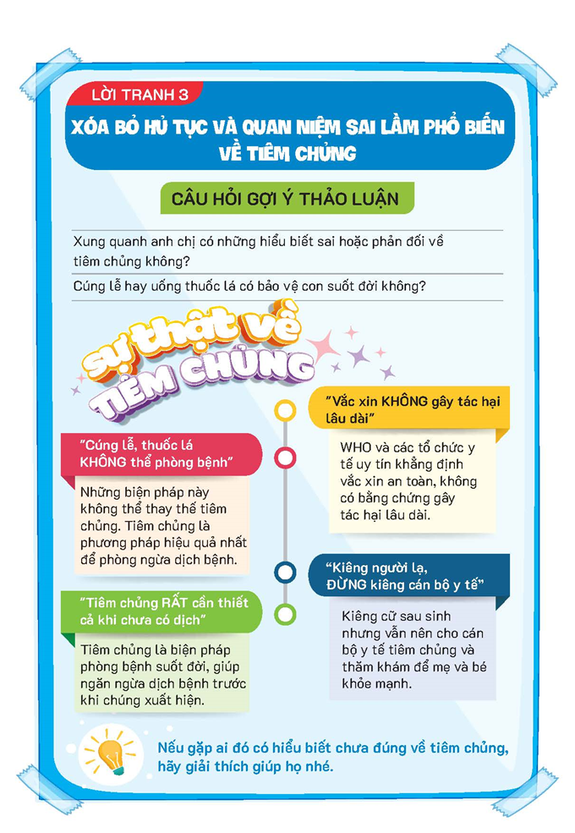

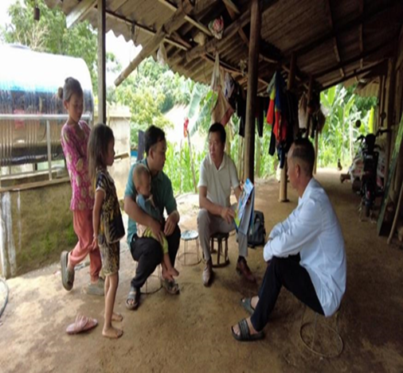
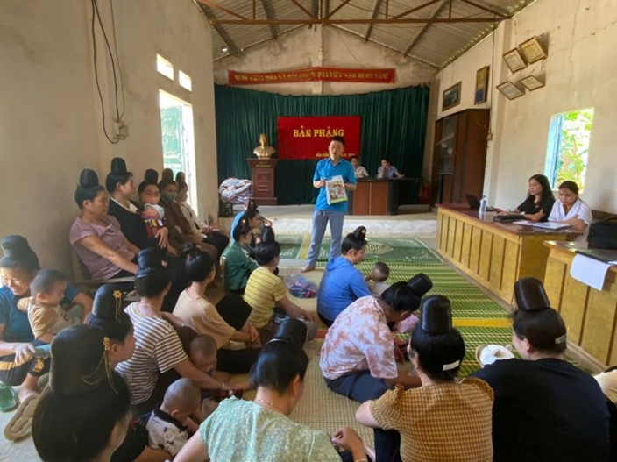
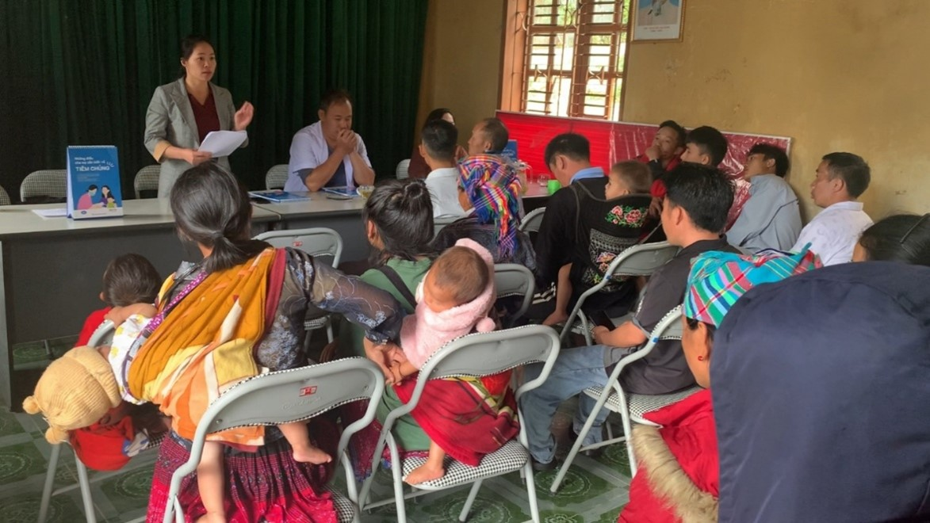
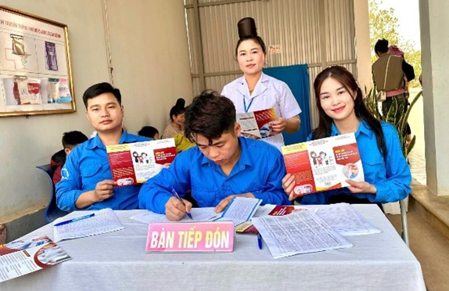
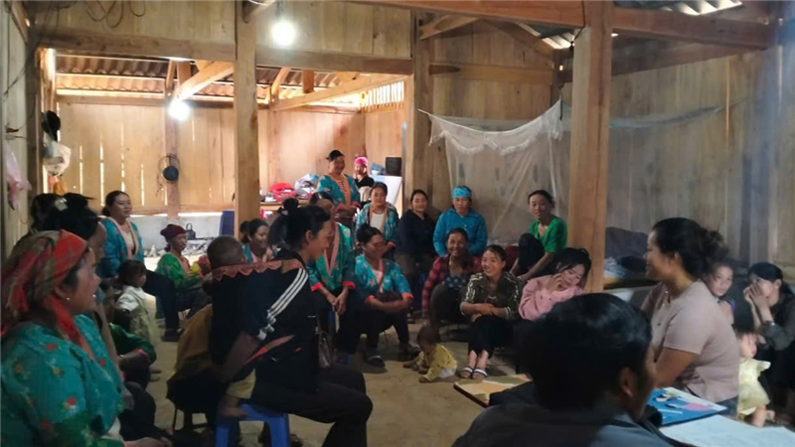
Civil society organizations drive community change in Vietnam

Slide 11
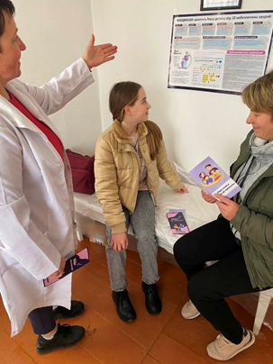
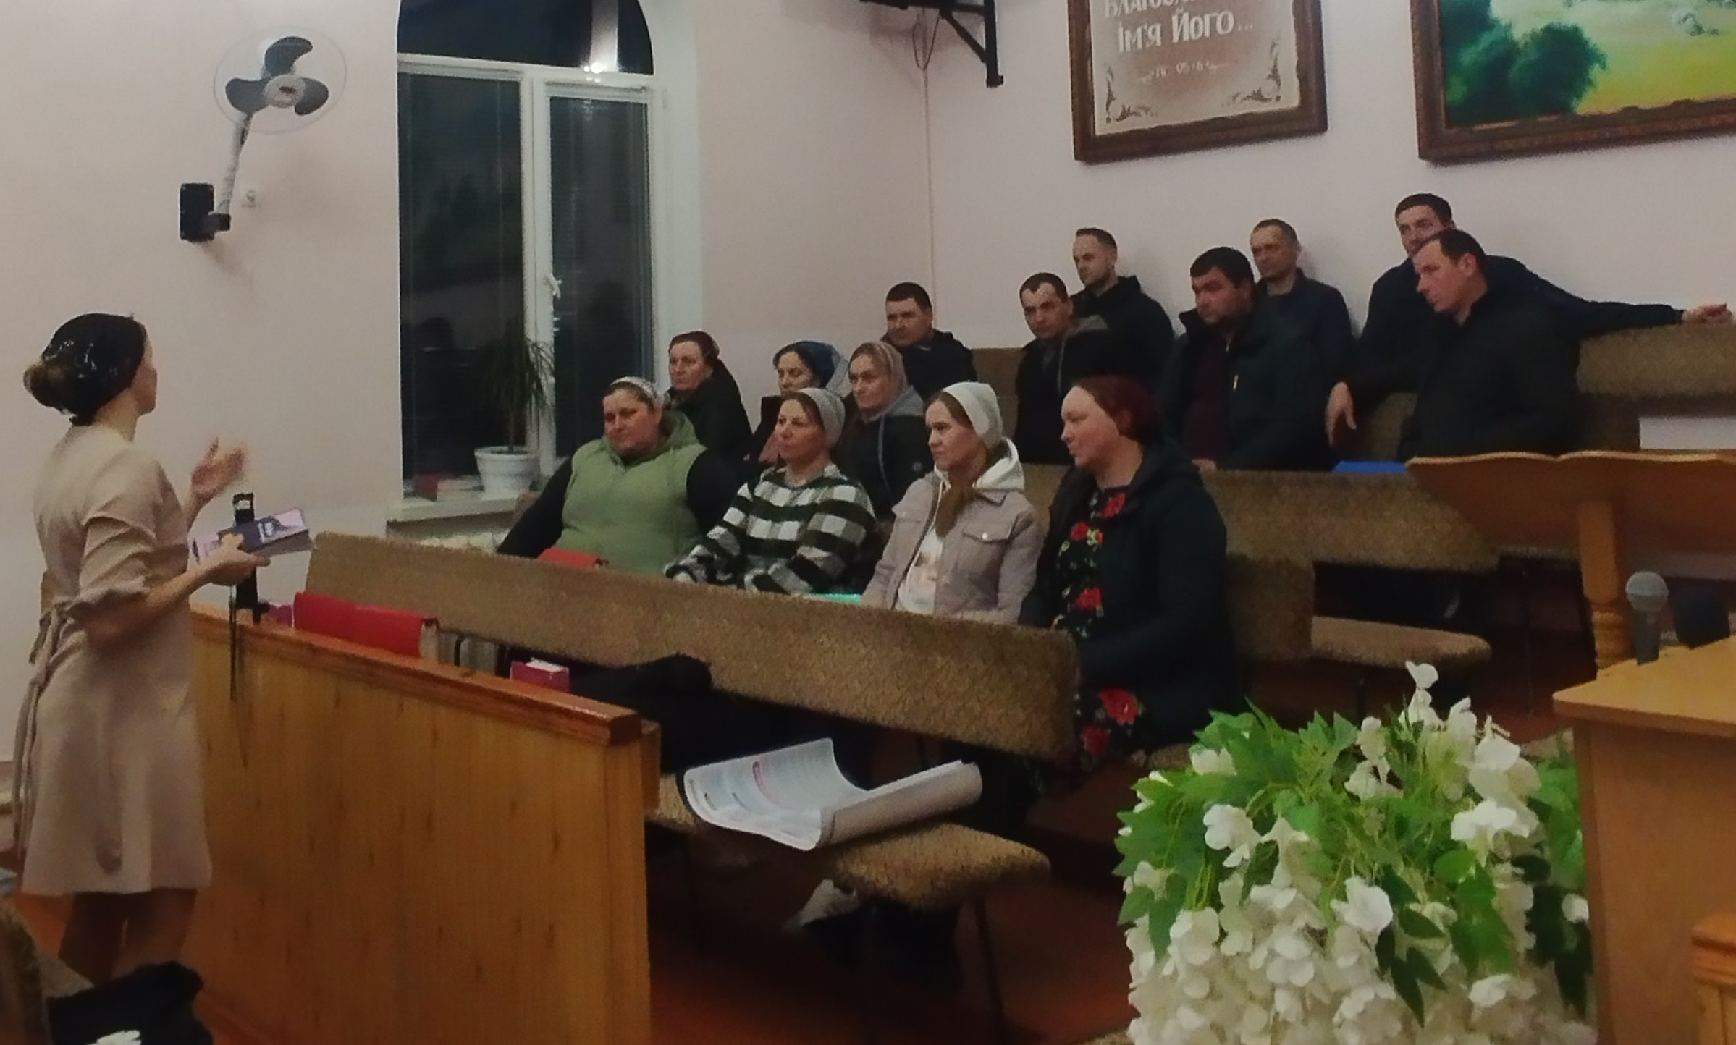
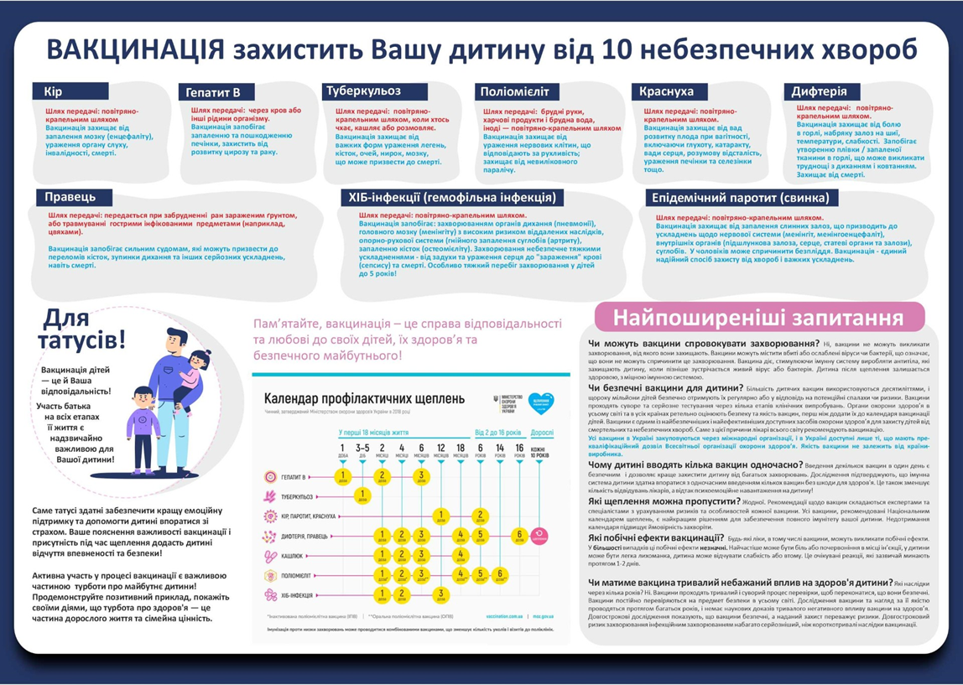
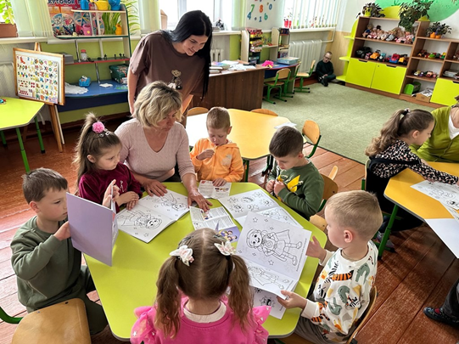

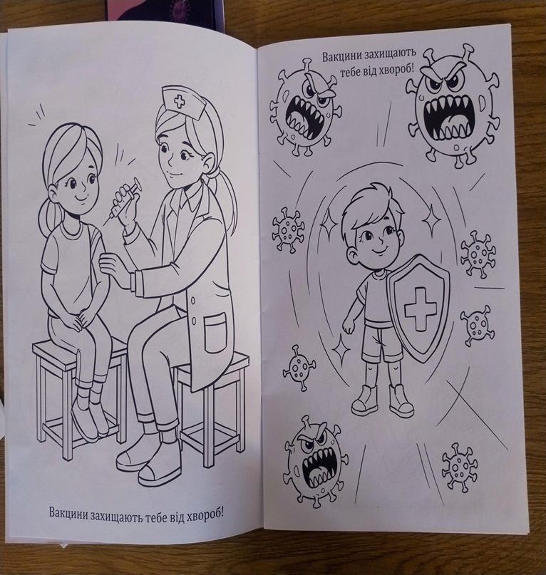
Civil society organizations drive community change in Ukraine

Slide 12
Microplanning Tool

Slide 13
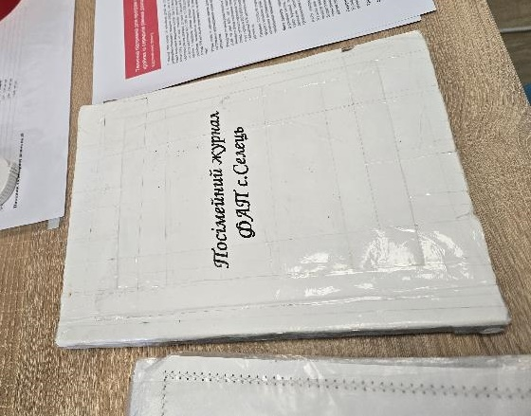
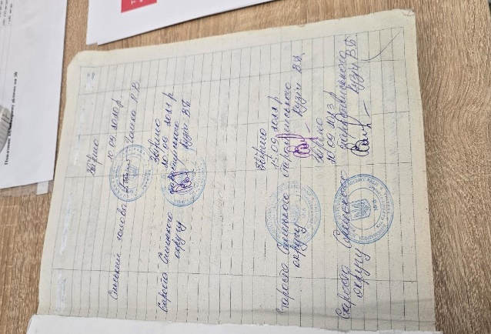
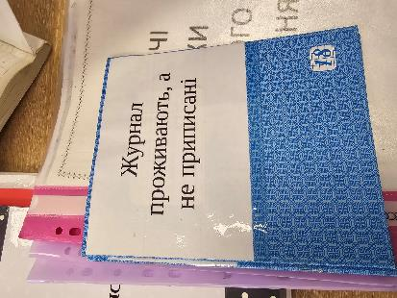
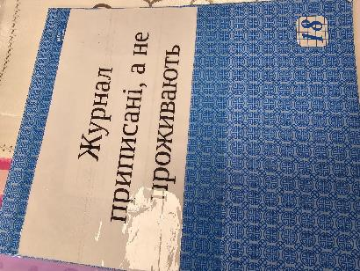
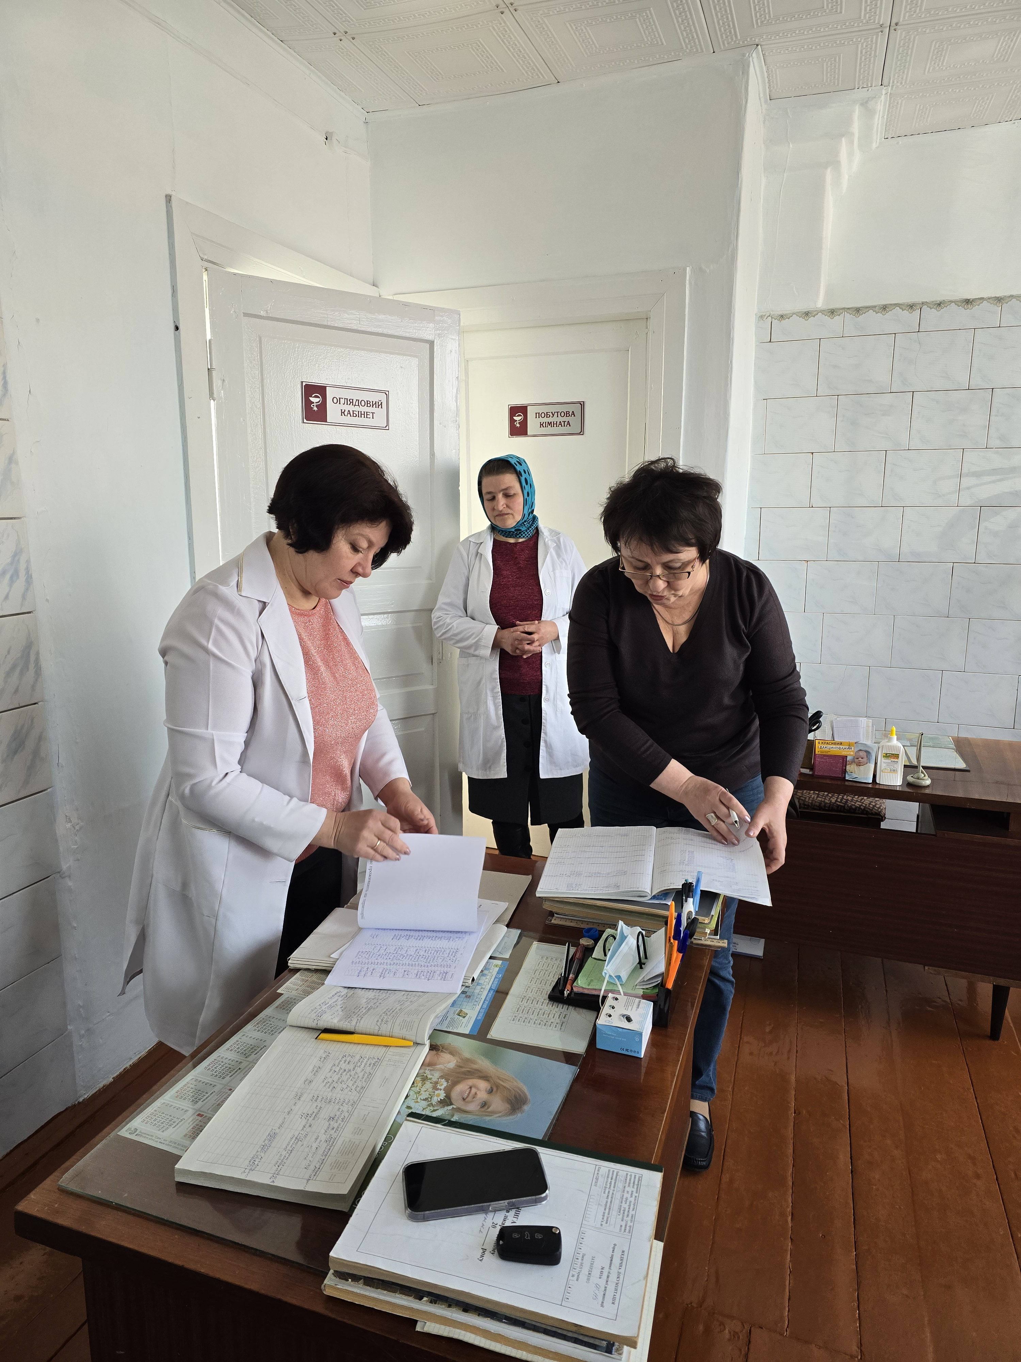
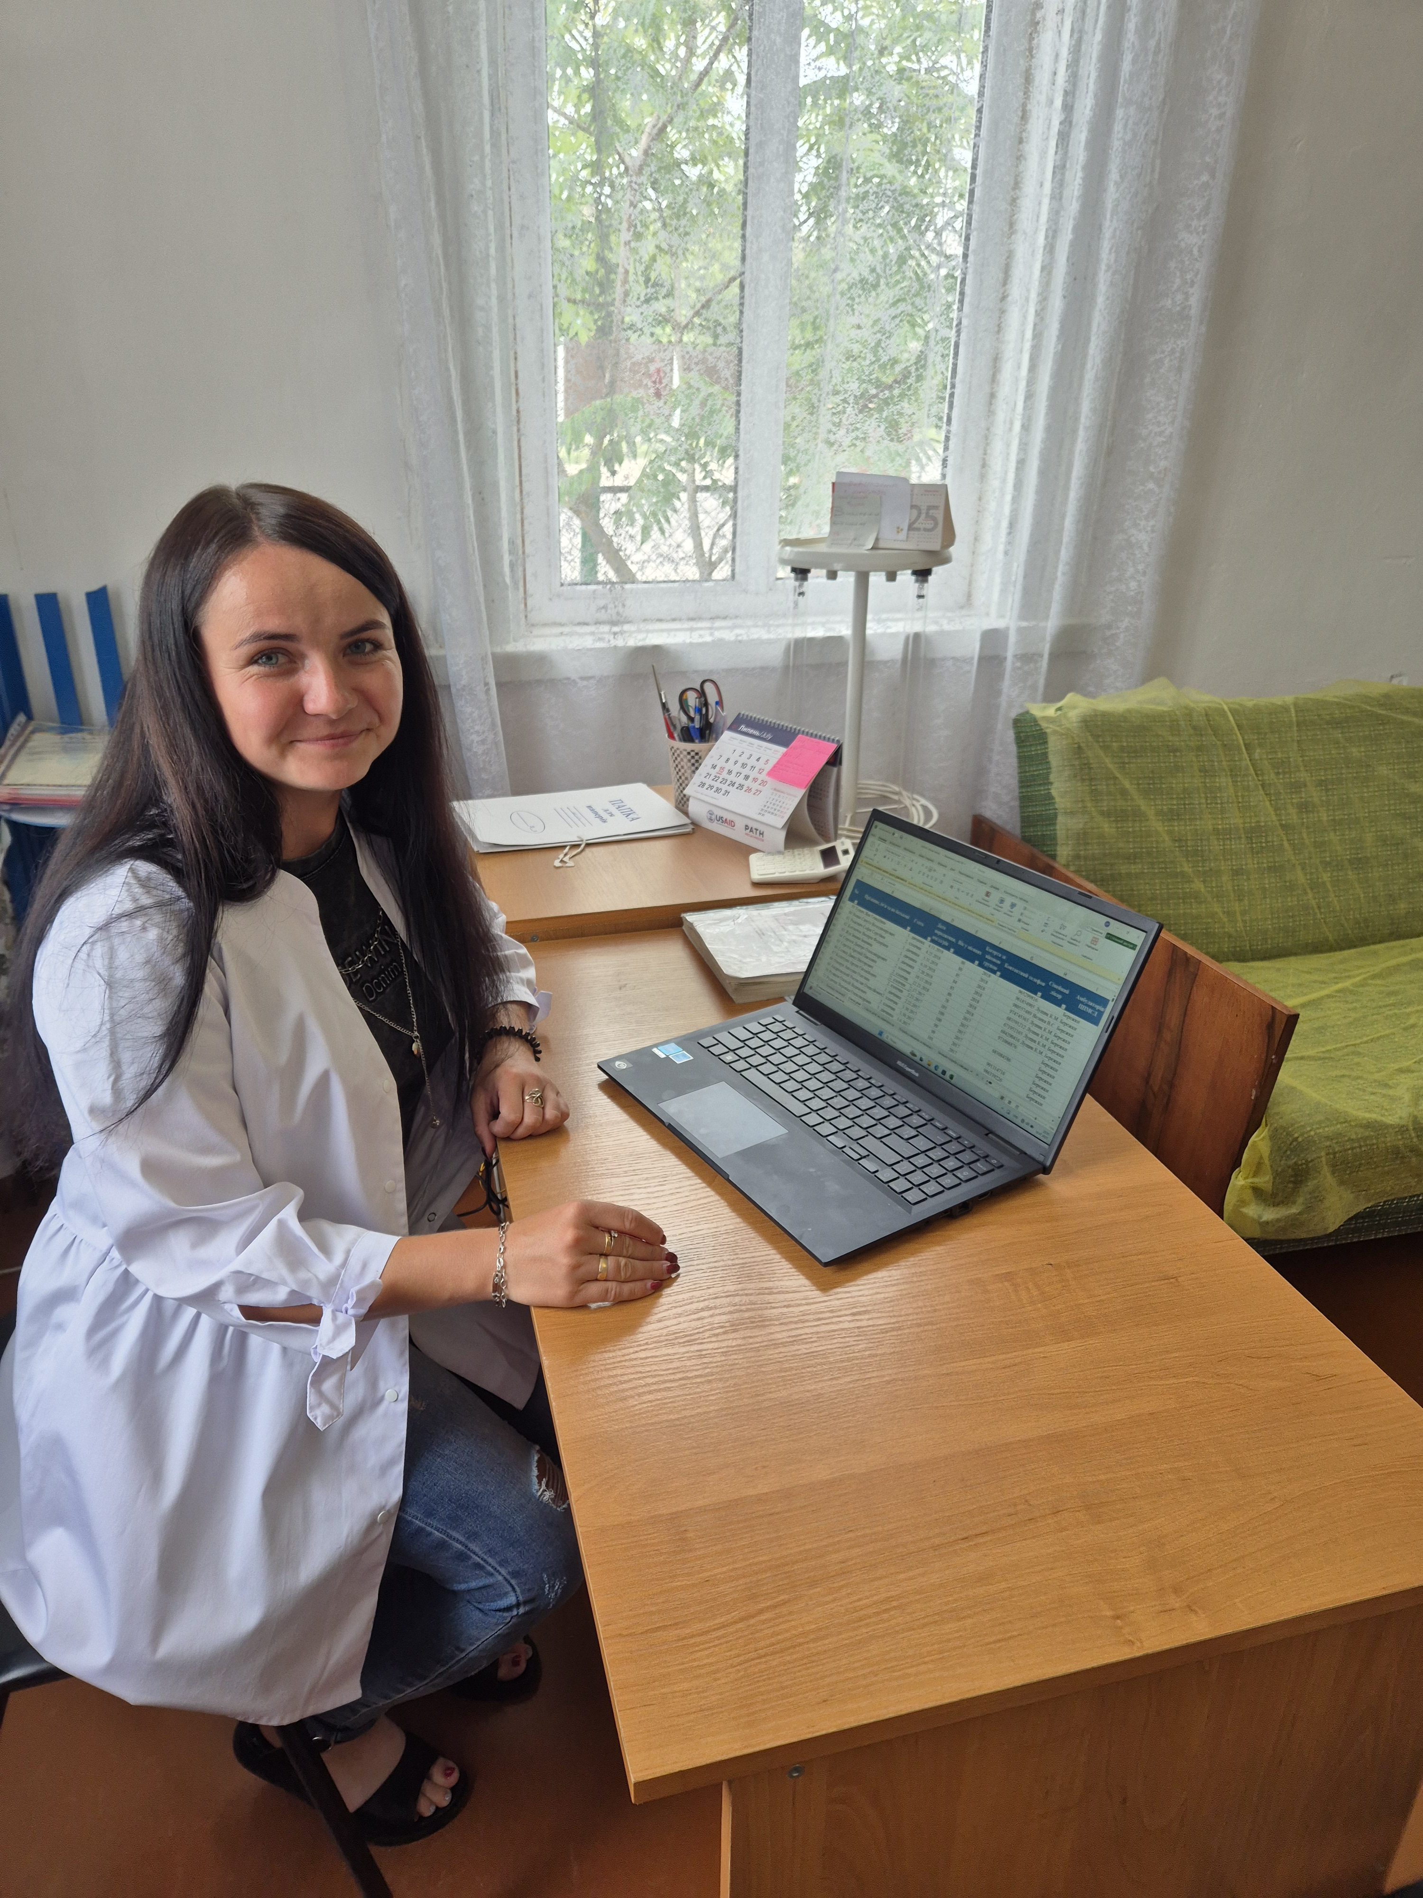
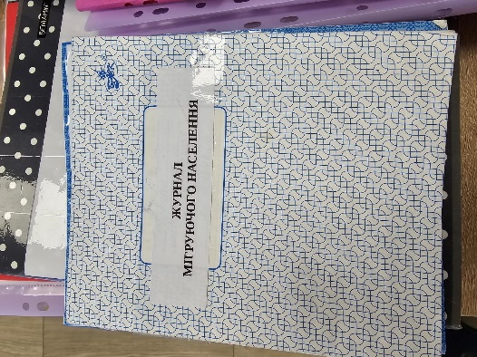
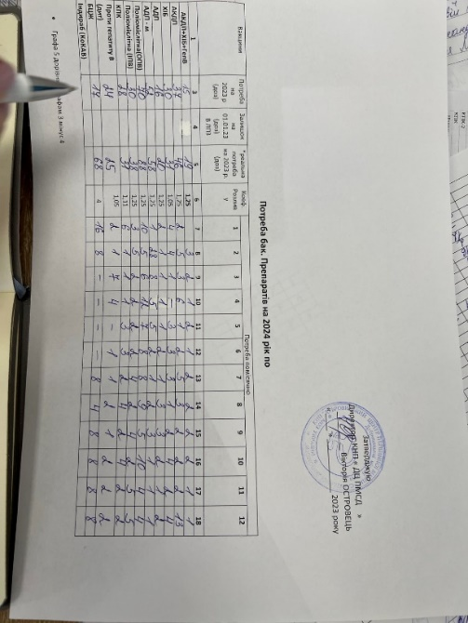
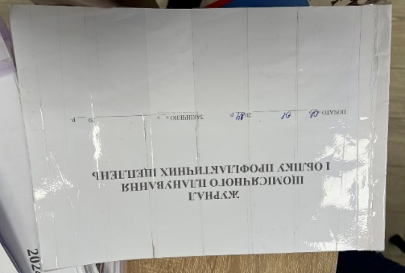
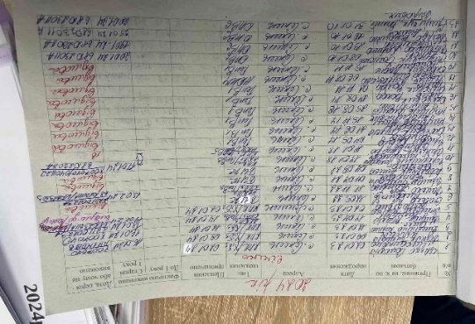
Microplanning at the center of reaching communities
Register of people residing but not officially registered.
Register of people officially registered but not residing.
Register of families living in Selets village. This official sealed is obtained by the FAP from the village council.
Register of migrating population.
The need for vaccines for year 2024
A register of monthly planning of vaccinations

Slide 14
Budget Tool

Slide 15
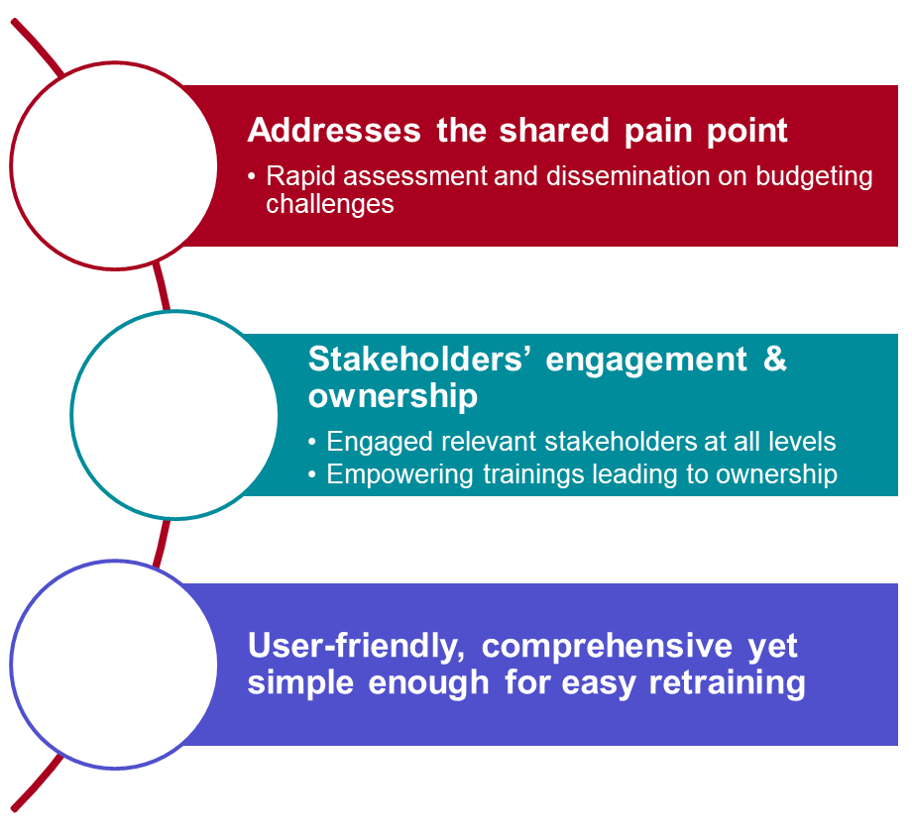
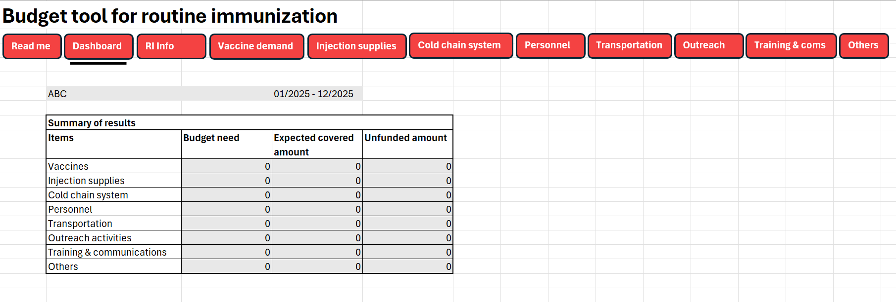

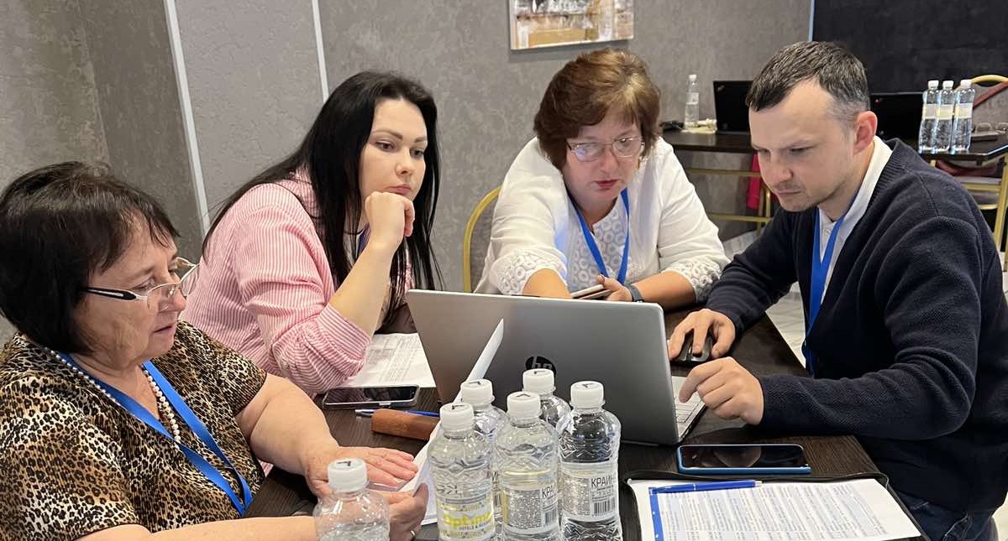


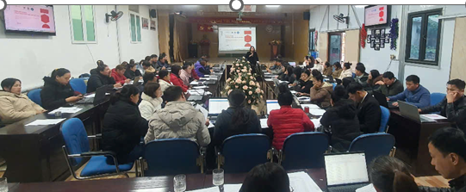
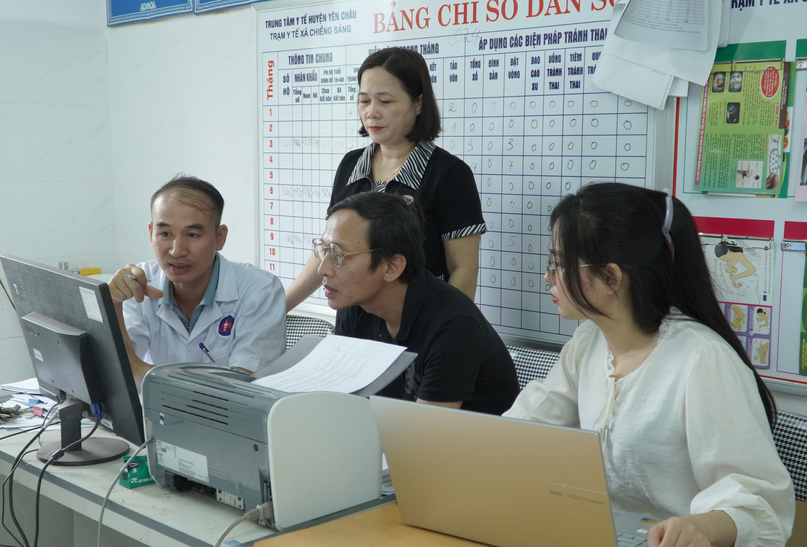
Budgeting for every dose: a tool for vaccine delivery planning

Slide 16
CSO Strategy and Immunization Perspectives tools

Slide 17
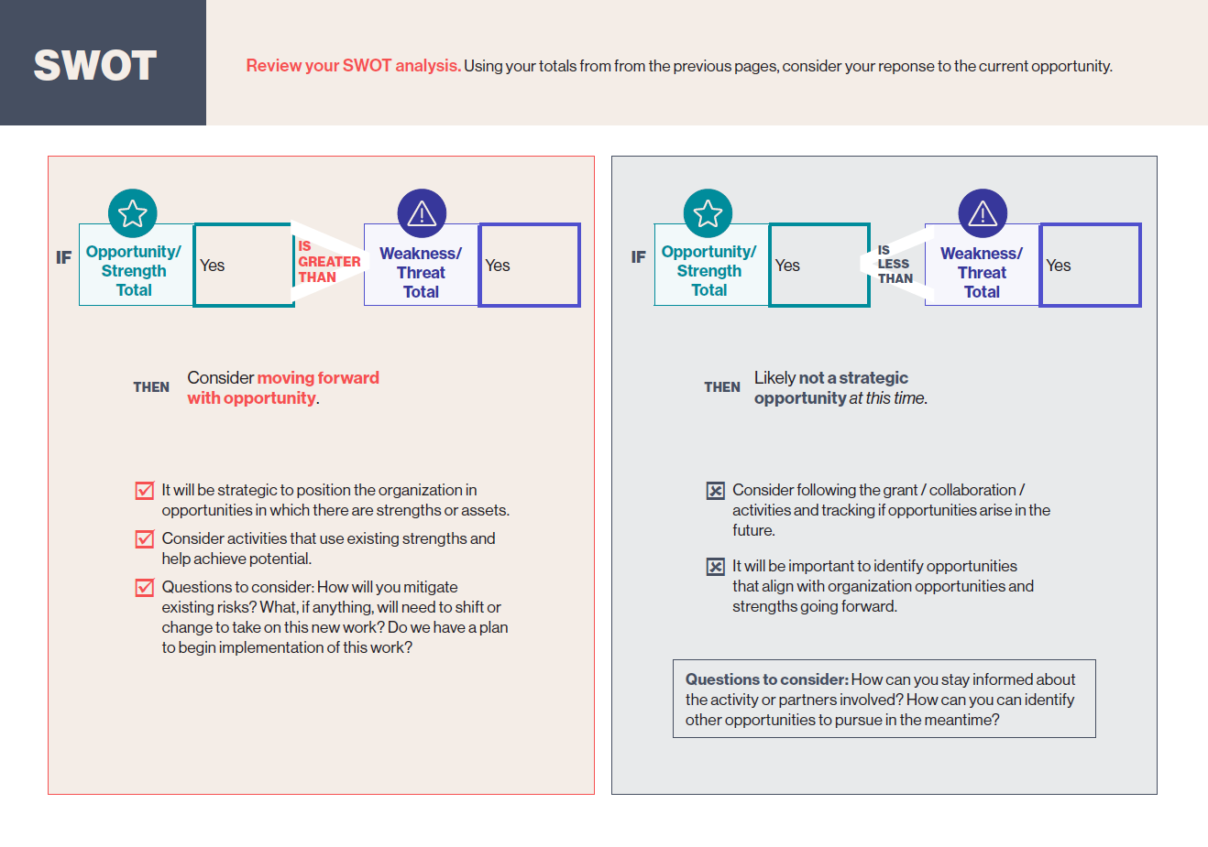
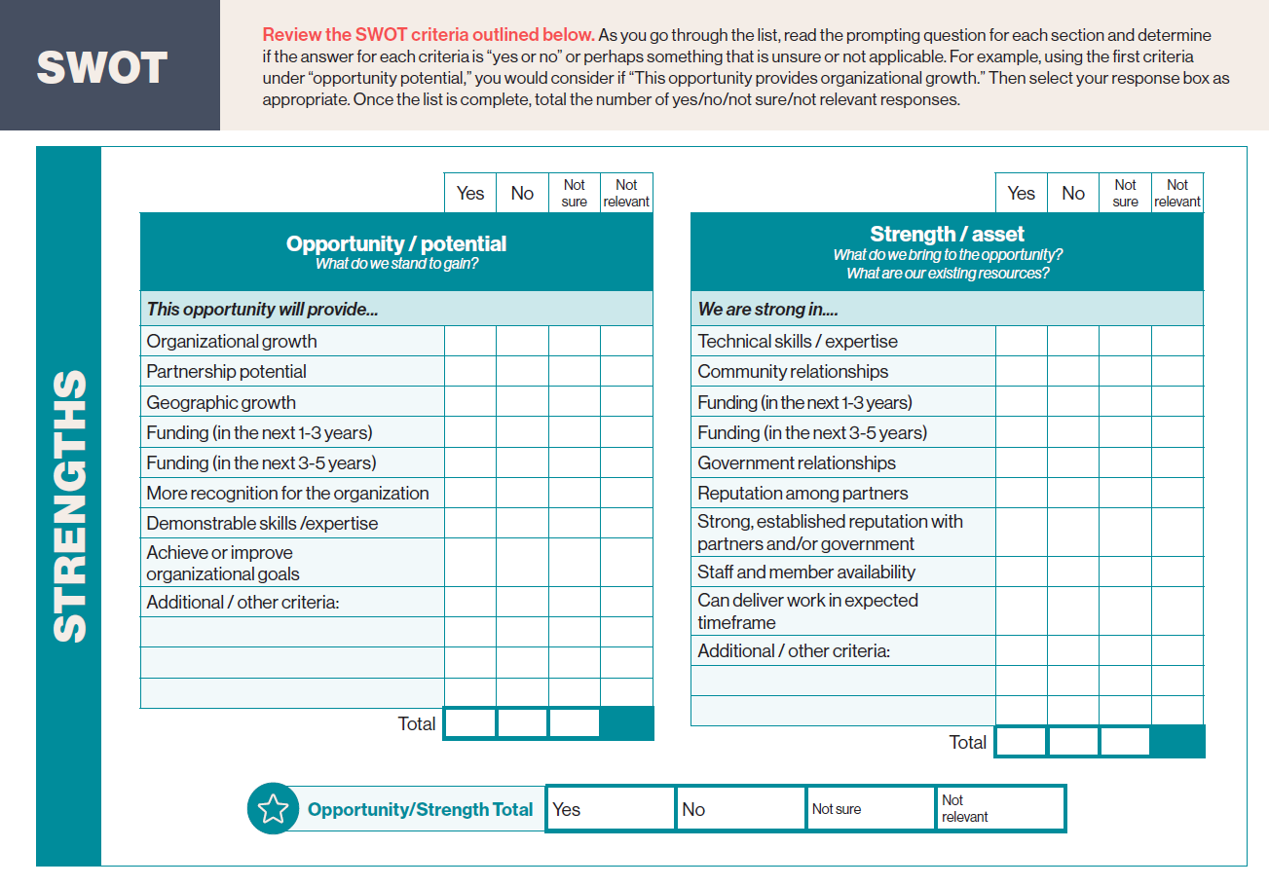
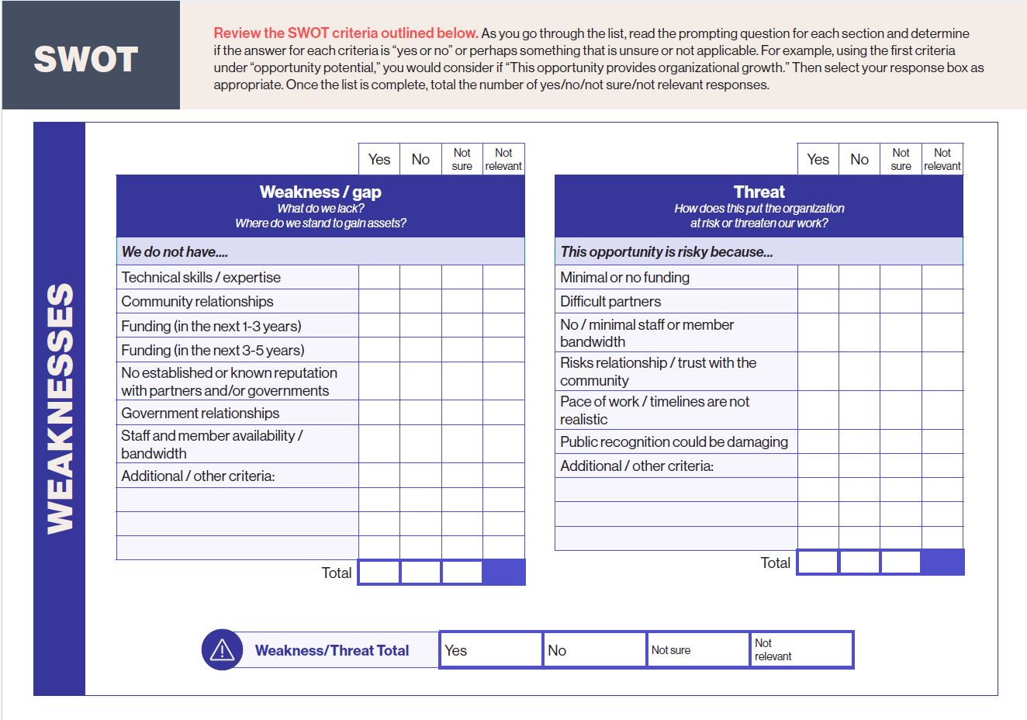
Decision making guide for civil society and community organizations

Slide 18
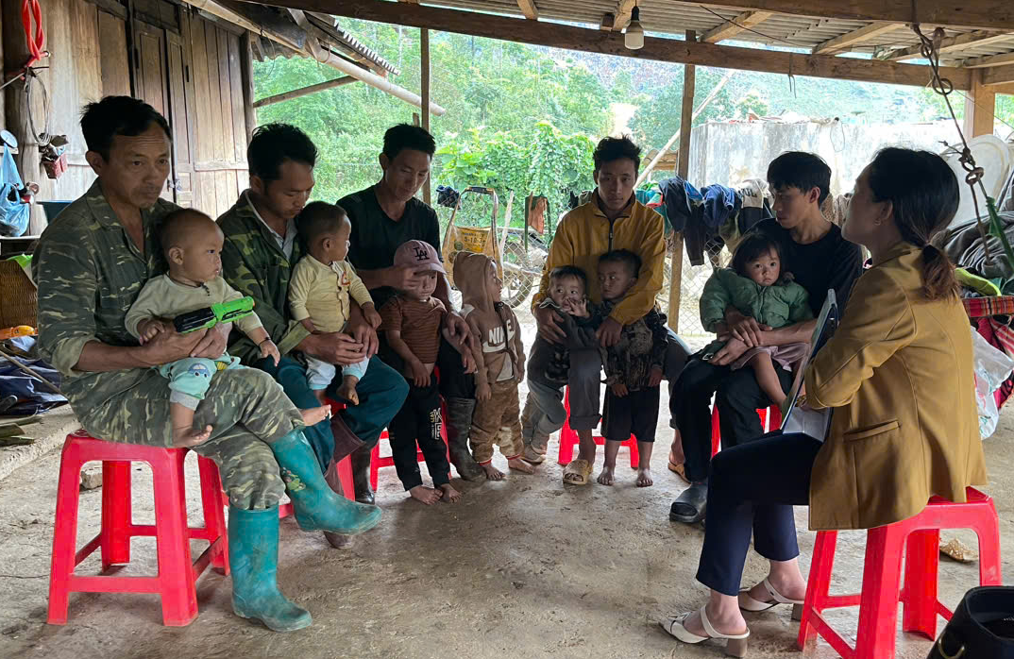
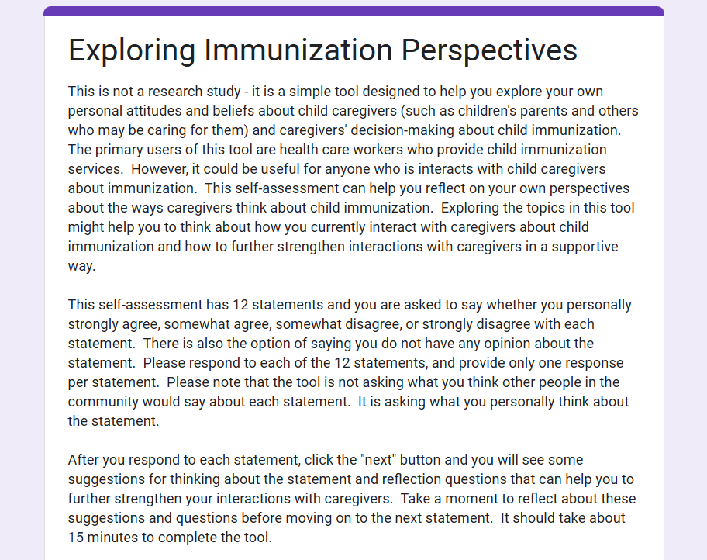
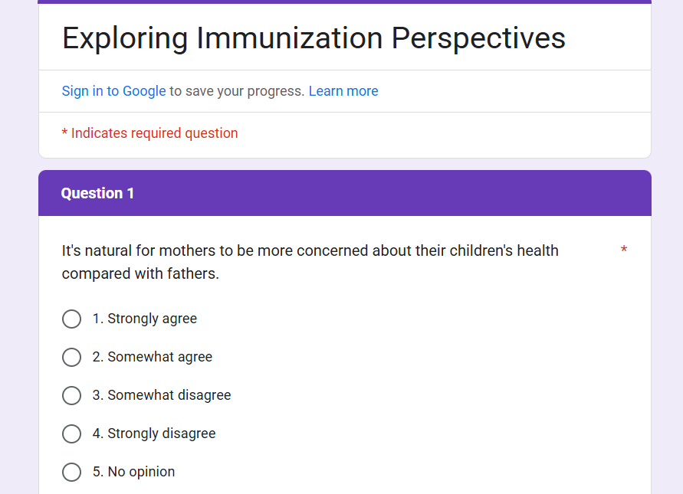
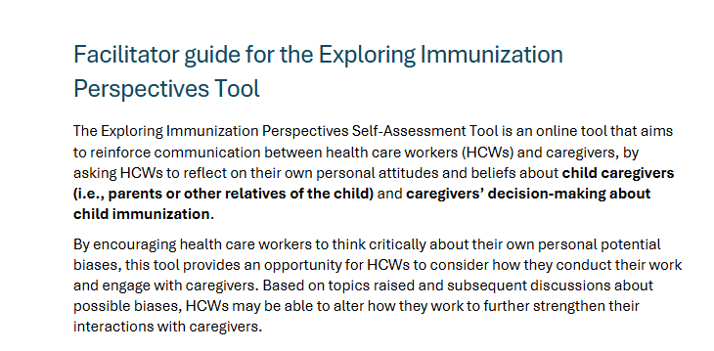
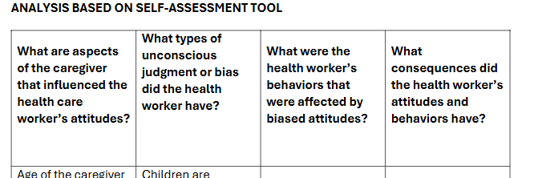
Raising awareness about gender bias in immunization activities

Slide 19
What we know now

Slide 20
"The training went beyond theory. Role-playing hesitancy cases was like rehearsal—I now feel confident to mobilize families for vaccination.”
Youth Union Secretary, Phieng Cam commune, Vietnam
Lessons and reflections
Back to basics
Activities do not have to be latest high-tech innovation. Major impact comes from simple, tried, and true interventions.
Community based solutions are crucial
Activities must be rooted in the community to reflect local customs, culture, and context.
Activities and interventions do not have to be intensive or expensive
Most intensive investment was in human resources. It is possible to have impact with investments in training, capacity building, monitoring, and supervision
“It’s a magic smart table that knows everything!”
Nurse from Dubrovytsia, Ukraine referring to the microplanning tool
“At the Posyandu, I record all the data of the [eligible] children, including those whose immunizations are not yet complete. A couple of days later, I follow up by going door-to-door to find their addresses.”
PKK cadre, Bekasi District, Indonesia

Slide 21
Acknowledgement
РATН in Ukraine Gamazina Kateryna, Head of the PATH Representative Office in Ukraine Zherebko Nina, Project Manager Shved Olga, PATH Consultant Kochanov Volodymyr, Program Associate Ponomarenko Alina, Project Assistant | Primary Health Center and Administration of Dubrovytsia Community Ostorovets Viktoria, Director of Primary Health Center Tomko Inna, Deputy Head of Administration of Dubrovytsia Community Vorobey Inna, Doctor of Dubrovytsia Primary Health Center
Rivne CDC Safonov Roman, Director of Rivne CDC Fesovets Natalya, Head of the Training Center of Rivne CDC Kotyash Nina, Epidemiologist of Rivne CDC Lebiedieva Ivanna, Head of the Immunoprophylaxis Department of Rivne CDC | CSO "100% Life. Rivne" Baborykin Yevgeny, Deputy Head of the CSO Chubay Mykhailo, PR Manager of the CSO
Special thanks for the support of the Department of Civil Protection and Public Health of the Rivne Regional State Administration, and our communities and participants.

Slide 22
Acknowledgement
Central level National Immunization Programme Provincial level Provincial health office of West Java CISDI – Local NGO (Center for Indonesia Strategic Development Initiative) | District level Bekasi and Depok City DHO Bekasi and Depok City PKK Puskesmas level 6 Puskesmas in Bekasi 6 Puskesmas in Depok City PKK Sub-regency Health and PKK Cadres
Special thanks to the communities and participants in our projects.

Slide 23
Acknowledgement
Central level Northern EPI Provincial level Son La Provincial People’s Committee Son La Provincial Health Department Son La Provincial Center for Disease Control and Prevention Son La Provincial Women Union Son La Provincial Youth Union PATH team in Vietnam | District level 4 District People’s Committees (Thuan Chau, Yen Chau, Muong La and Mai Son) 4 District Health Centers (Thuan Chau, Yen Chau, Muong La and Mai Son) Commune level 82 Commune Health Centers in 4 project districts Women Union members in 82 Communes in 4 project districts Youth Union members in 82 Communes in 4 project districts Commune authorities in 82 Commune in 4 project districts Village Heads, Religion Leaders in 82 Communes in 4 project districts
Special thanks to the communities and participants in our projects.

Slide 24
Farzana Muhib –Project lead/Rapid assessment/Immunization perspectives tool
fmuhib@path.org
Ashley Latimer – CSO capacity building/CSO strategy tool/Budget advocacy training
alatimer@path.org
An Nguyen – Budget tool
altnguyen@path.org
Sang Dao Dinh – Microplanning tool
sdao@path.org
Elizabeth Rowley (PATH consultant) – Gender expert/Immunization perspective tool
erowley@path.org
Gracy Gompana- Project manager
ggompana@path.org
For more information contact:
24

Slide 26
Extra Slides

Slide 27
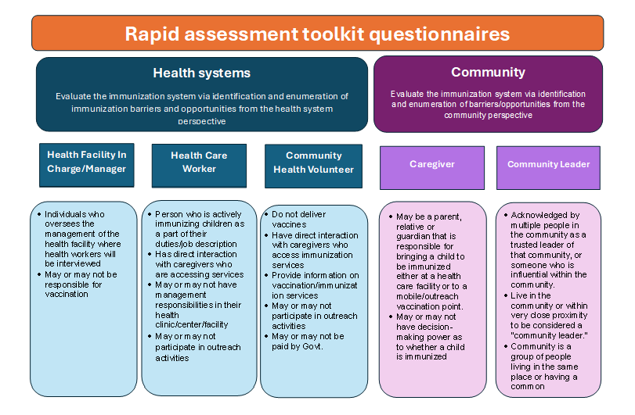
Notes:
Ukraine and Vietnam- Data collection complete and reports are being drafted
Indonesia- Data collection underway.
Guidance document- under development

Slide 28
Challenges faced by the three countries
Misinformation and lack of communication regarding adverse events following immunization (AEFIs) and the benefits of vaccination contribute to low vaccine confidence.
Access barriers to immunization services (transportation, vaccine shortages, vaccine session hours). There is a very real opportunity cost to taking children to immunization sessions, which is often borne by women as they commonly bear responsibility for ensuring children are vaccinated.
Unknown or unclear resource needs for critical immunization services, including confusion about budget requirements for critical immunization services(demand generation, microplanning, monitoring and supervision, etc.).
Overworked staff, and in some cases, high staff turnover.
Insufficient tracking and identifying children due for immunization, managing vaccine stocks.

Slide 29
Breakout Groups
Reflect on the discussions from your perspective (greatest challenges, barriers to success, what is needed going forward)
Reflect on the mechanisms of support – what has been valuable and not so valuable?
National Government
(Main Ballroom, Ivdity)
Subnational Government (Turquoise Room, 1st floor, Zunera)
Country Partners
(Lobby, Elizabeth)

Slide 30
Special Request!
From Indonesia:
Can you please share your microplanning format?
Chavia Tufani: trufanic@who.int

Slide 31
Session 6: The way forward

Slide 32


Private Sector Partnerships, Innovation & integration: an engine for
sustainable impact

Slide 33





















The PSI team brings resources, cutting edge innovations and industry expertise to Gavi
PSI country-driven priorities areas
Demand generation
Data
Supply chain
Climate and health

Slide 34





Gavi’s Private Sector Engagement leveraged best in class and disruptors
Industry Leaders
Corporate partners deploying their deep sector experience to immunisation bottlenecks
Innovators
Surfacing scalable and sustainable pioneers responding to country needs.
AI
Supply Chain
Data
Demand & Advocacy
Notes:
Gavi’s PS engagement stands on 2 key pillars:
Leveraging the best in class – the industry leaders – who have recognised expertise and international reach, in their specific industry. We put the wealth of knowledge they have to the benefit of the immunisation programmes.
Surface groundbreaking ideas - new tech & approaches that respond to a country need that industry leaders do not cover yet.
This approach is valid for multiple verticals such as supply chain – Toyota provides refregirated LandCruiser for vaccines delivery, while Logistismo offers supply chain tracking platform.
Mastercard works on a portable health credentials and record keeping.
Unilever and ZMQ build health-seeking behaviours – unilever combines it with hygiene, while ZMQ is engaging transgender communities to perform traditional storytelling artform.

Slide 35






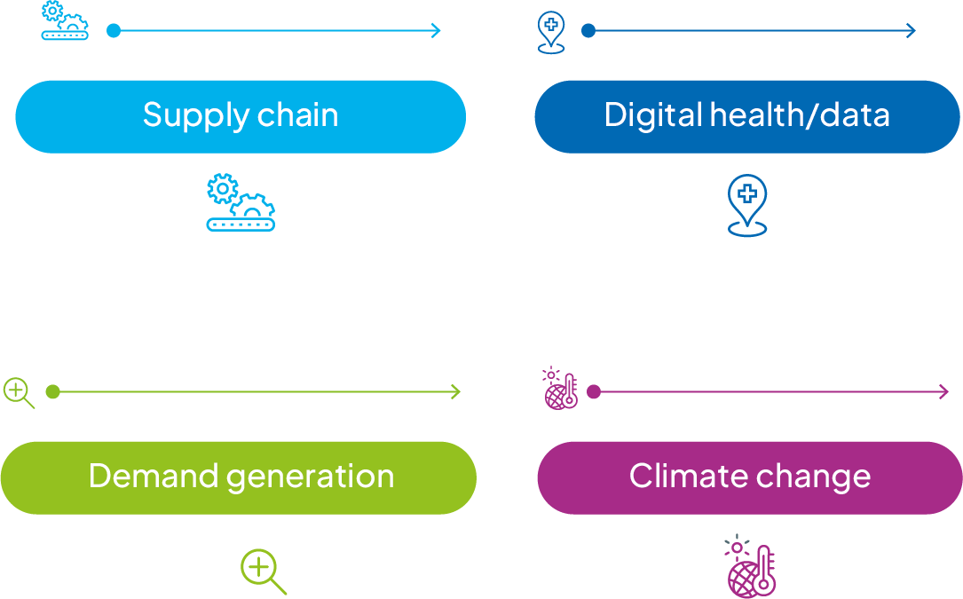

Leveraging PS expertise by matching country needs with carefully vetted solutions and resources
> 21 million
With Gavi & UPS Foundation’s support, Zipline’s drones have delivered more than 21 million vaccine doses to hard-to-reach places, contributing to strengthened supply chains.
Gavi partners with industry leaders to leverage their deep expertise for innovative immunisation delivery solutions and integrated programs.
Gavi focuses on matching country needs with carefully vetted solutions and resources from the private sector.
>100,000
Mobile health solution M-Vaccin is benefiting over 100,000 caregivers and children in Côte d’Ivoire.
.
-63% costs
Toyota Tsusho’s refrigerated vaccine transport vehicles reduced operational costs by 63%, by improving fuel efficiency and optimizing route planning in Niger, Burkina Faso & Senegal.
US$75m
in Google Ad Grants offered by Google to date – enabling Gavi to reach 86+ million people (2021–2023) with reliable information on vaccines.
60%
In Ethiopia, girls who had consumed Girl Effect content were 60% more likely to intend to get vaccinated against HPV.
3.8m & 30%
In India, 3.8m people were reached by the partnership with Unilever Lifebuoy. It brought about a 30% increase in uptake of rotavirus and measles vaccines among children under two.
Zero-dose
Reaching 140,000 Ethiopian under-served children through an integrated immunisation, nutrition and social protection programme.

Slide 36
A few examples:
Demand Generation & digital

Slide 37
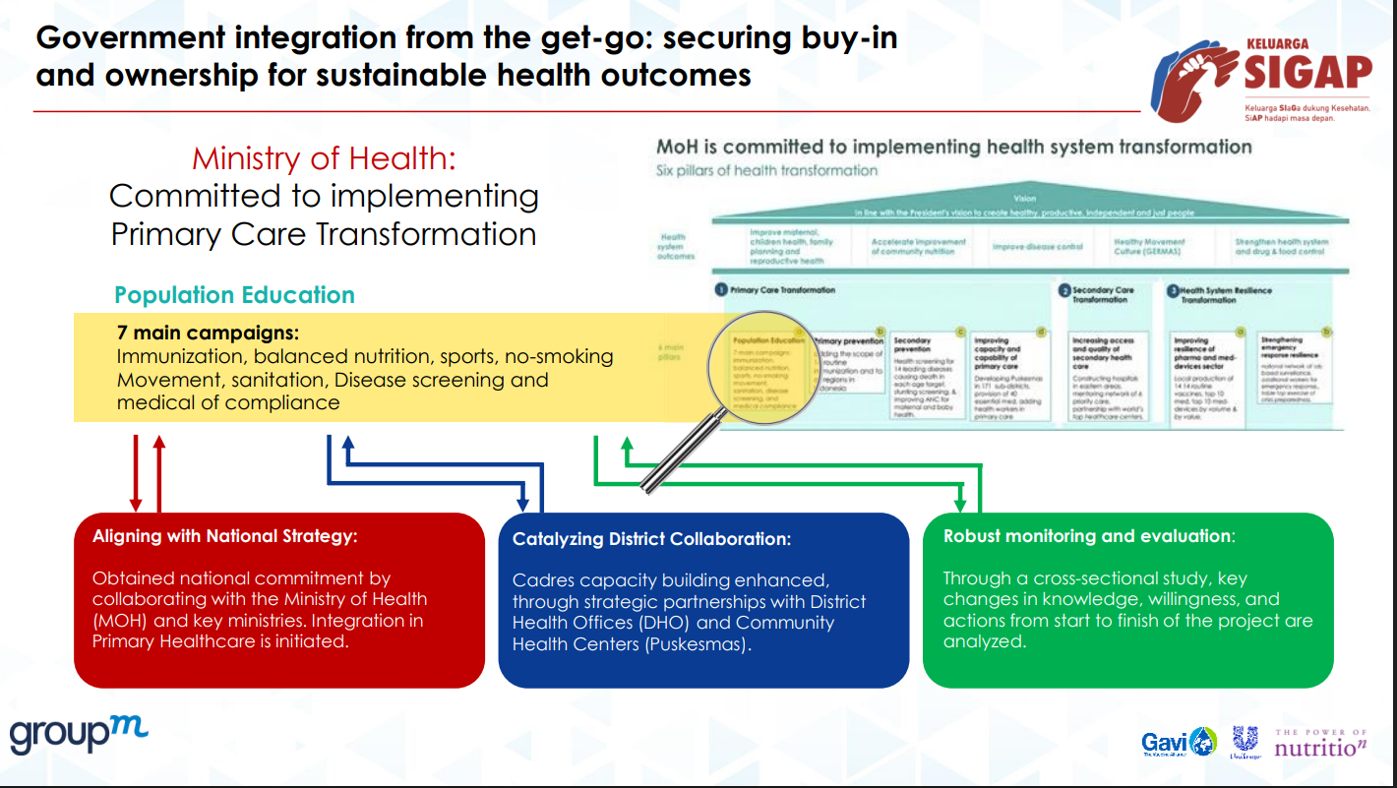

Slide 38
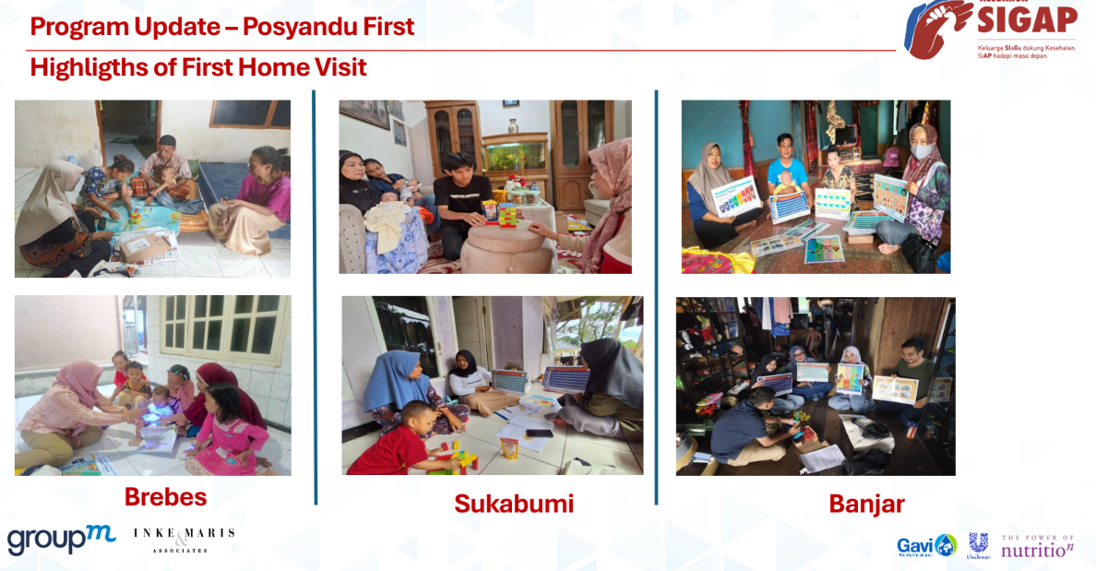

Slide 39
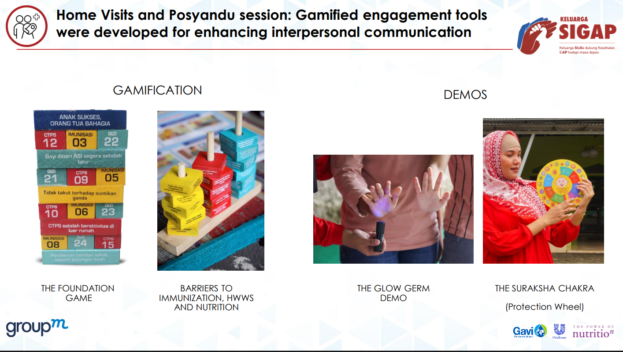

Slide 40
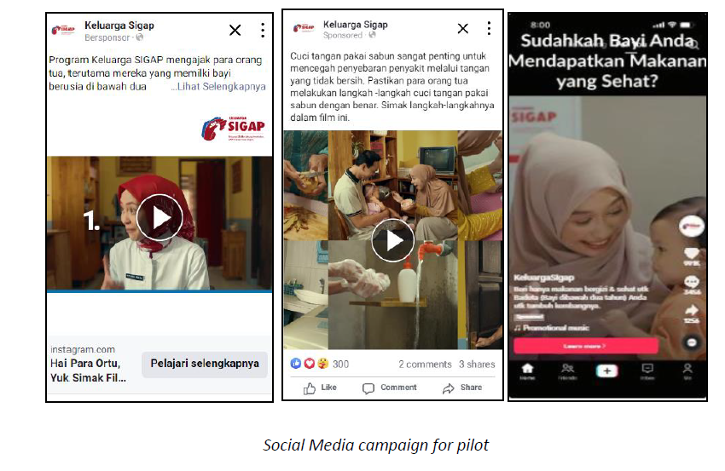
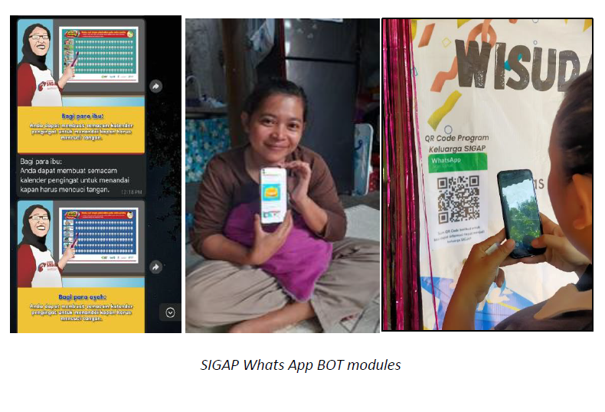


Slide 41
A few examples:
Vaccine hesitancy

Slide 42

In 2021, MSD and Meta announced a multi-year partnership called the Advancing Health Online Initiative
MISSION
OBJECTIVES
Advance understanding of how social media* can be utilized to increase the health and resilience of communities around the world
RESEARCH AND IMPLEMENTATION OF SOLUTIONS
DISSEMINATION OF KNOWLEDGE
BRINGING TOGETHER KEY STAKEHOLDERS
*AHO’s definition of social media is meant to be broad and inclusive. Our social media definition includes: traditional social media (e.g., Facebook, Instagram, Twitter, LinkedIn, YouTube, TikTok, SnapChat) and other online platforms including: WhatsApp and Facebook Messenger Chat services; and online chatbots.
Notes:
Just to provide you a bit more context about Advancing Health Online, the initiative that VaxSocial was born out of
So in 2021, MSD and meta launched the AHO initiative – this was during the peak of covid, and the idea was to use pooled resources and expertise to better understand how social media can be utilised to improve the health of communities around the world...
The objectives were three fold – conduct research and implementation of effective solutions, disseminate knowledge and best practice, and bring together key stakeholders, both across the private and public sectors.

Slide 43



Given the urgency, AHO’s initial focus was vaccine confidence
“Social media is a powerful, constantly evolving tool that is shaping opinions and behaviours across the globe.”
Heidi Larson, PhD, Head of the Vaccine Confidence Project
There is broad consensus that vaccine hesitancy presents a very real threat to immunization programs and innovative, proactive, multi-disciplinary approaches are required to address it.
Vaccine demand is increasingly being driven by information found online and by the perspectives of those in an individual’s social network.
With more and more communities relying on social media as a significant source of information, and the scale of these digital and online platforms, it is vital that we better understand the role these platforms can play, and effectively harness their capabilities to contribute to vaccine decision-making.
In 2019, the WHO listed vaccine hesitancy as one of the top 10 threats to global health.
Notes:
Since the initiative was launched at the peak of the pandemic, the focus naturally was on vaccine confidence
Especially at a time when demand for vacines was being driven increasingly by what people saw online.
Often times, this meant social media got a bad reputation for spreading mis and dis-information, therefore further driving the motivation to better understand the role these platforms can play, and effectively harness their capabilities to contribute to vaccine decision-making.

Slide 44



The projects leverage social media to drive uptake of routine immunization
DESIRED OUTCOME
OBJECTIVES
FOCUS
Improved understanding of how to leverage social media and online platforms to increase uptake of routine immunization (childhood and HPV), and the critical success factors required to achieve this.
Understand how and what types of social media and online platforms (messaging/content) are most conducive to driving vaccination uptake
Identify the ecosystem/health system-level enablers and barriers that need to be in place and/or controlled to enable success
Define the methodologies and best practices to scale, replicate or tailor solutions in different contexts
Thematic focus - Routine immunizations (childhood and HPV)
Geographic focus: India, Nigeria, Indonesia
Existing Gavi support
Existing immunization infrastructure
Low or declining rates of routine immunization
Social media use
Political will and government support
Strong implementing partners and stakeholder network with expertise
Notes:
Understand what works – and you will see in a moment that across the 6 grantees, we're trialing a range of social media platforms
Understand the ecosystem drivers – we understand and acknowledge that social media doesn't exist in vaccuum, and a range of other factors need to be in place to drive success of these intervention
Finally,

Slide 45
Why is Gavi
Interested in Integrated approaches?

Slide 46






The Health systems strengthening – to reach the last 5%
Simplified illustration of the Health Systems strategy Theory of Change (ToC)
.
Routine immunisation (RI) coverage maintained
Missed communities reached and fully immunised
RI strengthened through second year of life
Begin routine delivery of vaccines outside early childhood
Countries manage and sustain immunisation programmes
Political commitment and financing for immunisation
Intervention pillars¹
Outcomes
Goals
#1: Service delivery for zero-dose
#2: Health workforce for zero-dose
Levers of influence
#3: Supply chain
Equity 6.0 SG2 and link to SG1
#4: Data and digital
#5: Governance and leadership
#6: Health financing
Sustainability 6.0 SG3

Slide 47



Malnutrition and infectious disease drive each other
WHY INI
Zero dose children are more likely to have multiple deprivations, to be malnourished, and to have additional exposure to drivers of malnutrition – and need and deserve multiple interventions.

Slide 48

Why is INI of interest for Gavi as part of Strategy 6.0?
Physiologically, nutritional status does affect the way a child responds to vaccines, and inversely, under-immunized children are more prone to under-nutrition because of impaired immune systems.
Programmatically, rolling out immunisation and nutrition programmes together :
Can significantly increase the number Zero Dose Children reached
Can reduce delivery costs especially at the last mile
Can provide support to communities, families and societies to be more resilient to future pandemics
Strategically, INI resonates with the key recommendations of the FGHI by fostering a holistic, collaborative, and equitable approach to addressing health challenges on a global scale

Slide 49
Thank you!

Slide 50
Brainstorming new and innovative approaches to work together going forward
What is the greatest bottleneck that your country needs to tackle to sustainably strengthen your immunisation programme?
Какое основное препятствие необходимо устранить вашей стране для устойчивого укрепления программы иммунизации?
What are some key steps that you can take to move this forward, drawing on the resources and tools available?
Какие ключевые шаги вы можете предпринять для продвижения вперёд, используя имеющиеся ресурсы и инструменты?

Slide 51
Final Reflections & Evaluations

Slide 52

Conclusion

