Slide 1
Gavi-Linked Learning Forum: Sustaining and Strengthening Immunisation Coverage
DAY 2
8 October 2025

Slide 2
Field Visit Reflections

Slide 3
Session 4: Reflections & discussion on needs going forward

Slide 4
Understanding to what extent interventions and support to improve coverage have been successful – why or why not – and what can we learn from these successes and failures about the needs of countries going forward

Slide 5
Grp | Countries | Topic 1 | Topic 2
1 | Georgia (1) Indonesia (2) (Zunera) | Microplanning | HCW Capacity Strengthening
2 | Vietnam (2) Moldova (1) (Elizabeth) | Domestic Resource Mobilization | Community Engagement
3 | Moldova (1) Georgia (1) Ukraine (1) Uzbekistan (Ivdity) | Performance Monitoring and Mentoring | Community Engagement and Accountability
4 | Subnational reps: Moldova, Georgia, Indonesia, Vietnam (Inga) | Subnational Operational Financing | Multi-sectoral Engagement / PHC Integration
Instructions:
You have 30 minutes for each topic
Briefly share challenges/successes relative to the topic
Discuss what is needed to overcome these challenges (interventions, resources (how to mobilize these resources))
Assign someone to briefly summarize out on the challenges and needs (3 minutes)

Slide 6
Discussion Topic 1

Slide 7
Coffee Break

Slide 8
Grp | Countries | Topic 1 | Topic 2
1 | Georgia (1) Indonesia (2) (Zunera) | Microplanning | HCW Capacity Strengthening
2 | Vietnam (2) Moldova (1) (Elizabeth) | Domestic Resource Mobilization | Community Engagement
3 | Moldova (1) Georgia (1) Ukraine (1) Uzbekistan (Ivdity) | Performance Monitoring and Mentoring | Community Engagement and Accountability
4 | Subnational reps: Moldova, Georgia, Indonesia, Vietnam (Inga) | Subnational Operational Financing | Multi-sectoral Engagement/ PHC integration
Instructions:
You have 30 minutes for each topic
Briefly share challenges/successes relative to the topic
Discuss what is needed to overcome these challenges (interventions, resources (how to mobilize these resources))
Assign someone to briefly summarize out on the challenges and needs

Slide 9
Discussion Topic 2

Slide 10
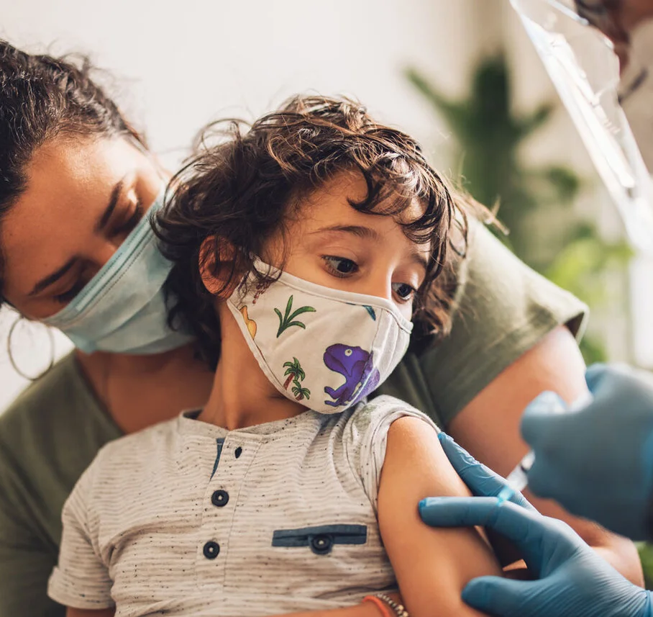
Conclusion

