Slide 1
Gavi-Linked Learning Forum: Sustaining and Strengthening Immunisation Coverage
DAY 1
7 October 2025

Slide 2
Welcome

Slide 3
Dr. Bakhodir Yusupaliev
Chairman
Committee for Sanitary Epidemiological Wellbeing and Public Health
Uzbekistan

Slide 4
Adriana Jimenez-Cuen
Director
Middle-Income Countries
Gavi, the Vaccine Alliance

Slide 5
Session 1: Country Introductions

Slide 6

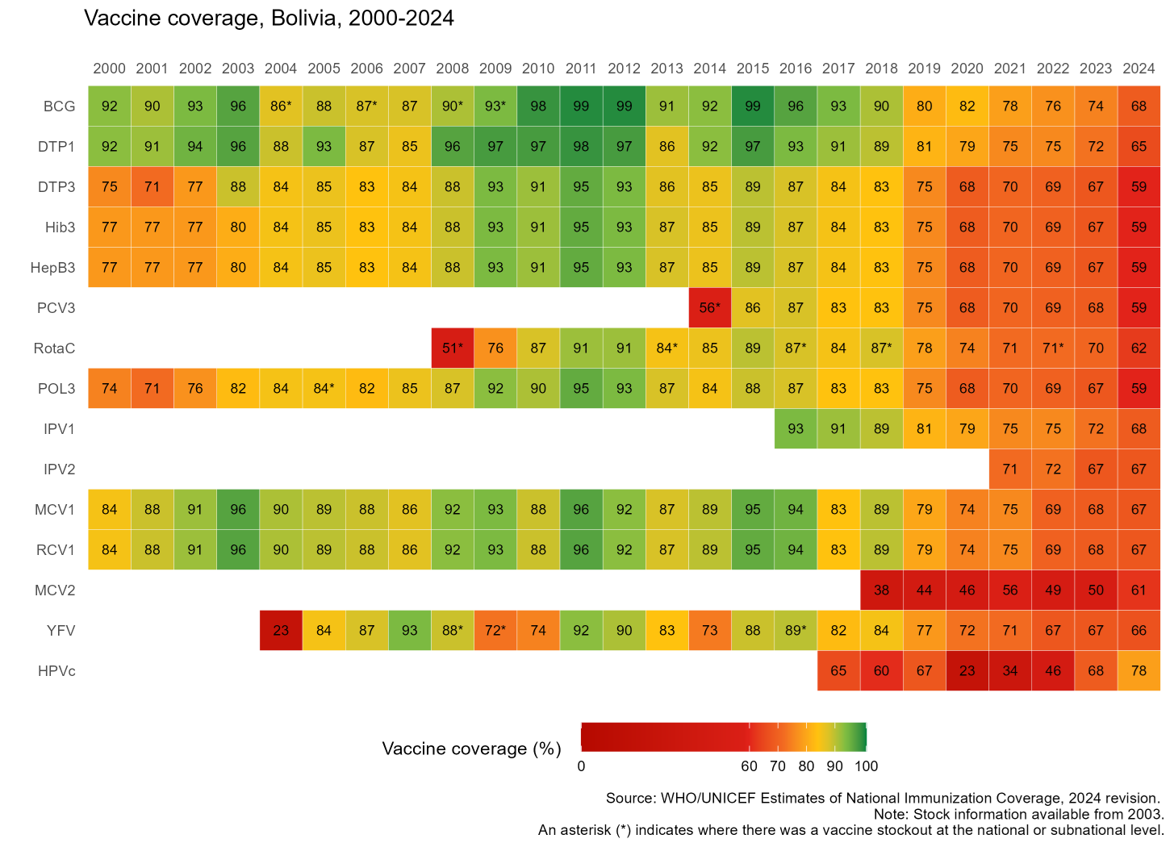


Bolivia
Sustaining and Strengthening Immunization Coverage
in Middle-Income Countries
Tashkent, Uzbekistan, 07-09 October 2025
Priority drivers of persistent coverage challenges
Unequal resource availability and implementation of strategies between departments, reflected in significant coverage disparities Insufficient human resources at all levels, with high staff turnover Insufficient funding and lack of dedicated immunization budget at the local level Heightened misinformation and vaccine hesitancy during and following COVID-19 pandemic, which continues to persist Service disruption at healthcare units and schools
Priority needs to optimize coverage (as of 2026)
Increase the prioritization of the immunization program to high Assign dedicated funding to the immunization program Increase dedicated immunization staff at all levels Reduce staff turnover, particularly at higher coordinating levels Train human resources of prioritized health networks and their establishments Develop local micro-planning with definition of vaccination goals, defined by network diagnoses Strengthen participatory planning processes in subnational governments Restore public confidence in vaccines
Approaches implemented
Comprehensive TI targeted 44 health networks in 56 municipalities, supplementing program activities Electronic Nominal Vaccination Registry has been implemented Currently in the midst of a critical measles outbreak, and control measures being implemented
Successes and lessons learned
Population census conducted in 2024 to be incorporated into WUENIC data. Importance of political support, trained human resources, well coordinated and well funded health system.

Slide 7

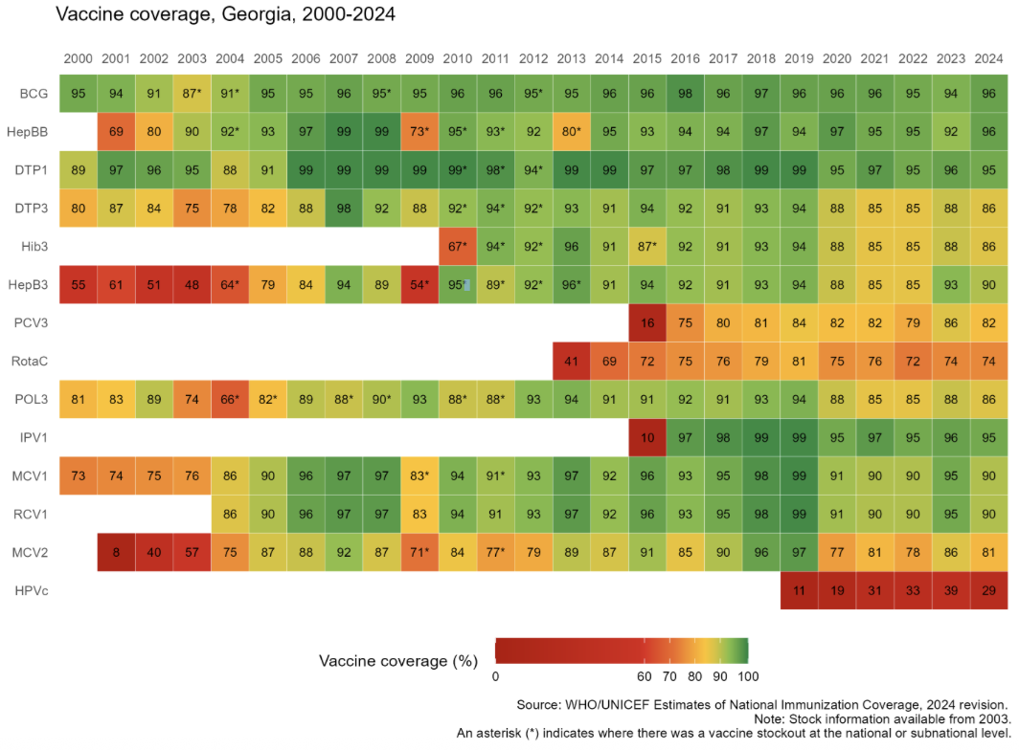
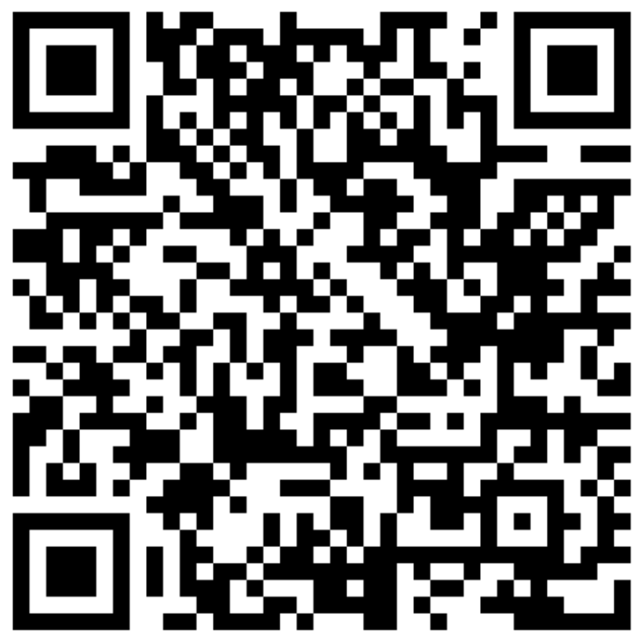
Georgia
Sustaining and Strengthening Immunization Coverage
in Middle-Income Countries
Tashkent, Uzbekistan, 07-09 October 2025
Priority drivers of persistent coverage challenges
Late registration of children at urban PHC, leading to late initiation and delayed vaccination (root causes: no patronage system, no urban geographical catchment areas, Electronic Information systems interoperability issues leading to information gap on newborns in catchment area) Private Insurance liability (child supervision responsibilities incl. imm.) & data sharing issues Poor linkages across different state-funded schemes leading to uncertainty on target population at facility level Inadequate performance feedback from public health to PHC and from PHC management to health care workers Low capacity of PHC doctors, nurses in effective immunization communication.
Priority needs to optimize coverage (as of 2026)
Enforced policies ensuring newborns timely registration at PHC for proactive actions EIR modification (incl. automatic SMS notifications), Improving linkages between electronic systems, expanding EIR access to private practitioners Policies to ensure private insurance takes responsibilities on child supervision and shares data on covered children population lists.
Approaches implemented
Government resolution (2022) obliging PHC to register newborn within 7 days after birth. Government resolution (2025) introducing performance indicators linked to bonus payments (including MMR1 coverage) from 2026. Improvement plans developed based on several studies 2023-25: 1)Identifying un & under-vaccinated children & developing microplans in the regions of Georgia (2023-24, WHO); 2) JEE of IHR core capacities (2024, CDC,WHO); 3) Rota & PCV coverage evaluation (2024,WHO); 4) Coverage and Equity assessment with Root Cause Analysis of Backsliding and Zero Doses in 3 districts (2024,UNICEF,CIF); 5) Qual. study to inform routine vaccination interventions (2023, WHO); Follow-up actions: 1) Monitoring impact of interventions to address immunization inequities (2025, WHO); 2) Addressing Vaccination Backsliding in Rustavi, Gori, and Marneuli (2025, UNICEF, Caritas Czech Republic, Gov. of Korea)
Successes and lessons learned
Ongoing activities: Targeted catch-up vaccinations among underserved population Online meetings with public health centers regarding immunization program challenges Immunization program monitoring in the selected districts Medical personnel capacity building (trainings, job-aids) Dissemination of educational video and other materials in health facilities to raise public awareness
Link to educational video

Slide 8

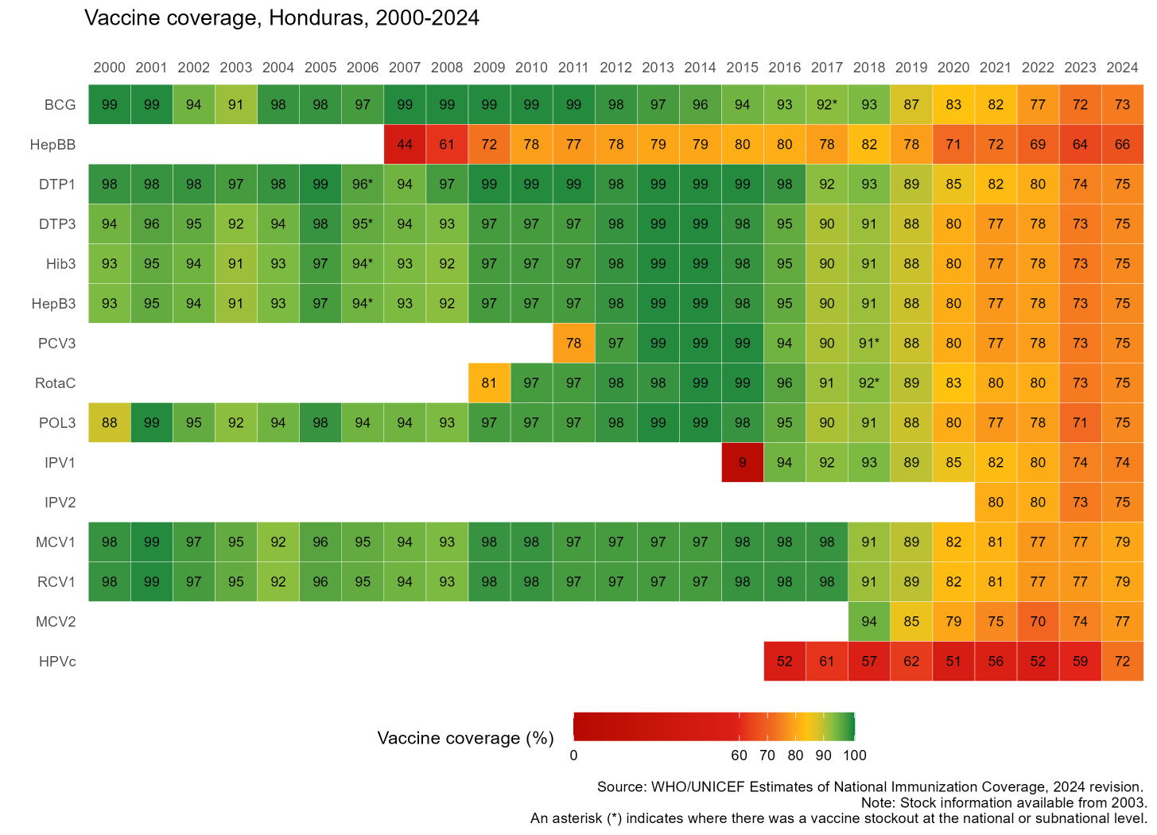
Honduras
Sustaining and Strengthening Immunization Coverage
in Middle-Income Countries
Tashkent, Uzbekistan, 07-09 October 2025
Country Flag
Priority drivers of persistent coverage challenges
Human resource limitations including high staff turnover and limited technical, operational and leadership capacity at the various levels. The lack of complete and timely information at both individual and population levels hinders effective decision making and strategic planning. Population displacement mainly due to migration and social unrest is disrupting healthcare service access and operations. Economic downturns and political instability have led to reduced financial support, impacting vaccine procurement and distribution.
Priority needs to optimize coverage (as of 2026)
Training and capacity building to increase knowledge and capacity, including through strengthening leadership and intra-ministerial coordination. Focus on establishing stable capacity at the EPI and Health Networks Unit. Digital information systems and strengthened microplanning at the local level should be fully in place to ensure evidence-based strategic planning and more effective targeting of population with pending immunizations. Mobile units providing door to door vaccination in rural and hard to reach areas to ensure universal access. National Action Planning and budget planning considering various components and activities of the immunization program is critical.
Approaches implemented
Communication Strategy involving high political level was very successful in engaging society and mobilizing partners and community. Mobile brigades for vaccination during the COVID-19 pandemic were very successful in reaching target population. Projects supported and engaging partners very important, including World Bank Reshape project, PAHO microplanning, and UNICEF communication strategy and cold chain inventory.
Successes and lessons learned
Importance of well-structured communication strategy with strong political support. Interagency coordination and communication can be enhanced to optimize partner engagement and communication with country teams. NITAG well structured and involved in technical decision-making process based in evidence.

Slide 9

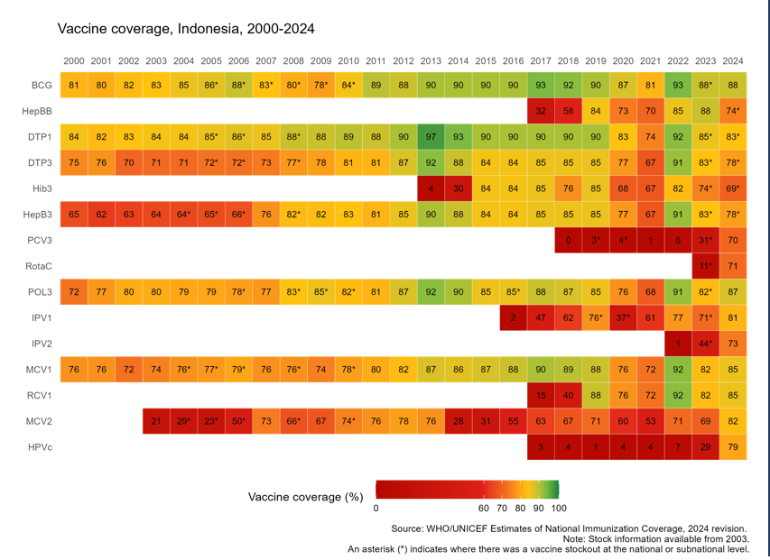
Indonesia
Sustaining and Strengthening Immunization Coverage
in Middle-Income Countries
Tashkent, Uzbekistan, 07-09 October 2025
Priority drivers of persistent coverage challenges
Governance & Leadership: Multisectoral coordination remains suboptimal, particularly in reaching remote and hard-to-reach areas. Financing: Limited budget to support programming, esp. at subnational level Human Resources: High turnover, uneven capacity, unequal distribution, and multiple roles among health workers Service Delivery: Sub- optimal integration with other programs Vaccine and logistics: Interrupted vaccine supply Data and Information: RR transition from manual to digital, vaccine hesitancy
Priority needs to optimize coverage (as of 2026)
Advocate local government to allocate budget for immunization program Strengthen HR capacity and multisectoral collaboration, including private sector Developing multi-year planning for vaccine and logistics Integrating the immunization registry and vaccine logistics system Optimize the implementation of the Sustainable Outreach Services (SOS) Improve the adaptation and implementation of immunization communication strategies at subnational level
Successes and lessons learned
Districts that conducted detailed costing and resource mapping were better able to align partner support and mobilize local funds for outreach and service delivery. Engaging health cadres, PKK (Family Welfare Movement), and community/religious leaders, and other local partners proved effective in rebuilding trust and increasing community acceptance in hesitant or underserved areas. Peer-to-peer exchanges across districts enabled practical learning and adaptation of successful approaches, especially in areas with similar geographic or demographic profiles. PIRI/PENARI has administered over 1 million doses of catch-up immunizations across two rounds in 2025 (May and August), with an additional round planned for November.
Approaches implemented
Developed National Immunization Strategy (NIS) 2025 - 2029 (2024-2025) Ongoing advocacy and regular monitoring, complemented by incentives through PIRI/PENARI CSO engagement to support defaulter tracking and reaching zero dose children through INEY2 initiative (2024 - now) Communication strategy implementation, inc. engagement w/ social media influencers and professional organizations to counter misinformation Optimize electronic immunization logistics (SMILE) to ensure real-time visibility of vaccine stocks & storage conditions (2023-now) Enhance health worker competencies, including in the private sector, through diverse training methods such as in-person training and MOOCs

Slide 10

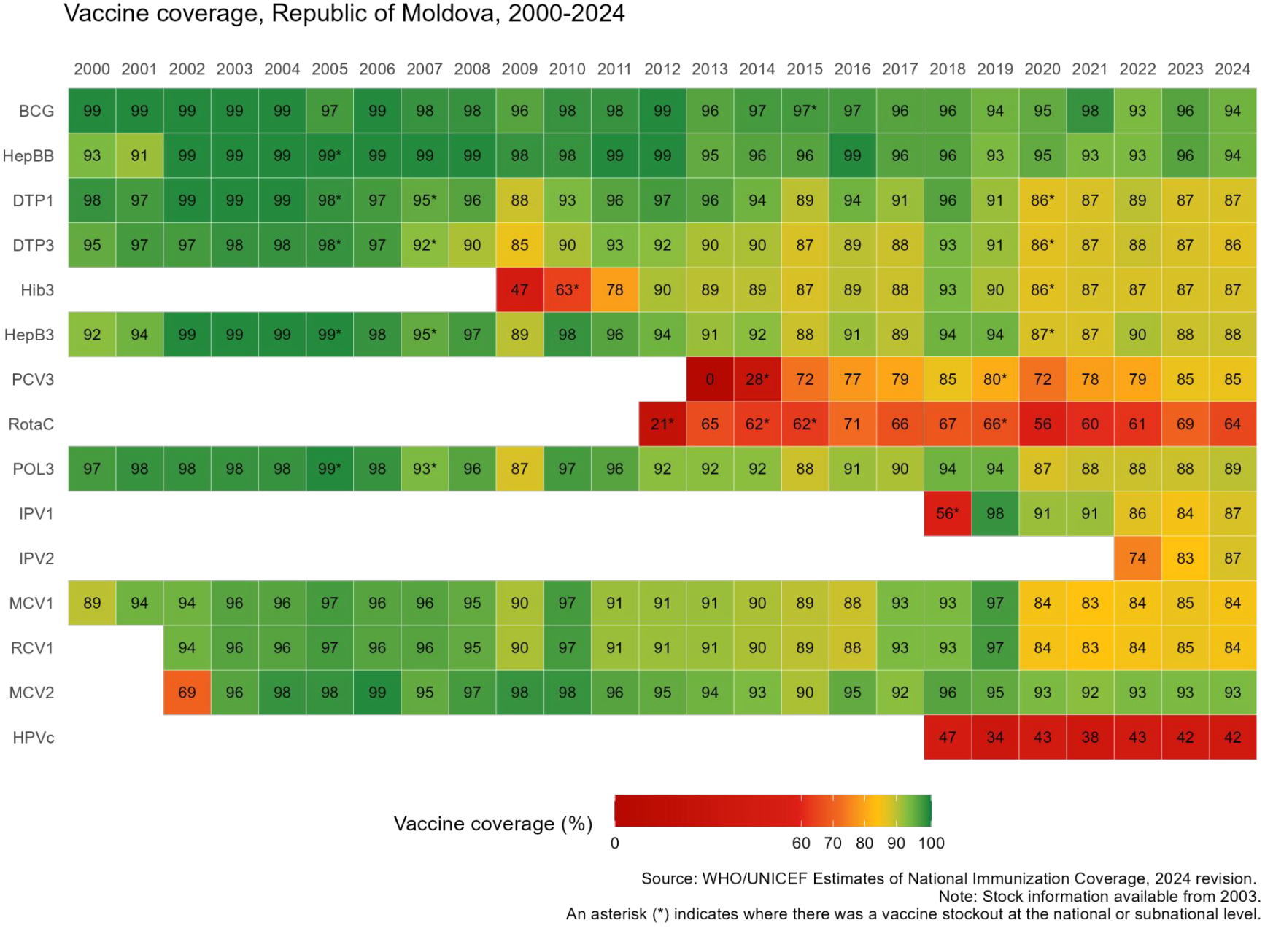
Moldova
Sustaining and Strengthening Immunization Coverage
in Middle-Income Countries
Tashkent, Uzbekistan, 07-09 October 2025
Priority drivers of persistent coverage challenges
Unjustified contraindications from private practitioners, specialist doctors, neonatologists leading to delayed immunisation Poor immunisation communication skills among PHC workers Limited immunisation data analysis by family doctors, performance monitoring at facility level, supportive supervision from Public Health Policy limitations (opt-in policy, immunisation is not part of the PHC accountability framework, weak enforcement of mandatory immun.) Vaccination refusal from religious and cultural (Roma) subgroups. Online and offline misinformation leading to mistrust in routine vaccination
Priority needs to optimize coverage (as of 2026)
Engage religious and Roma leaders in targeted interventions Strengthen capacities in immunization counselling for medical and social workers, including community mediators for Roma and refugee communities Implement the Social Listening and Media Monitoring for immunisation initiative Enhancing data collection and reporting systems to ensure real-time data Strengthen the supervision system for primary healthcare facilities Promote community engagement activities in rural areas & integrate vaccination subject into the education curricula.
Approaches implemented (2023-2025)
Comprehensive root cause analysis of barriers to vaccination in Balti district, developing and implementation of targeted interventions (2023) Community Engagement for Immunisation (2023-2024): Multicomponent, multisectoral interventions in 10 rayons and 14 suburbs of Chisinau including consensus building, educational, communication and awareness raising events with the target groups. Evidence generation and coverage and equity assessment, and development of Social and Behaviour Change Action Plan 2023-2027 Integration of Interpersonal communication skills on immunization Module into in-service and pre-service national curricula Social listening and countering misinformation Support PHC workers in the vaccination process through the establishment of a Methodological Centre for Vaccination, MCH Institute.
Successes and lessons learned
Following tailored actions & community engagement, uptake rose by 35% for DTP3, 29% for MMR, 63% for HPV in Bălți, and by 3–5% in several rayons (Cahul, Căușeni, Comrat, Râșcani, Ștefan Vodă). HPV coverage among 15-y increased by 40% in some suburbs of Chișinău and by 5–10% in rayons such as Călărași, Căușeni, Ceadîr-Lunga, and Comrat. With support from the Methodological Centre for Immunization, over 500 previously unvaccinated children received vaccines The Social Listening initiative was institutionalized within the National Agency for Public Health, and the SBC Action Plan was approved and integrated into the EPI. The IPC Module was integrated into 10 in-service and pre-service curricula at Medical Colleges, and into 9 programs at the University of Medicine. Lessons learned: Tailored, evidence-based interventions are essential to address specific barriers. Community engagement is key to building trust and acceptance of vaccines.

Slide 11

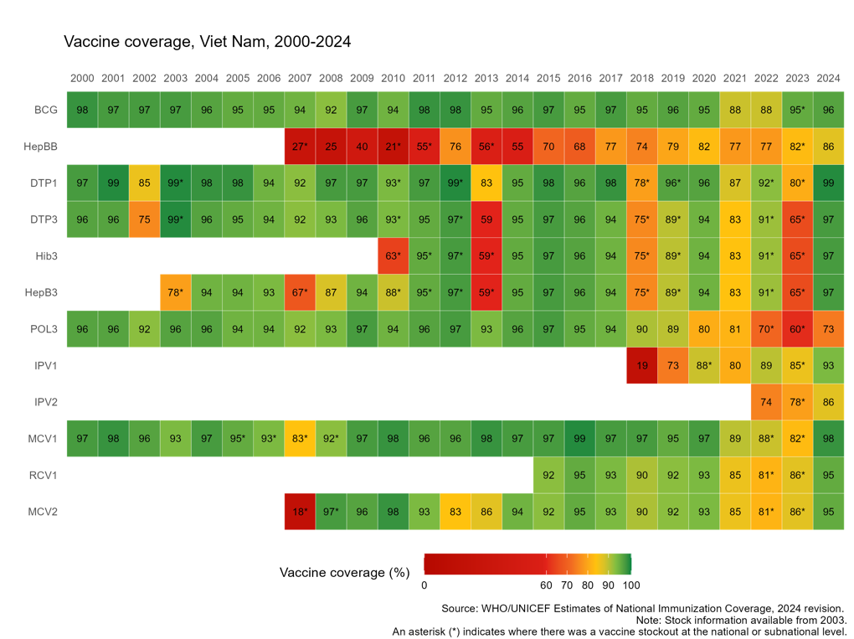
Vietnam
Sustaining and Strengthening Immunization Coverage
in Middle-Income Countries
Tashkent, Uzbekistan, 07-09 October 2025
Priority drivers of persistent coverage challenges
Sustain and strengthen the capacity of the subnational workforce in planning, implementing, and monitoring essential activities, while effectively navigating ongoing administrative restructuring. Timely and adequate operational funding key to supporting outreach, supervision, and routine immunization activities. Streamlining procurement and supply systems can help avoid stockouts and improve timeliness of vaccine delivery. Clarifying ownership and management of digital systems, such as NIIS, can enhance data use and coordination across levels. Persistent vaccine hesitancy and misinformation, especially in underserved or remote areas, affect uptake despite high national averages.
Priority needs to optimize coverage (as of 2026)
Build sustained provincial capacity for planning, budgeting, and monitoring to deliver tailored, equity-focused immunization strategies. Secure predictable, flexible domestic financing through a dedicated national vaccine budget line and streamlined operational fund disbursement. Advance governance and system integration by finalizing NIIS transition to MOH ownership and aligning digital systems with broader health sector reforms
Approaches implemented (incl. year(s))
Launched targeted outreach and mop-up campaigns in underserved southern and highland provinces Transitioning ownership of the National Immunization Information System (NIIS) to the MOH to improve system sustainability and integration Updated national immunization guidelines and SOPs to align with health system reforms and strengthen routine delivery, especially in the absence of a vertical immunization program. Revised law and policies to secure central budget allocations and enabled centralized vaccine procurement for essential immunization activities
Successes and lessons learned
Strong national leadership and technical capacity enabled recovery Catch-up campaigns and data-driven microplanning effective in identifying and reaching missed children Integration of immunization into primary health care supports long-term sustainability but requires continued investment in local ownership and coordination.

Slide 12

Ресублика Узбекистан
Поддержание и укрепление охвата иммунизацией
в странах со средним уровнем дохода
Ташкент, Узбекистан, 7–9 октября 2025 г.
Ведущие факторы, вызывающие постоянные проблемы с охватом
Отказы по религиозным причинам Медицинские отводы (обоснованные и необоснованные) Миграция населения как внутренняя так и внешняя Слабая связь с ПМСП, особенно в семьях сезонных работников
Приоритетные потребности в оптимизации охвата (на 2026 год)
Усиление мониторинга и кураторской поддержки Работа с населением по преимуществам иммунизации Выявление непривитых и недопривитых детей Цифровизация и использование информационных технологий в программе иммунизации
Осуществленные подходы
Мониторинг и кураторская поддержка Работа с сообществами (махаллями) и религиозными лидерами Догоняющая иммунизация, кампании массовой иммунизации Информационная кампания по преимуществам иммунизации через СМИ, социальные сети
Успехи и извлеченные уроки
Стабильно высокий охват 95 % DTP3; внедрение ВПЧ (2023), ротавирусной вакцины (2022), ПКВ (2020); надёжные системы эпиднадзора и холодовой цепи; интеграция с программами раннего развития детей (ECD) и питания в ряде регионов.

Slide 13
Poster Walk

Slide 14
Poster Walk
Key questions to consider as your review posters:
Challenges:
What key challenges seem to be common across all countries?
How are countries identifying the priority challenges and root causes of these challenges driving coverage declines or stagnation at lower coverage levels?
Interventions:
What similar interventions or approaches are implemented to address challenges across countries?
Were there unique interventions or approaches that you would like to learn more about?

Slide 15
Lunch

Slide 16
Icebreaker

Slide 17
Session 2: Enablers and Barriers

Slide 18
Understanding to what extent interventions and support to improve coverage have been successful – why or why not – and what can we learn from these successes and failures about the needs of countries going forward

Slide 19
Understanding to what extent interventions and support to improve coverage have been successful
How do we define success?
Notes:
Consider the immunisation programme and system outcomes that contribute to impact. Beyond completing implementation of an intervention.

Slide 20
Task #1
Consider interventions or actions implemented to strengthen immunisation programme performance over the past 3-5 years
For each intervention or action implemented, consider whether it was considered a success, partially successful, or a failure.
For each intervention, write a sticky – country, name of intervention, what was the outcome?
Success = Green sticky
Partial success = Yellow sticky
Failure = Red sticky

Slide 21
Understanding to what extent interventions and support to improve coverage have been successful – why or why not –
What were the enablers and barriers
to success?

Slide 22
Task #2
For each intervention, write each of the **critical** enablers and barriers to achieving the outcome on a sticky – country name, intervention, enabler/barrier. One enabler/barrier per sticky.
Enabler = Green sticky
Failure = Red sticky

Slide 23
Enablers & barriers
Was the challenge targeted by the intervention accurately identified as a means of achieving the desired outcome?
Was the intervention selected appropriate to address the challenges?
Was the scope of the intervention too large, too limiting?
Was the implementation timeframe appropriate or limiting?
Were there delays in implementation?
Were sufficient human, financial, and capital resources available to support effective implementation?
Was technical support available as needed?
Did resources have sufficient capacity to be effective?
Were stakeholders sufficiently supportive/engaged?
Did implementation go as planned?
Were there elements of implementation performance that were particularly strong or weak which impacted effectiveness?
Were the monitoring and measurement tools effective in capturing the intervention’s outcome?
Was there sufficient time to measure the outcome of interventions in the WUENIC 2024 results or other key routine measurement tools?
Was the intervention selected appropriate to achieve the desired outcome?
Notes:
Turn to Zunera for example

Slide 24
Enablers & Barriers to Success
Objective: To identify the enablers and barriers contributing to the successes or failures of interventions
Was the intervention successful?
“Yes” = Green note
“No” = Red note
“Partially” = Yellow note
Please include country name and name of the intervention on all notes (including for enablers & barriers)
DEFINITION OF NEED
DESIGN OF INTERVENTION
Was the challenge or population need targeted by the intervention appropriate to achieve desired outcomes?
Was the intervention appropriate to achieve the objective of improved coverage?
Illustrative questions to consider within each topic, should not be seen as limiting
“Enablers” = Green note
“Barriers” = Red note
Stages of implementation
SCOPE & ALLOCATION OF INPUTS
IMPLEMENTATION
MONITORING & MEASUREMENT
Scope of the intervention?
Implementation timeframe?
Sufficient human, financial, and capital resources and commodities available?
Sufficient technical advisory support?
Did implementation go as planned?
Implementation performance?
Sufficient stakeholder support or engagement?
Were the monitoring and measurement tools effective in capturing the intervention’s impact?
Was there sufficient time to see the impact of interventions in the WUENIC 2024 results?
Notes:
Task #3: Map each barrier to the stages of implementation
Definition = the challenge or need to be addressed

Slide 25
Discussion
Tell me about your experience during this analysis exercise.
What aspects were particularly challenging?
Did it change your perspective on an intervention or the implementation experience?
Did anything surprise you?
Did you learn anything new?

Slide 26
Daily Reflection

Slide 27
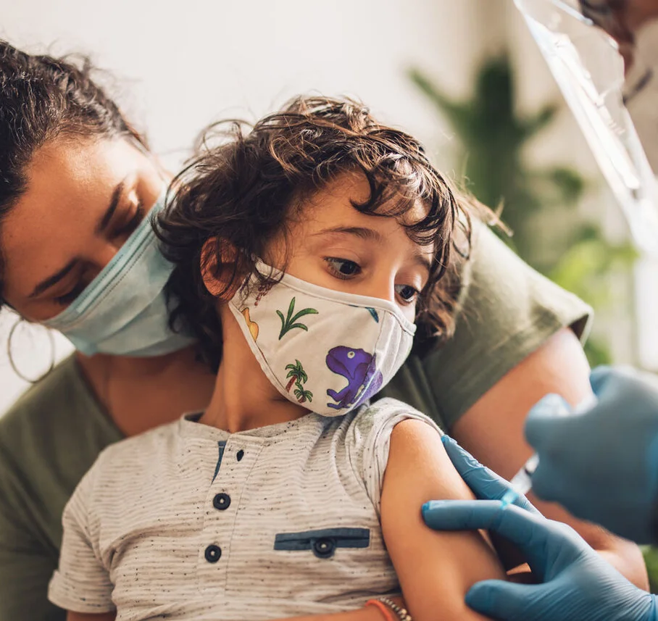
Conclusion

