Slide 1

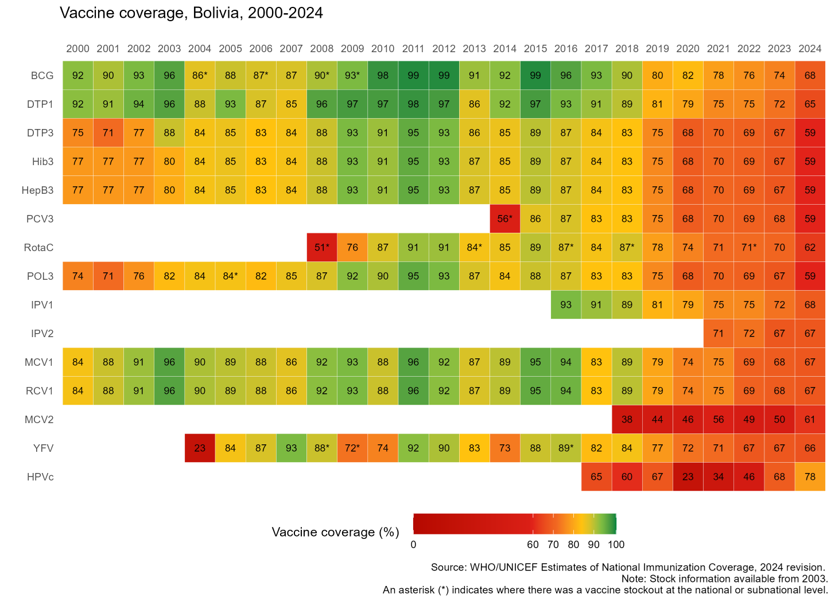


Bolivia
Sustaining and Strengthening Immunization Coverage
in Middle-Income Countries
Tashkent, Uzbekistan, 07-09 October 2025
Priority drivers of persistent coverage challenges
Unequal resource availability and implementation of strategies between departments, reflected in significant coverage disparities Insufficient human resources at all levels, with high staff turnover Insufficient funding and lack of dedicated immunization budget at the local level Heightened misinformation and vaccine hesitancy during and following COVID-19 pandemic, which continues to persist Service disruption at healthcare units and schools
Priority needs to optimize coverage (as of 2026)
Increase the prioritization of the immunization program to high Assign dedicated funding to the immunization program Increase dedicated immunization staff at all levels Reduce staff turnover, particularly at higher coordinating levels Train human resources of prioritized health networks and their establishments Develop local micro-planning with definition of vaccination goals, defined by network diagnoses Strengthen participatory planning processes in subnational governments Restore public confidence in vaccines
Approaches implemented
Comprehensive TI targeted 44 health networks in 56 municipalities, supplementing program activities Electronic Nominal Vaccination Registry has been implemented Currently in the midst of a critical measles outbreak, and control measures being implemented
Successes and lessons learned
Population census conducted in 2024 to be incorporated into WUENIC data. Importance of political support, trained human resources, well coordinated and well funded health system.

