Slide 1

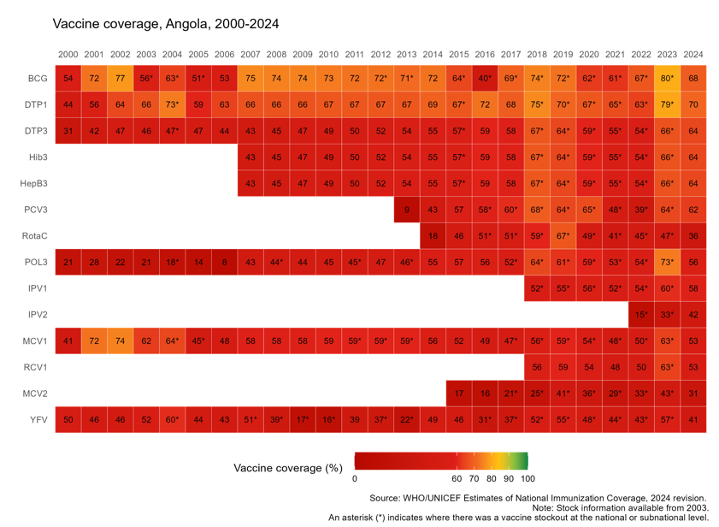


Angola
Sustaining and Strengthening Immunization Coverage
in Middle-Income Countries
Tashkent, Uzbekistan, 07-09 October 2025
Priority drivers of persistent coverage challenges
Systemic underinvestment in health system infrastructure and workforce development Limited municipal autonomy and inadequate allocation from national budget Fragmented planning and accountability mechanisms at subnational levels limit effective adaptation to local challenges Stockouts and unreliable vaccine supply logistics disrupting routine delivery Weak engagement with civil society and community leaders and mistrust in health services, limiting demand generation efforts
Priority needs to optimize coverage (as of 2026)
Mobilization of additional resources to support municipal level activities in selected provinces with considerable number of unvaccinated children. Increase in routine vaccination units and reinforce mobile vaccination in coordination with communities. Use of a digital platform to better manage vaccination logistics in real time to avoid vaccine stock outages.
Approaches implemented to improve coverage
TI Project implemented in 22 municipalities in 5 provinces during 2022-2023 - intensification of routine vaccination providing all EPI child vaccines to children up to 5 years Measles campaign to control outbreak expanded to target children up to 5 years of age and multiple municipalities National Polio Vaccination Campaign in May, June and Sept 2024 to control circulating type 2 vaccine-derived poliovirus (cVDPV2)
Successes and lessons learned
Efforts to restore coverages have shown results in 2023 coverage indicators, but emergencies and outbreaks have impacted and interfered with strategies and activities for restoring backsliding coverages Real time digital data platform (REDIV) used during the COVID-19 pandemic to monitor vaccine coverage was successful and seen as an example for routine program use Polio campaigns (3 rounds), tetanus maternal vaccination campaign, and measles campaign rollouts successfully completed in 2024

