Slide 1

One-dose HPV vaccination webinar: Evidence, lessons learned and strategies with experiences from Guyana and Estonia
Linked Webinar
October 9th, 2024

Slide 2
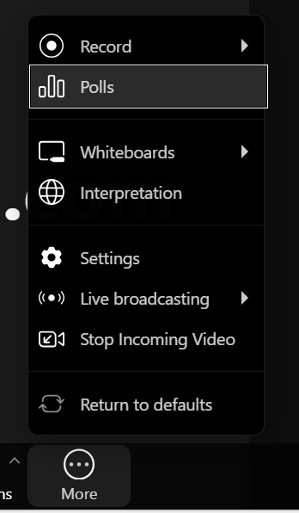
Welcome!
English, French, Spanish, and Russian interpretation are available
Please select yourpreferred language channel

Slide 3
Agenda
5 mins | Welcome and Introduction | Priscilla Rouyer
20 mins | Overview of evidence for a one-dose schedule followed by Q/A | Anh Ly, Jaymin Patel (CDC)
20 mins | Guyana’s experience, followed by Q/A | Dr. Oneka Scott
20 mins | Estonia’s experience, followed by Q/A | Maia-Triin Kanarbik
20 mins | Facilitated discussion among countries | Priscilla Rouyer
5 mins | Sharing reflections and closing | Priscilla Rouyer

Slide 4

HPV One Dose Vaccination: Evidence, lessons learned from Guyana
October 9, 2024
Dr. Oneka Scott,
Maternal and Child Officer, Guyana

Slide 5
HPV Vaccine Delivery
History
Intro 2012, girls only, dual modality, 9-13
Re-intro 2017 ,girls only, dual modality , 9-13
2019- boys targeted, age extended 9-15

Slide 6
Delivery Methods
Pulse Campaigns
Facility Access
Mixed

Slide 7
National coverage 9-13 boys /girls[ excludes 14-15]

Slide 8
Accumulative regional coverage boys /girls

Slide 9
HPV Vaccine Doses Administered April to October 2024
1st Dose Administered
2nd Dose Administered
Total 2nd Doses – 3,369
  9 to 15 Years - 0
  16 to 21 Years - 1,183
  22 to 45 Years – 2,186
Total 1st Doses – 20,403
  9 to 15 Years - 8,911
  16 to 21 Years - 2,769
  22 to 45 Years – 8,723

Slide 10
Why single dose strategy ?
Decision to adopt single dose;
Macroeconomic and geographic advantage: cost to conduct outreaches One dose better than no doses.
Dropout rate from 1st – 3rd dose was over 10%; because of the macroeconomic and geographic barriers
Barrier to multiple doses – strange correlation to administration to both sexes .[Vaccine uptake in February 2019, when vaccines were given to males, the coverage increased by 48%; population also requested one dose then ]
Supporting Evidence

Slide 11
Reviewing the evidence and making the case for one dose
Executed departmental study group
Debated the evidence
Presented the pros and cons to policy
Policy reviewed Alerted cabinet
Issued no objection to CMO No objection
Memo released
Public Health Care Workers

Slide 12
Approach: leveraging social media to address HPV vaccine hesitancy
2016: Conducted a pre reintroduction study
KAP study
Covered:
- Lessons learnt from 2010
- Acceptance views
- Barriers
- Attitudes to health
- Knowledge of vaccine
2016:
First HPV risk communication strategy
2018:
Post introduction study
2019, 2023 & 2024: Prepared updated versions of communication strategic plan

Slide 13
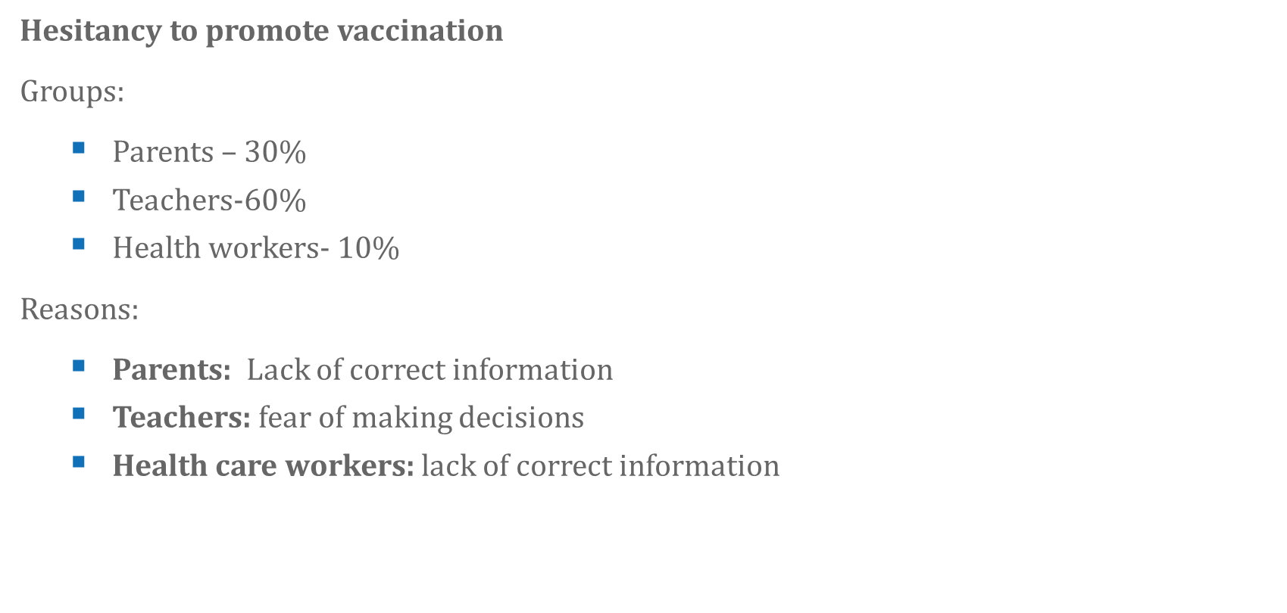
Context: HPV vaccine hesitancy in Guyana
Hesitancy to accept vaccination:
Causes:
  Misinformation
  Lack of information
Major sources of misinformation:
  Social medial- 90 %
  Community personnel – 10%
Major themes relating to hesitancy :
Population control | infertility
Promotes promiscuity
Belief that the HPV vaccine is unnecessary for those who are not sexually active

Slide 14
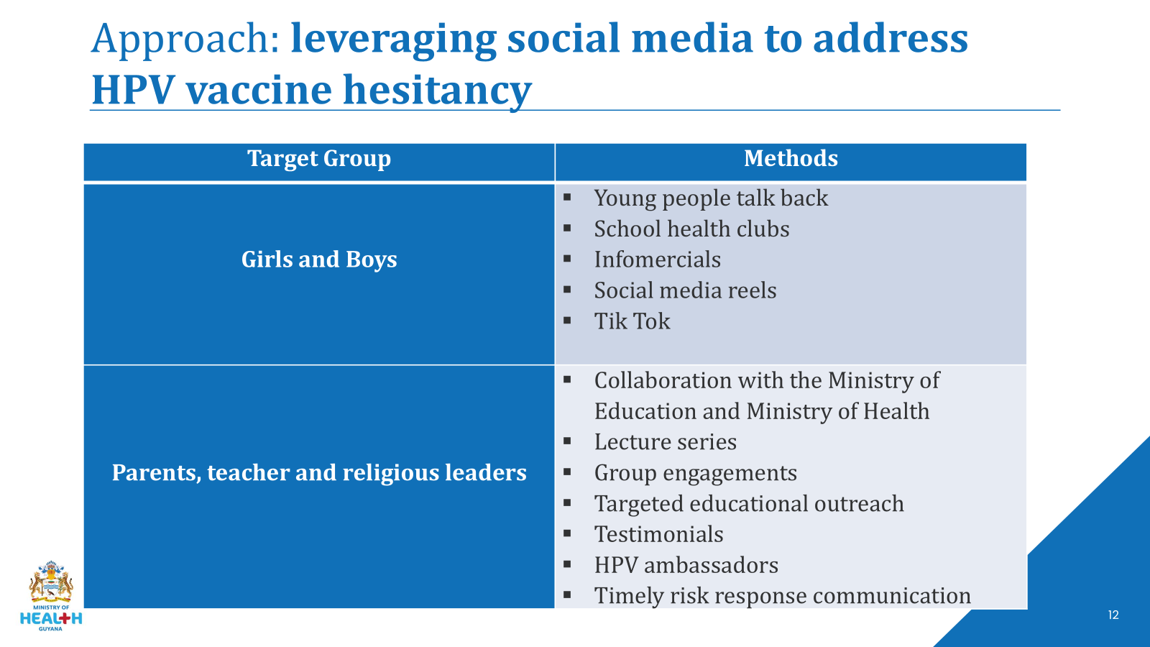
Approach: leveraging social media to address HPV vaccine hesitancy
Sources of Misinformation | Methods
General Public | Social medial advertising Newspapers advertising Billboards advertising Radio advertising Television advertising

Slide 15
Challenges & Lessons learned
Challenges
  Voluntary facility access (stunted health seeking behavior)
  Completing health agenda
Lessons learnt:
The voice of health needs to be as loud as those anti-vaxers.

Slide 16
2024 Campaign Material [ samples]

Slide 17

Approach: leveraging social media to address HPV vaccine hesitancy [ 2024 promotion ]

Slide 18
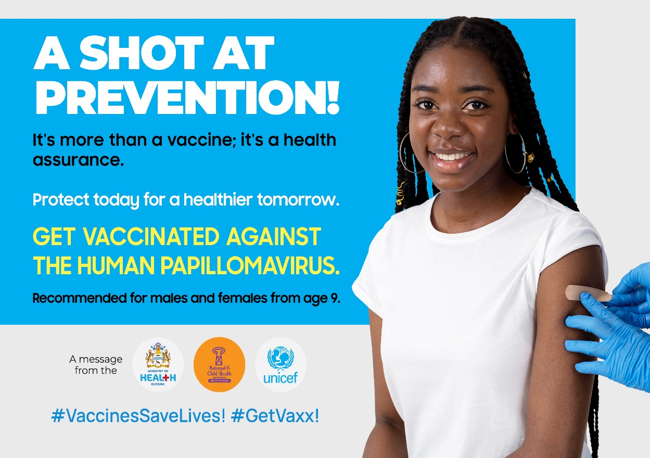
Approach: leveraging social media to address HPV vaccine hesitancy [ 2024 promotion ]

Slide 19
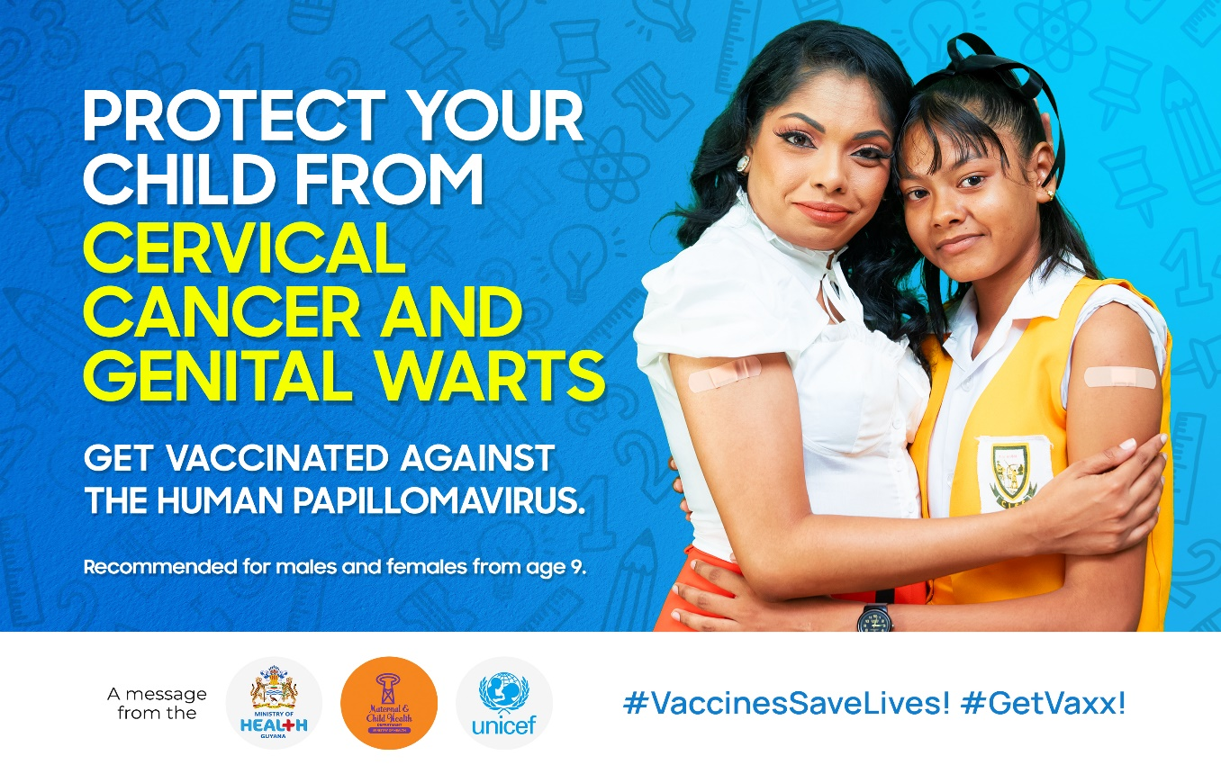
Approach: leveraging social media to address HPV vaccine hesitancy [ 2024 promotion ]

Slide 20

Approach: leveraging social media to address HPV vaccine hesitancy [ 2024 promotion ]

Slide 21
Questions ?

Slide 22


One-dose HPV vaccination—Estonian experience

Slide 23
Health system in Estonia
Unified national health insurance is available in Estonia (13% of the salaries). Most medical costs are covered by health insurance. The list of services is updated annually and approved by government regulation. Vaccinations for children are free.
Children are vaccinated according to the immunisation schedule that is advised by the Estonian NITAG
Newborn babies are vaccinated at maternity wards, young children are vaccinated at family physician offices, and schoolchildren at health service providers at schools.
Consent for vaccinating a child is provided by a parent or guardian.

Slide 24
Before 2024
Since 2018 HPV vaccination was provided for girls in the ages of 12 to 14
We used two-dose vaccination with Gardasil9

Slide 25
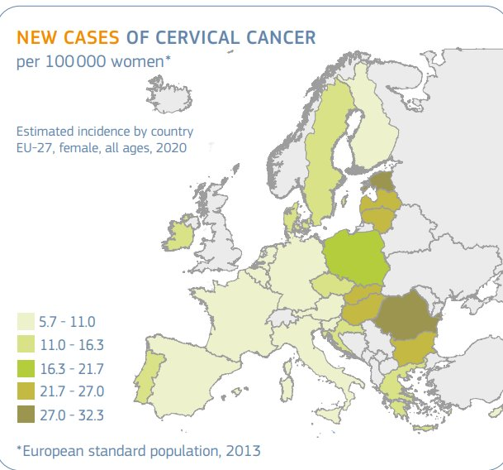
Why we wanted to change NIP?
High prevalence of HPV infection and HPV related cancers
​Insufficient coverage by cervical cancer screening (43,8-63,6%)​
Late introduction of HPV vaccination into the NIP (2018)​
Insufficient HPV vaccination coverage in the target group (~60%)
Narrow target group for HPV vaccination (12-14-year-old girls) ​
SOURCE: https://ecis.jrc.ec.europa.eu/pdf/factsheets/cervical_cancer_en-Nov_2021.pdf

Slide 26
Since 01.02.2024
The main target group is 12-14-year-old boys and girls
Catch-up group: 15-18-year-old boys and girls
One-dose vaccination scheme for 12-18-year-olds. We use Gardasil9.
Two-dose vaccination is recommended for 19+
Three-dose vaccination scheme for immunocompromised

Slide 27

Why the change?
A one-dose schedule is recommended by the WHO SAGE.
Scientific evidence by CVT, IARC, ect proves the high and long-term protection offered by a single dose of HPV vaccine, which is comparable with protection offered by two or three doses.
The introduction of a single-dose vaccination scheme simplifies the vaccination process.
Countries that have moved to one-dose (UK, Ireland, Australia) have not said that the decision was based on high rates of immunization or screening.

Slide 28
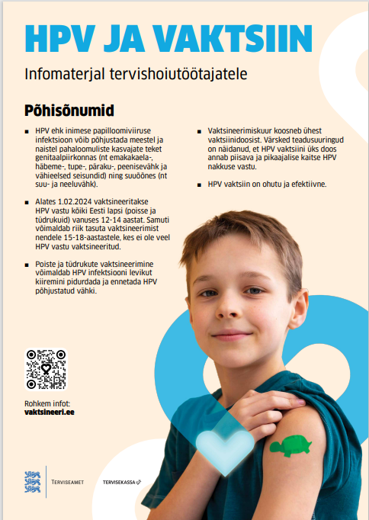

Communication
Health Board updated communication materials for schools and health care professionals
Two training sessions: HPV immunization and how to communicate with parents/children
HPV vaccination campaign

Slide 29
Response
During the spring of 2024, there was a big increase in HPV vaccination. The amount of vaccination done in the spring is equal to the amount of vaccinations in 2.5 years.
  It is expected that the biggest vaccination will happen in the first year, but we expect that the increase will also be felt in 2025.
The media took it up well with personal stories of cancer and what protection vaccine offers.
The public had no reaction to the change of dosage. We had some doubts from health care providers, but in the end the change was approved.
Confusion on how to show in data if the HPV vaccination has been finished.
Questions on if the child just turned 19 or if they are in a class of mostly 18-year-olds, then if they could also have a free vaccination.

Slide 30
Fears
Activation of antivaccers
Distrust increasing in the public health authorities regarding the change of NIP
Backlash from the health care providers
Possible problems with procurement

Slide 31
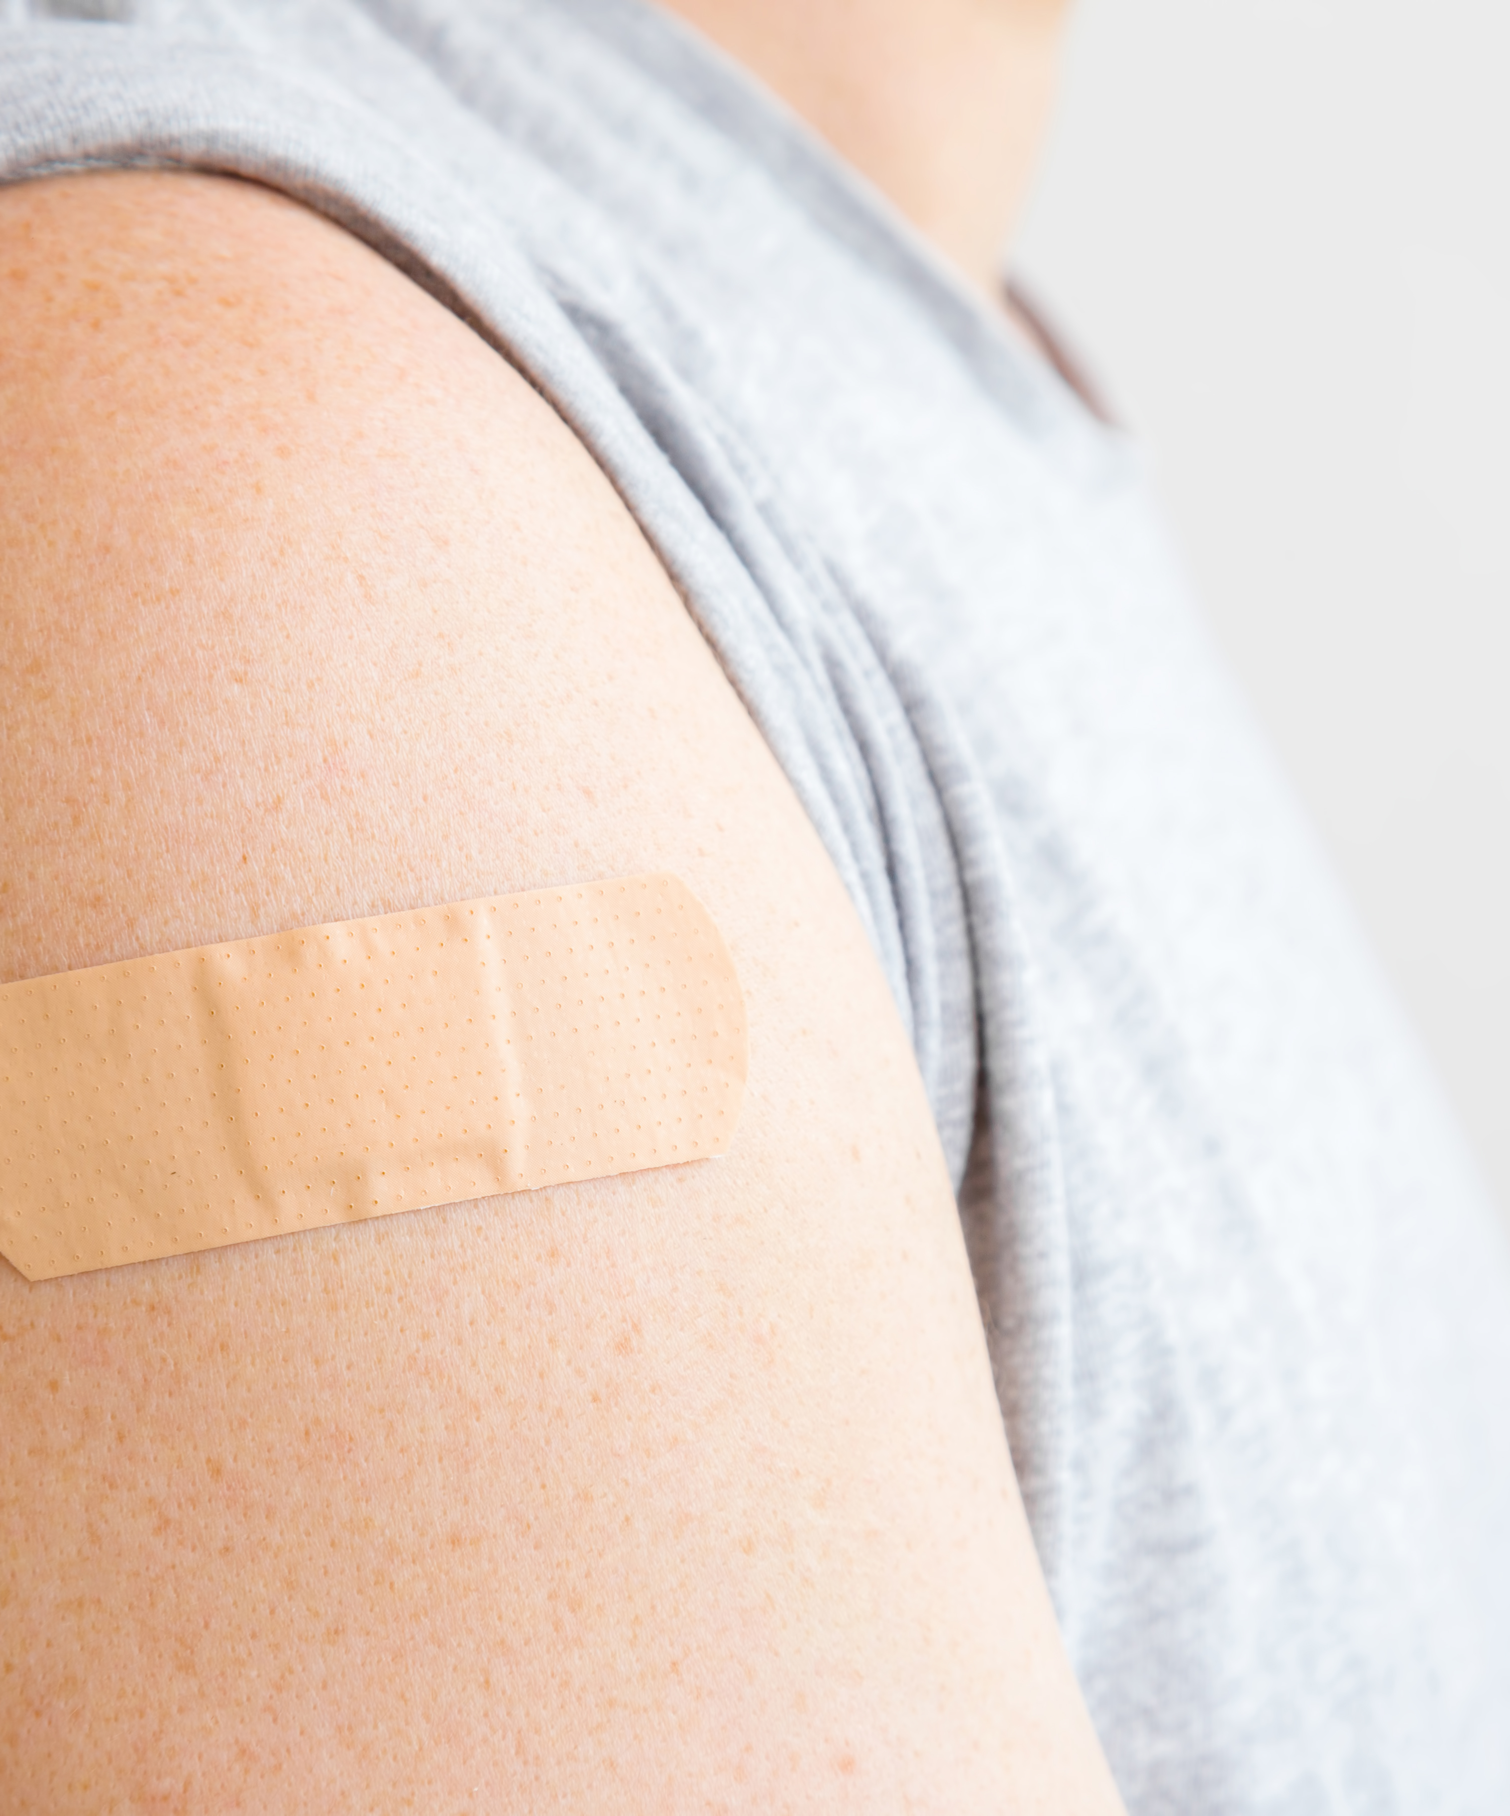



Lessons learned
Include other stakeholders early (oncologist, gynecologist, colposcopy)
Try to prepare the health care providers before the change
Attempt to agree on all the required opinions, even if some of details are not applicable to public health institutions.

Slide 32


Thank you for listening!
Nathan J Hilton

Slide 33
Facilitated discussion
What have you learned from Guyana and Estonia on their decision process, stakeholder engagement and implementation plans that you could experiment in your own country?
What experience can you contribute to the group about introducing or switching to one-dose?
What questions or hesitations remain for you?

Slide 34
Thank you!

