Slide 1
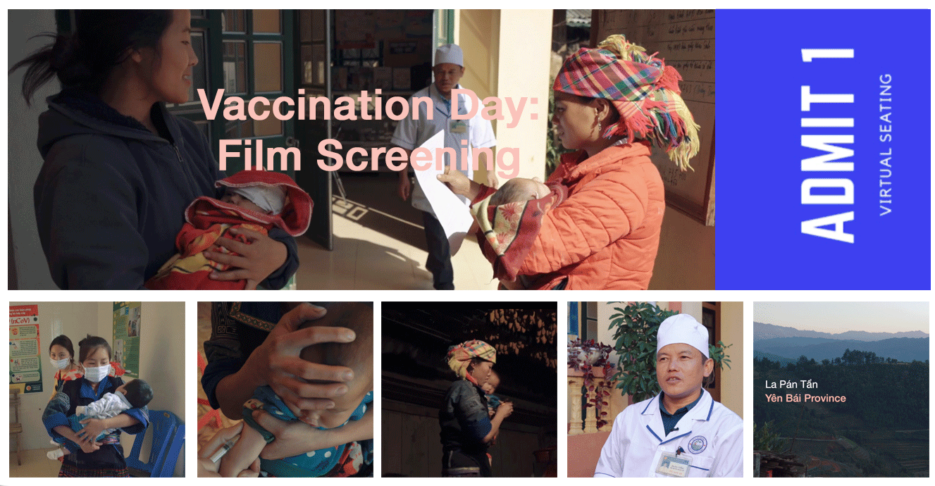








Slide 2

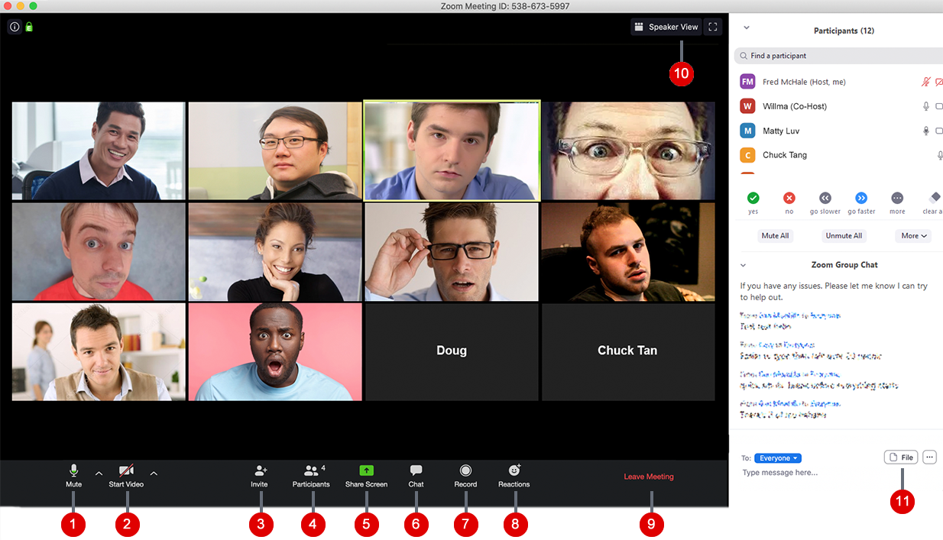
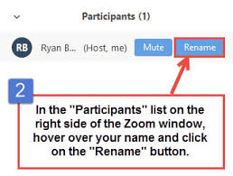

Housekeeping
Sherine, Common Thread, Romania
Felicity, Common Thread, UK

Slide 3
Housekeeping
Q&A:
We will be having a moderated Q&A discussion with our panelists during this webinar.
Please feel free to submit questions as they arise via the “Q&A” panel on your screen.
Chat:
If you have technical issues and need to contact us, use the Chat

Slide 4
Flow
Film: Journey to Immunisation in Viet Nam
Film introduction
Film screening
Discussion

Slide 5
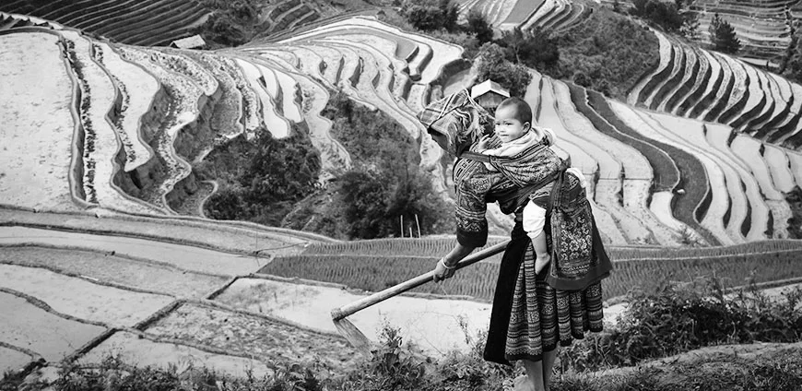


Film: Journey to Immunisation in Viet Nam
About the films

Slide 6
Setting and Context for the Films
In December 2020, in the height of the Covid-19 pandemic, LNCT commissioned Common Thread to develop two videos on building demand for immunisation in Yenbai Province, Viet Nam, amongst minority ethnic group (Hmong).
The films have been designed to create empathy for the populations most vulnerable to not being vaccinated. They are stories about real people, and how they make their vaccination choices.

Slide 7
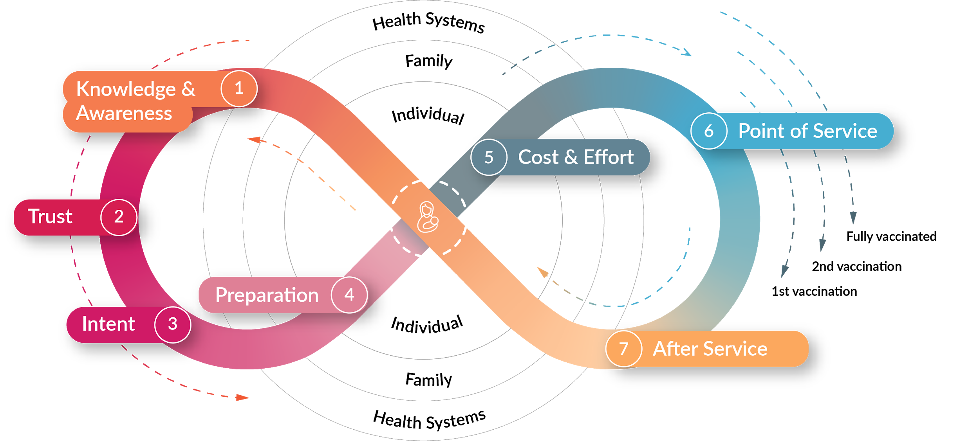
The Caregiver Journey Model
The films provide an opportunity for health workers to practice using UNICEF’s Caregiver’s Journey to Vaccination model to analyze the barriers that marginalized communities face in getting vaccinated and the strategies that health workers might adapt to build demand in these communities.
The model shows that demand side factors—such as knowledge about the immunization schedule—and supply side factors—such as people’s experience at the health clinic—can work together either to encourage—or discourage—full vaccination.

Slide 8
Using a storytelling approach
The films also show both the power of storytelling as a technique to build empathy and understanding.
Storytelling allows us to:
Empathise with those we are trying to support.
Understand the people and lives hidden behind numbers.
Change behaviour. Data doesn't change people’s minds, but stories and emotions do.
Give diverse people an opportunity to be heard

Slide 9
Aims and objectives of today
To practice using the Caregiver’s Journey as a framework for analyzing the challenges related to reaching marginalized populations with immunization services.
To capture ideas or successful strategies that helped build demand among the La Pan Tan commune in rural Vietnam.
To have a conversation about storytelling as a technique to build empathy for the people we are trying to serve with immunization and demand strategies.
Notes:
We want to show that they are multi-dimensional, human, have different needs for health services, information and engagement.
Designing health services that meet people’s unique needs is the most effective way to build demand.

Slide 10
Film Screening

Slide 11
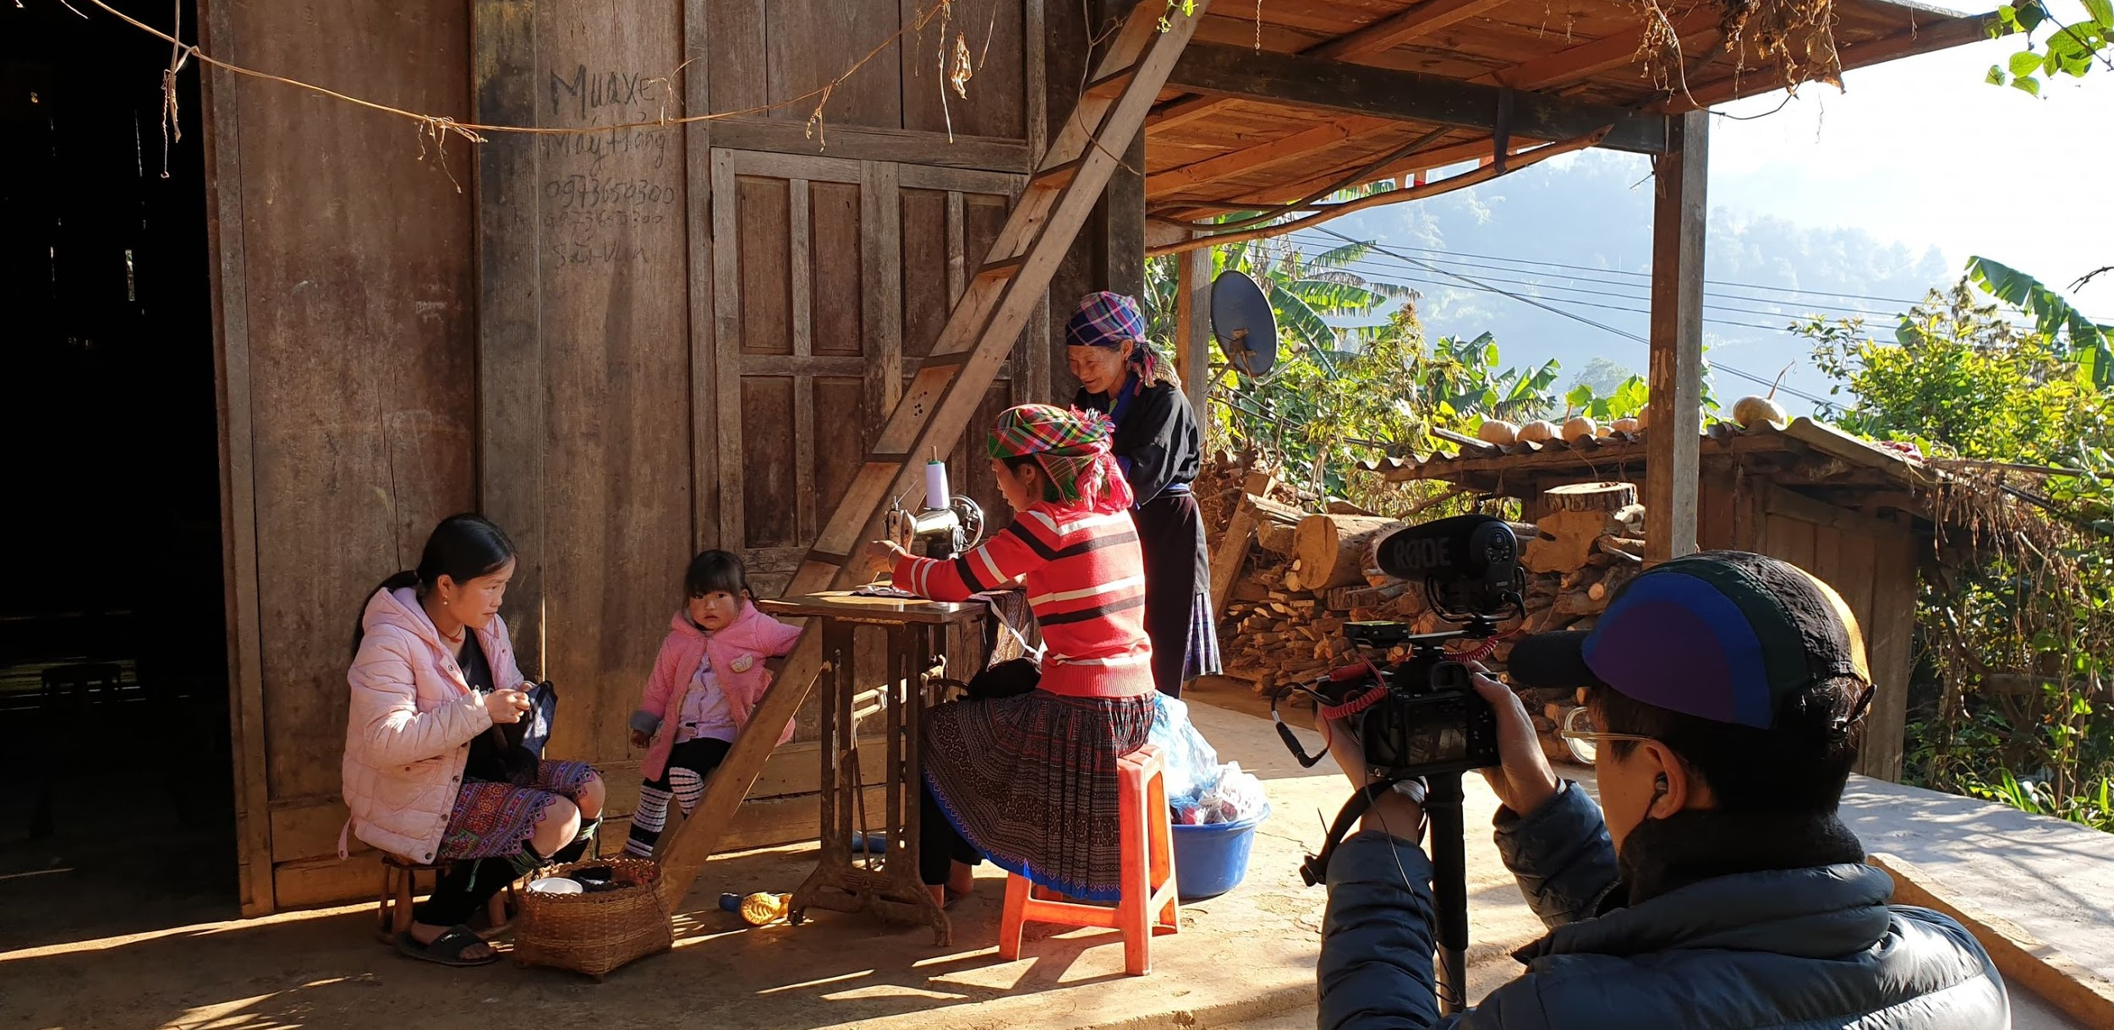
Cha’s Journey
Notes:
Link to put into the chat: https://vimeo.com/511006479
Password yenbai

Slide 12
Film: Journey to Immunisation in Viet Nam
Discussion

Slide 13
Initial observations
What did you observe about the films?
What stood out to you?

Slide 14
UNICEF’s Caregiver Journey to Vaccination
UNICEF. Demand for health services field guide. https://www.unicef.org/innovation/sites/unicef.org.innovation/files/2018-11/demand_for_healthservices_fieldguide.pdf
Notes:
The model shows that demand side factors—such as knowledge about the immunization schedule—and supply side factors—such as people’s experience at the health clinic—can work together either to encourage—or discourage—full vaccination.

Slide 15
1. Knowledge and awareness
This encompasses awareness of the health service, its purpose and where/where/how to receive it.
6. Point of service
This includes all aspects of the experience, including client satisfaction, wait times, interpersonal communication with health workers, missed opportunities and the physical environment.
2. Trust
This stage describes people trusting vaccines, health workers, and/or the experience of being vaccinated
7. After service
Short-term factors include immediate feedback, understanding the next steps and getting home from the clinic.
Long-term factors include side effects, cues to action, reminders, social reinforcement (what they tell their friends) and accepting the health service as a social norm.
3. Intent
This stage focuses on overcoming the gap between intention and behaviour. Caregiver’s at this stage intend on travelling to a health facility. Their readiness to do so is determined by (1) their attitude towards immunisation (2) their subjective norms and (3) their perceived behavioural control
4. Preparation
Preparing for a visit to a health facility includes planning the logistics of accessing the services, finding transportation, arranging child care and mitigating opportunity costs
5. Cost and effort
Cost is not only financial — there is effort to find the time and make the required trade-offs to travel to the point of service. Opportunity, transport, lost income, uncertainty of service and social and security costs are all part of this step.
UNICEF. Demand for health services field guide. https://www.unicef.org/innovation/sites/unicef.org.innovation/files/2018-11/demand_for_healthservices_fieldguide.pdf

Slide 16
Cha’s journey
Can you identify the stages of the Caregiver Journey to Vaccination model?
Knowledge and awareness: How much does Cha know about immunization? Does this family understand the benefits of vaccination?
Trust: How has trust been established between health workers and the community over time?
Intention: Are there traditional practices or views that could have obstructed vaccination, or that helped encourage vaccination? Can you spot any strategies used to counter vaccine hesitancy?
What can you tell about this family? What are the gender and social dynamics? What is the decision making structure?
Preparation: Do you think vaccination cards are useful and valued? How have health services and communication been tailored for Cha’s village?
Cost and effort: Are there financial barriers to vaccination?
Point of service: What is Cha’s experience like when she arrives at the health clinic? Do you think she will want to return? Why or why not?
Overall: What are some useful strategies that you can apply to your context?

Slide 17
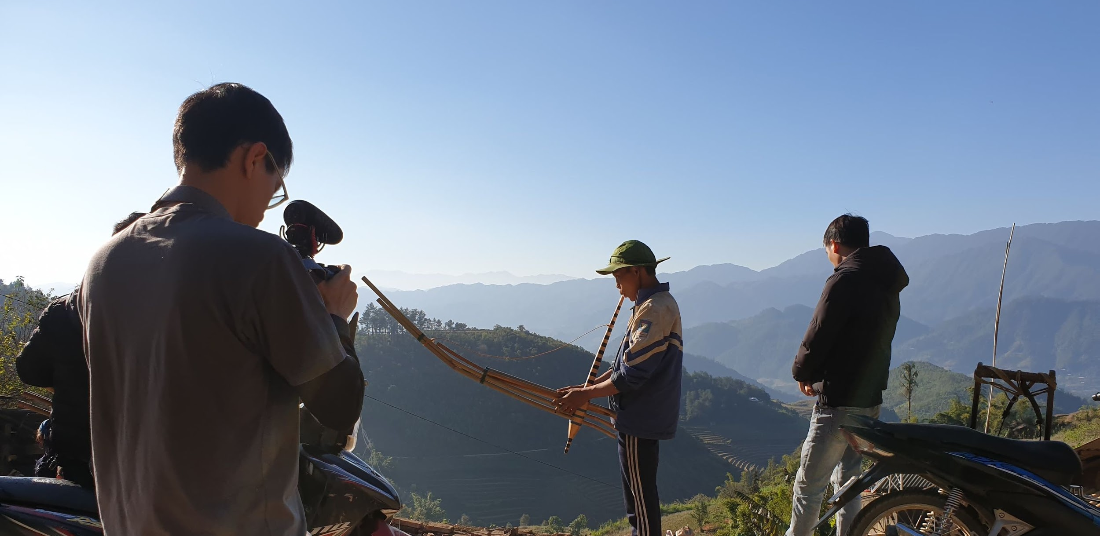
Do’s Journey
Notes:
Link to put in the chat: https://vimeo.com/511007616

Slide 18
Film: Journey to Immunisation in Viet Nam
Discussion

Slide 19
Overall Observations
What did you observe about the films?
What stood out to you?

Slide 20
Do’s journey
What can you tell about this family? How is it different or similar to Cha’s family?
Trust: Which local customs could signify a lack of trust in health workers? What actions do the health workers take to help build trust with the community?
Intention: Why does Do want to vaccinate her child? What barriers are shown impacting Do’s intention to vaccinate her child? What ultimately triggers Do to go to the vaccination clinic today?
Preparation: How have health services and communication been tailored in this context?
Cost and effort: How long does the mother need to walk to the health centre? How could vaccination be made more convenient for Do and others in her community?
Point of service: What small changes could be made to support the issues raised by health workers?
Overall: What are some useful strategies that you can apply to your context?

Slide 21
About
storytelling
Do you find this an effective approach to learn?
Do you think these videos could be useful in your context? how/why not?

Slide 22
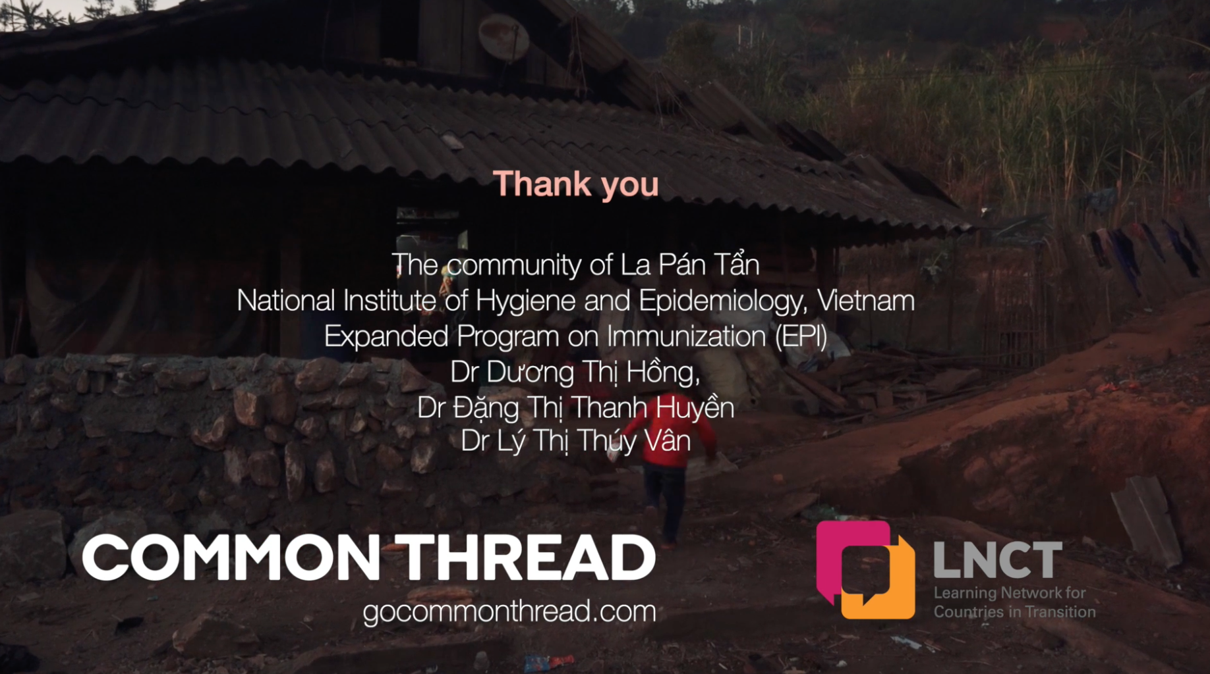






Client Project
Thank you!
Common Thread connects people to policy by listening, learning and translating local voices into long-lasting and measurable public health and development strategies.

