Slide 1

Making the Case for Investing in Immunization
Why Immunization Funding Needs to Increase (Scenarios)
Note: this presentation draws heavily on materials from the WHO Euro Immunization Advocacy Library and VoICE, The Value of Immunization Compendium of Evidence
Revised November 30 2019

Slide 2
Purpose Of Slide Set
Purpose: to give LNCT members a set of ideas for arguments for increasing (or at least maintaining) investment in immunization
Some material is intentionally repeated because it can be used for different arguments
Slides are intended to be picked out and adapted for different audiences (for example, MOF, Parliamentarians, others) and contexts
Your input needed: is this helpful? Can it be improved to be more useful to your needs and your work?

Slide 3
Scenarios That May Benefit From Specific Messages To Support Investment
1. Presenting Gavi transition requirements to decision makers
2. Presenting cold chain investment requirements to decision makers
3. Presenting evidence for a new vaccine introduction to decision makers
4. Presenting evidence for release of budget for vaccine procurement in a timely way
5. Presenting evidence to decision makers on the need for increased funding to improve coverage/ equity
6. Presenting evidence to adequately fund non-vaccine delivery costs
7. Presenting evidence for sustained commitment and funding over time
8. Presenting evidence to decision makers on vaccine safety

Slide 4
1. Presenting Gavi Transition Requirements to
Decision Makers
Key Message
Gavi transition requires a rapid increase in government co-financing {modify as appropriate for your country situation}
Transition is determined by Gavi’s eligibility policy: timeline not negotiable
Gavi support has helped country introduce X life-saving vaccines
These vaccines have a high return on investment
Dropping a vaccine from the current schedule would have negative, potentially more costly, health and economic consequences
Coverage and equity needs to be maintained or increased, which will require additional resources
Show projected budget requirements over the next few years

Slide 5
2. Presenting Cold Chain Investment Requirements to Decision Makers
Key Message
We have requested $$ in 2018 and $$ in 2019 for investments in cold chain. Modernizing our cold chain with high performing equipment will (modify as appropriate):
Reduce the running costs, by reducing reliance on kerosene, replaceable solar batteries, and ice packs
Safeguard our investment in immunization by reducing vaccine wastage (unreliable cold chain equipment exposes vaccines to excessive heat/ freezing leading to costly wastage)
Help improve coverage and equity. New passive cooling technologies will extend the geographic reach of our cold chain, enabling remote facilities to store vaccines safely.

Slide 6
3. Presenting Evidence For A New Vaccine Introduction To Decision Makers
Key Message
XX vaccine will reduce morbidity and mortality by YY and ZZ
XX vaccine will save $$$ annually in terms of reduced outpatient visits and hospitalizations
Our analysis indicates that the vaccine is highly cost-effective
XX vaccine will boost economic growth by improving productivity
XX vaccine is recommended by our National Immunization Technical Advisory Group and WHO
Our neighboring countries ____ and ____ have already introduced this vaccine

Slide 7
4. Presenting Evidence For Release Of Budget For Vaccine Procurement In A Timely Way
Key Message
Vaccine procurement needs to be planned well in advance.
UNICEF Procurement Services requires prepayment before orders will be placed.
Delays in the release of funds can lead to interruptions in supply, putting children at risk of vaccine-preventable diseases.
Releasing most of the funds for vaccine procurement by the end of the 1st quarter of the fiscal year is best practice

Slide 8
5. Presenting Evidence To Decision Makers On The Need For Increased Funding To Improve Coverage/ Equity
Key Message
We have pockets of low immunized groups in urban slums, among nomadic groups {insert country specific details…}
To reach these populations we need: (approach will be country specific…)
  More overall funding for primary health care?
  More funding for new community based interventions in certain areas?
  Cold chain upgrade…?
  Social mobilization measures to increase demand?
  Etc.

Slide 9
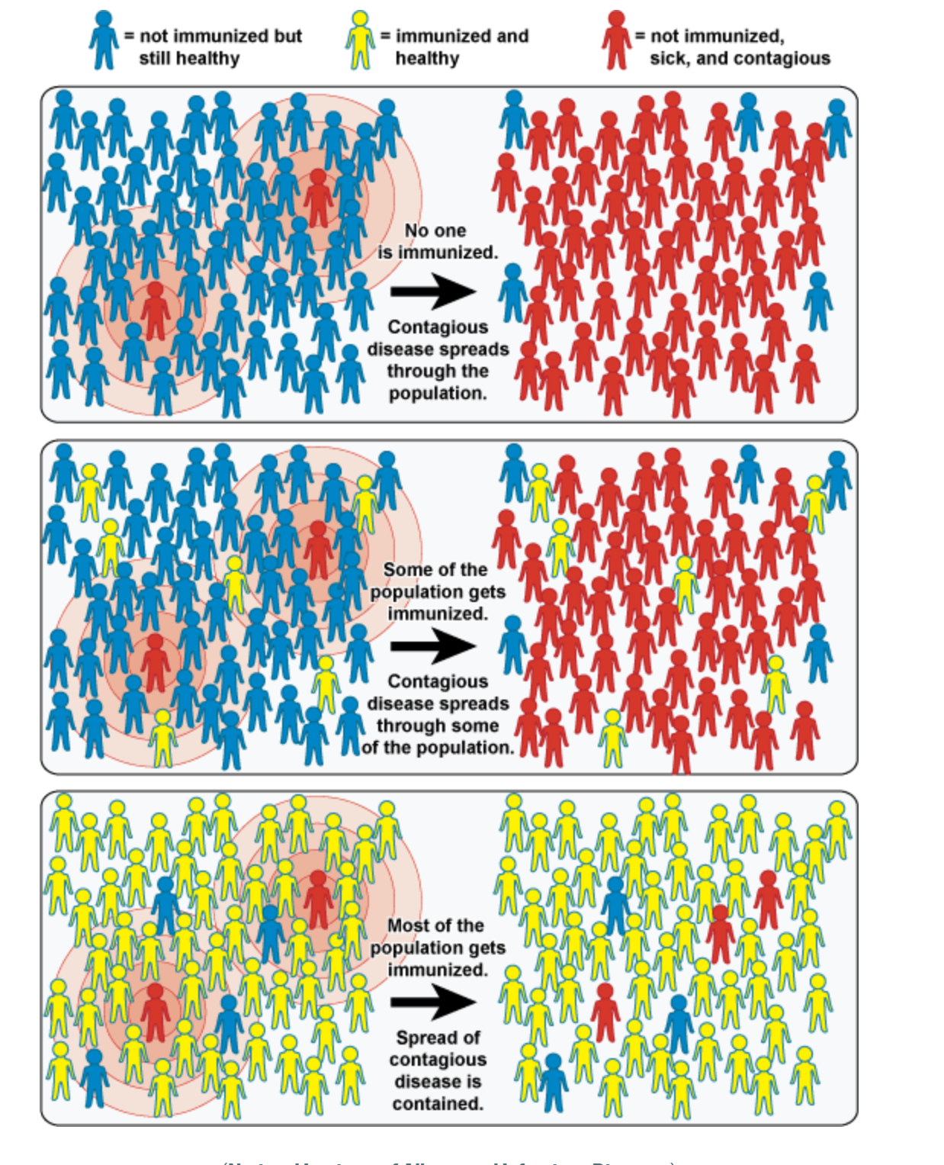
We Need To Achieve High Coverage To Contain The Spread Of Contagious Disease: How Vaccines Protect Our Population
Key Message
Source: National Institute of Allergy and Infectious Diseases

Slide 10
Low Coverage Means Contagious Disease Can Spread Rapidly In The Population
Key Message
Source: National Institute of Allergy and Infectious Diseases

Slide 11
6. Immunization programs are more than funding vaccines—we need to fully fund the operational costs of programs and delivery strategies
Key Message
Programs depend not only on vaccines but all the program elements to effectively deliver them and monitor progress:
  supply chain systems
  monitoring and surveillance
  planning and supportive supervision
  staff training
  Outreach
To deliver immunization services efficiently, these non-vaccine operational costs must be adequately funded as well, otherwise investments in vaccines could be wasted
Immunization programs depend on strong primary health care systems

Slide 12
9. Presenting Evidence For Sustaining Commitment And Funding Over Time…
Data
When programs falter, there have been dire consequences…
Japan, 1979, Pertussis*
Immunization rates fell from 80% in 1974 to 10% in 1976
Result: 13,000 cases / 41 deaths
Former USSR, 1990-1999, Diphtheria**
Breakdown of public health services
Result: 150,000 cases / 5,000 deaths
Sweden, 1979-1996, Pertussis***
Government lapse in vaccination
Result: 60% infected before age 10
Ireland, 2000, Measles†
Vaccine refusal
Result: 300 cases / 3 child deaths
Vietnam, 2013, HepB‡
Coverage drop following publicity surrounding Adverse Events Following Immunization for the pentavalent vaccine
Expected result from the one year drop in coverage: In the 2013 birth cohort, more than 17,000 future deaths from chronic hepatitis B infection (liver cancer, liver cirrhosis) and more than 90,000 chronic infections.
* https://www.cdc.gov/vaccines/vac-gen/why.htm
** https://wwwnc.cdc.gov/eid/article/4/4/98-0404_article
***https://www.ncbi.nlm.nih.gov/pubmed/8483621
† https://www.ncbi.nlm.nih.gov/pubmed/12867830
‡ https://www.ncbi.nlm.nih.gov/pubmed/26055296

Slide 13
8. Presenting Evidence To Decision Makers On Vaccine Safety
Key Message
Vaccines are safe.
  Licensing of a vaccine requires exhaustive evaluation and testing to make sure that it is both safe and effective.
  Following prequaliﬁcation and licensing, WHO continues to monitor the vaccine, and any serious side effect reported is thoroughly investigated.
Vaccines are still needed, even if the diseases have become uncommon.
Combined vaccines:
  Save time and money through fewer clinic visits;
  Reduce discomfort for the child through fewer injections;
  Increase the probability that the child will receive the complete set of vaccinations according to the national schedule.
Quoted from documents in WHO EURO’s Vaccination and Trust Library, where much more useful material is available. See: http://www.euro.who.int/en/health-topics/disease-prevention/vaccines-and-immunization/publications/vaccination-and-trust-library-1

Slide 14
VoICE is an excellent source of information on the value of immunization
https://immunizationevidence.org/
Easy to use and regularly updated

