Slide 1

Making the Case for Investing in Immunization
Promoting Economic Growth through Immunization
Note: this presentation draws heavily on materials from the WHO Euro Immunization Advocacy Library and VoICE, The Value of Immunization Compendium of Evidence
Revised November 30 2019

Slide 2
Purpose Of Slide Set
Purpose: to give LNCT members a set of ideas and graphics for arguments for investment in immunization
Some material intentionally repeated because it can be used for different arguments
Slides intended to be picked out and adapted for different audiences (for example, MOF, Parliamentarians, others) and contexts

Slide 3

Economic growth gains from immunization arguments in red, below
Prevention of antimicrobial resistance
Platform for outbreak preparedness (#3)
Entry point for health service delivery and core component Universal Health Coverage
Reduced future burden on health system
Productivity gains (#1)
Improved health, reduced mortality
Better cognition, educational attainment, nutrition (#2)
Best buy for health
Pro-poor intervention
Adapted from Palu, T. (2016).
Sustainable Immunization Through Universal Health Coverage. World Bank SAGE Meeting.

Slide 4
#1 Immunization Generates Large Economic Gains
Key Message
Return on investment analyses quantify the benefits of immunization in monetary terms.
Recent work shows that every $1 invested in immunization brings an estimated…
These returns on investment are made up of:
Savings in treatment costs
Savings in costs of seeking treatment
Averted losses in caretaker wages
Averted losses in productivity from illness and premature death
The largest gains are in productivity.
$16
in benefits
These analyses show that immunization is an excellent investment. Comparative analyses show that immunization is one of the development investments with the best value for money.
Source: Ozawa et al. Return on Investment from Childhood Immunizations in Low- and Middle-
Income Countries, 2011-20, Health Affairs, February 2016.

Slide 5
#2 Immunization strengthens children’s educational prospects and cognitive development
Key Message
Growing body of evidence shows that:
Immunized children miss less school
Recurring vaccine-preventable infections can cause children to delay their start of school, stunt their physical development, and impair their cognitive development
Some vaccine-preventable infections can result in long term hearing, psychosocial, and neurological disabilities
Children vaccinated with measles vaccine stored better on cognitive tests than unvaccinated children
Children whose mothers received a tetanus vaccine in pregnancy had better educational attainment than those who did not
For more information, see: https://immunizationevidence.org/

Slide 6
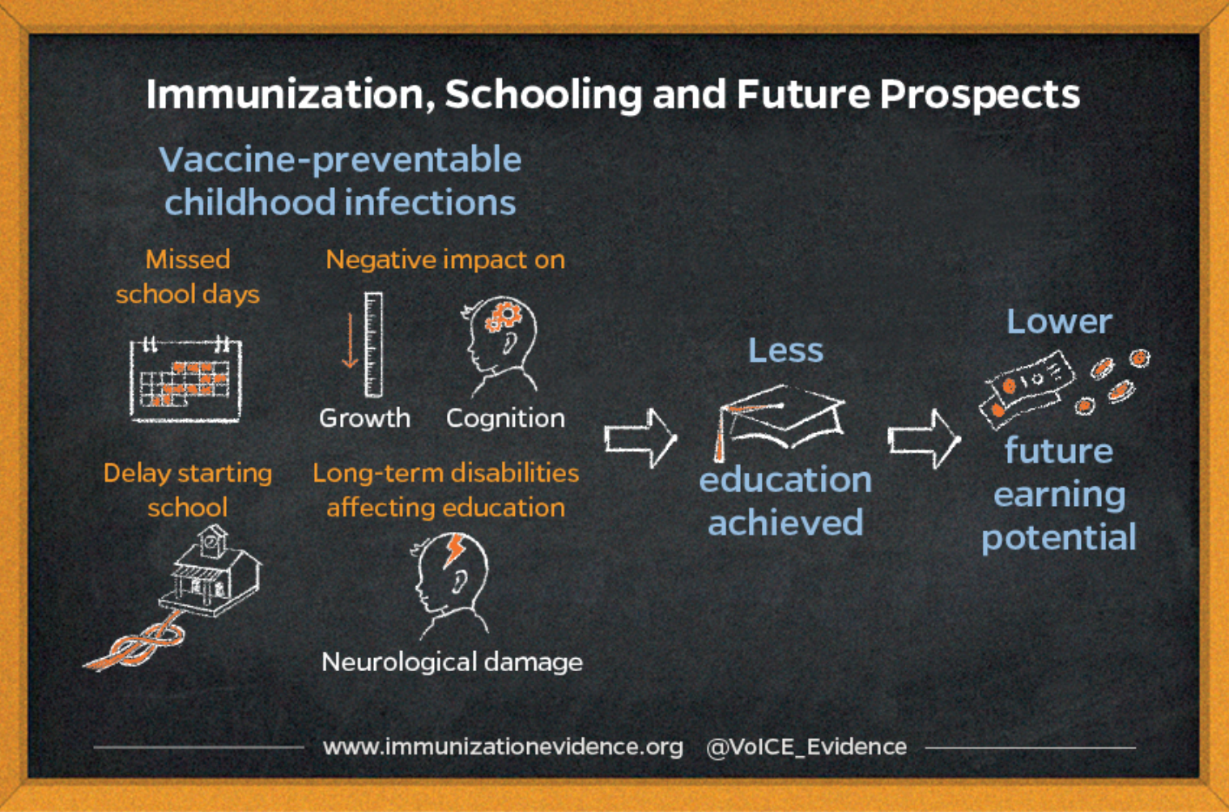
Recap: Immunization strengthens children’s educational prospects and cognitive development
Key Message

Slide 7
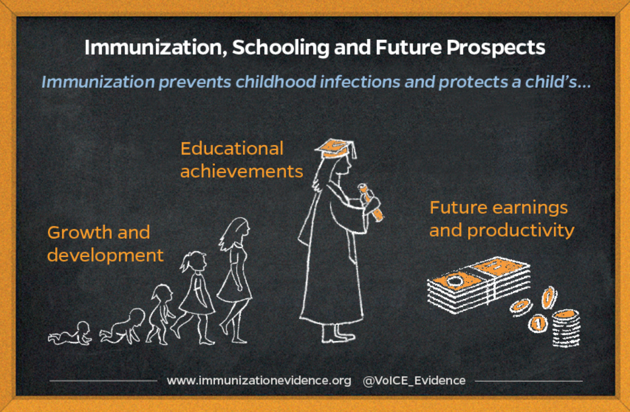
Immunization’s improvements in child health and education → more earnings & improved productivity as an adult
Key Message
The World Bank estimates that in Africa, an additional year of school yields a 12.4% in future adult earnings
Returns are highest in low and middle income countries

Slide 8
#3 Strong Immunization Programs Are A Platform For Outbreak Prevention and Preparedness (1/2)
Key Message
Disease outbreaks have been on the rise for the past several decades and have large human and economic costs.
  Large disease outbreaks can severely damage the economy and slow growth by hurting trade, tourism, manufacturing, transport.
  The countries hardest hit by the 2014-15 Ebola outbreak in West Africa lost about 5% of GDP.*
  South Korea suffered over $1b in economic losses from the MERS outbreak in 2015.*
  Expected global losses from pandemic influenza modeled at 0.7% of global GDP.*
*Reported in World Bank. 2017. From panic and neglect to investing in health security: financing pandemic preparedness at a national level. Washington, D.C.

Slide 9
#3 Strong Immunization Programs Are A Platform For Outbreak Prevention and preparedness (2/2)
Key Message
Immunization can directly prevent outbreaks of some diseases, including yellow fever, cholera, meningitis, measles, and Japanese encephalitis, for which vaccines already exist.
Strong immunization programs allow countries to respond quickly when new vaccines against additional outbreak diseases become available.
Full immunization for health workers is vital.
Epidemic preparedness plans, public health communications, and infectious disease surveillance also critically important

Slide 10
Using Data To Show That Your Country’s Immunization Achieves Clear Economic Results (and more needs to be done)
Data
Data Requirements | Hypothetical Analysis Example:
Immunization coverage overall and by district or subgroups of the population | We have made solid progress in immunization coverage as a country, but children in _____ and ______ districts are at much higher risk of vaccine-preventable illnesses. Increased investment in immunization to reach these families could improve education attainment and cognition, which translates to higher productivity and economic growth in the long term.

Slide 11
VoICE is an excellent source of information on the value of immunization
https://immunizationevidence.org/
Easy to use and regularly updated

