Slide 1

Making the Case for Investing in Immunization
Improving Child Health & Survival through Immunization
Note: this presentation draws heavily on materials from the WHO Euro Immunization Advocacy Library and VoICE, The Value of Immunization Compendium of Evidence
Revised November 30 2019

Slide 2
Purpose Of Slide Set
Purpose: to give LNCT members a set of ideas and graphics for arguments for investment in immunization
Some material intentionally repeated because it can be used for different arguments
Slides intended to be picked out and adapted for different audiences (for example, MOF, Parliamentarians, others) and contexts

Slide 3

Health and child survival gains from immunization in red, below
Prevention of antimicrobial resistance (#4)
Platform for outbreak preparedness (#3)
Entry point for health service delivery and core component Universal Health Coverage (#2)
Reduced future burden on health system
Productivity gains
Improved health, reduced mortality (#1)
Better cognition, educational attainment, nutrition
Best buy for health
Pro-poor intervention
Adapted from Palu, T. (2016).
Sustainable Immunization Through Universal Health Coverage. World Bank SAGE Meeting.

Slide 4
#1 Immunization Leads To Improved Health And Reduced Mortality
Key Message
Today, immunization against deadly diseases already prevents between 2 and 3 million deaths each year. Even more lives could be saved with higher coverage of existing vaccines. Most of these lives saved are children.
New, lifesaving vaccines will continue to be developed that will be important for our country.
Immunization can make possible the complete elimination of feared diseases.
For example, it led to the eradication of smallpox in 1979 and has brought polio eradication within our sight—in 1988 there were 350,000 new cases annually, this fell to 37 in 2016 and to 16 in 2017 (as of December 4, 2017).
http://polioeradication.org/polio-today/polio-now/
http://www.who.int/campaigns/immunization-week/2017/infographic/en/
http://www.who.int/csr/disease/smallpox/en/

Slide 5
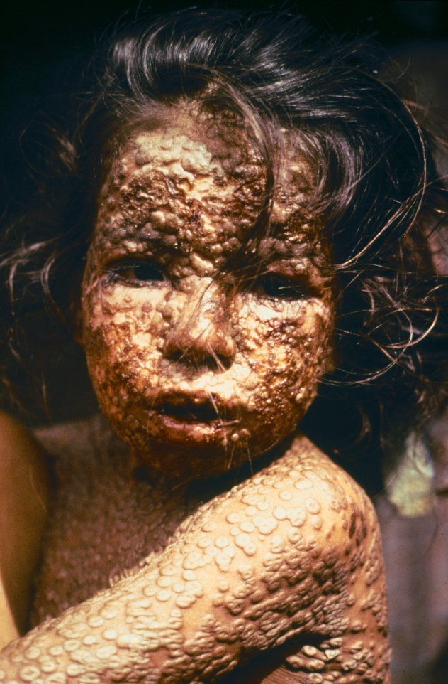
Example- Immunization Led To The Eradication of Smallpox
Smallpox is a devastating disease. On average, 3 out of every 10 people who contracted smallpox died. Smallpox may have been responsible for 300m deaths in the 20th century.
The last known natural case of smallpox occurred in Somalia in 1977. The disease was declared eradicated in 1980, following a lengthy global eradication program.
Eradication of disease is not always possible, but when it is, it has the added benefit that countries no longer have to spend resources on controlling it.
Photo: Young girl in Bangladesh infected with smallpox in 1973
Photo Credit: CDC/James Hicks, public domain, via Wikimedia Commons: http://www.who.int/csr/disease/smallpox/en/

Slide 6
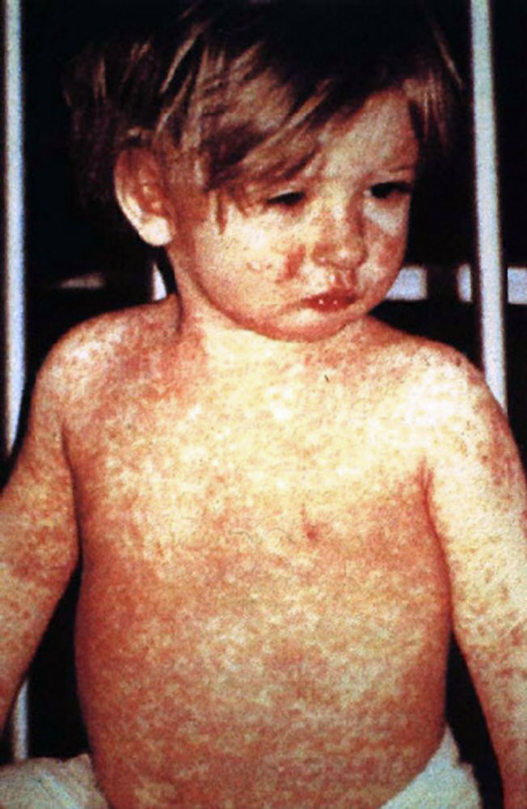
Example- Measles Vaccine Has Led To A 99% Reduction In Measles Cases Compared With The Pre-vaccine Era
Measles is a highly contagious and serious disease.
Before the introduction of the measles vaccine in 1963 and widespread vaccination, measles caused approximately 2.6m deaths a year.
The measles vaccine is safe, effective, and inexpensive.
Despite the vaccine, low coverage in some countries means that measles is still one of the leading causes of death in young children globally.
Photo: Child with measles rash
Photo Credit: CDC/NIP/Barbara Rice, public domain, via Wikimedia Commons: http://www.who.int/mediacentre/factsheets/fs286/en/

Slide 7
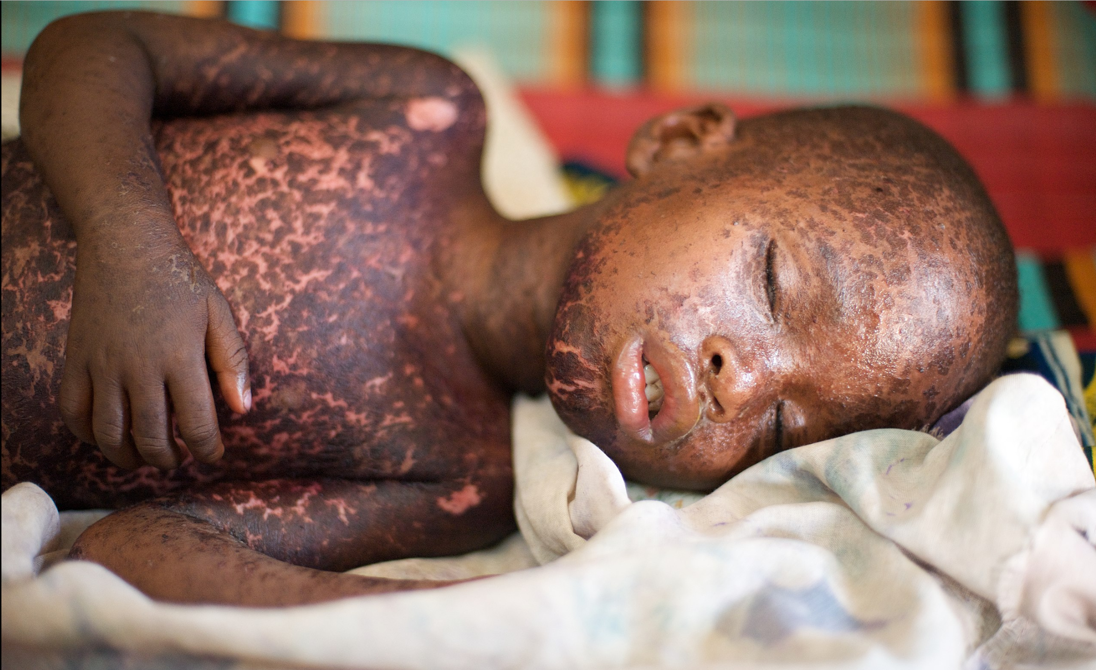
Example- Even if children survive measles, the disease inflicts devastating harm on their immune system
Measles “resets” the immune system
in infected persons leaving them
highly vulnerable to other infections,
even if they survive measles.
It may take several years for the
protective immune system to
be restored.
Measles vaccines therefore has two
huge benefits: protection against
measles infection, and protection against the broader loss of immune system functions that result from measles.*
* Michael Mina et al. Measles virus infection diminishes preexisting antibodies that offer protection from other pathogens. Science 01 Nov 2019: Vol 366, issue 6465, pp 599-606.
Photo: https://commons.wikimedia.org/wiki/Category:Measles#/media/File:Child_with_measles.jpg

Slide 8
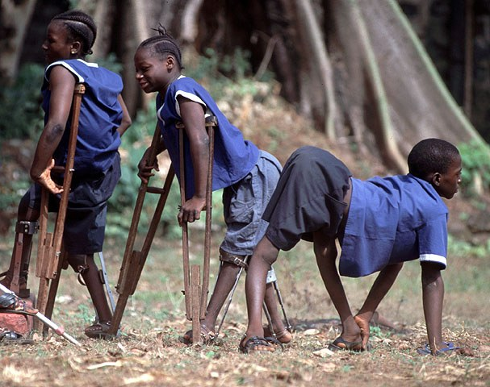
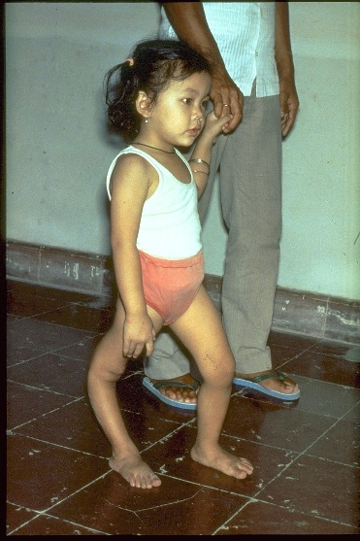
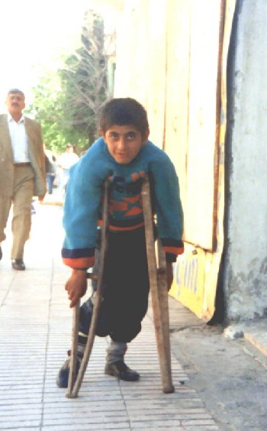
Example- Polio Cases Have Fallen By 99% Since 1988
Polio is a highly infectious disease caused by a virus. It mainly affects children under 5. One in 200 infectious cases leads to irreversible paralysis. There is no cure, only prevention. Partners and countries are working to eradicate polio.
Photo 1: Polio survivors in Freetown, Sierra Leone. Credit: WHO, via Immunization Action Coalition
Photo 2: Child with deformed leg due to polio. Credit: WHO, via Immunization Act
Photo 3: Boy with paralysis from polio infection. Credit: WHO Regional Office for Europe, via Immunization Action Coalition

Slide 9
Example-Reduction in Group A Meningococcus cases
The introduction of Meningococcal A conjugate vaccine in 9 countries in Africa’s meningitis belt has reduced the cases of meningitis from Group A Meningococcal in fully vaccinated populations by more than 99%¹
Nine countries: Benin, Burkina Faso, Chad, Côte d'Ivoire, Ghana, Mali,
Niger, Nigeria, Togo
¹ Trotter CL, Lingani C, Fernandez K et al. Impact of MenAfriVac in nine countries of the African meningitis belt, 2010-15: an analysis of surveillance data. Lancet Infectious Diseases 2017; 17(8):867-872.

Slide 10
#2 Immunization Is An Entry Point For Health Service Delivery
Key Message
The immunization schedule requires multiple contact points between the mother and child especially in the first year of life
For example, vaccines as soon as possible after birth, at 6 weeks of life, 8 weeks, 10 weeks, 14 weeks, 6 months, 9 months, 12 months
Immunization is a platform for integrating other health services, including for example Vitamin A, deworming, family planning
Immunization services rely on strong primary health care services

Slide 11
#2 Immunization Is A Core Component of Progress Towards Universal Health Coverage (UHC)
Key Message
UHC means ensuring that everyone has access to quality health services without financial hardship or the risk of being forced into poverty
Immunization is one of the most cost-effective life-saving health interventions
Making immunization accessible and affordable by including it in the essential services package or the national health insurance system’s benefits package is a critical step towards achieving UHC
Source: Immunization Financing Resource Guide (2017). Available at: http://www.immunizationfinancing.org/en/immunization-fundamentals/universal-health-coverage-and-immunization-financing#!

Slide 12
#3 Strong Immunization Programs Are A Platform For Outbreak Prevention and Preparedness (1/2)
Key Message
Disease outbreaks have been on the rise for the past several decades and have large human and economic costs.
  Large disease outbreaks can severely damage the economy and slow growth by hurting trade, tourism, manufacturing, transport.
  The countries hardest hit by the 2014-15 Ebola outbreak in West Africa lost about 5% of GDP.*
  South Korea suffered over $1b in economic losses from the MERS outbreak in 2015.*
  Expected global losses from pandemic influenza modeled at 0.7% of global GDP.*
*Reported in World Bank. 2017. From panic and neglect to investing in health security: financing pandemic preparedness at a national level. Washington, D.C.

Slide 13
#3 Strong Immunization Programs Are A Platform For Outbreak Prevention and preparedness (2/2)
Key Message
Immunization can directly prevent outbreaks of some diseases, including yellow fever, cholera, meningitis, measles, and Japanese encephalitis, for which vaccines already exist.
Strong immunization programs allow countries to respond quickly when new vaccines against additional outbreak diseases become available.
Full immunization for health workers is vital.
Epidemic preparedness plans, public health communications, and infectious disease surveillance also critically important

Slide 14
#4 Immunization programs can counteract antimicrobial resistance, one of the greatest health challenges facing the world by:
Key Message
Reducing disease incidence, including sensitive and resistant infections, which in turn reduces the incidence and severity of resistant infections
Reducing disease incidence also reduces the use of antimicrobials (both appropriate and inappropriate)
If pneumococcal conjugate vaccine were universally introduced in all low and low-middle income countries, it would avert an estimated 11.4m days of antibiotic use, a 47% reduction ¹
“Resistance is inevitable when antibiotics are used…a continual pipeline of antibiotics is needed” but “Vaccines can be used for decades without generating significant resistance”²
¹Laxminarayan R, Matsoso P, Pant S, Brower C, Rottingen J.A. et al. Access to effective antimicrobials: a worldwide challenge. The Lancet. 2016 Jun;387(10036):168-75
² https://www.pnas.org/content/115/51/12868.full

Slide 15
Using Data To Support Prioritization Of Health Within The Government Budget And Prioritization Of PHC Within Health
Data
Country Data Requirements | Example Analysis
Share of total government expenditures to MOH from this year’s budget and previous years | Over time, is the figure growing, stable, declining? Does it approach the Abuja target of 15% of government spending to health?
Share of total MOH budget for PHC (how to measure this will depend on how your budget is organized) | Is this figure growing, stable, declining over time?
WHO database on health expenditure. http://apps.who.int/nha/database/Select/Indicators/en Download “General Government Health Expenditure (GGHE) as % of General Government Expenditures (GGE) for countries you wish to examine | How does our share of government spending on health compare to peer countries?

Slide 16
Illustration: “Our Country Is Lagging Behind In Investing In Health”
Data
Argument for investment: Our country’s government health spending as a percent of total government spending is low: almost half the average for all LMICs, and much less than our neighboring countries
Government health spending as percent of total government spending
Our country
Source: http://apps.who.int/nha/database/Home/Index/en

Slide 17
Illustration: “Our Country Is Lagging Behind In Investing In Health”
Data
Argument for investment- Government spending on health in our country is well under of the lower middle income country average, and well below that of our key neighbors
Domestic public spending on health per capita, 2016
https://apps.who.int/nha/database/Select/Indicators/en
Estimate of lower middle income country average calculated by LNCT.
Source:

Slide 18
Using Data To Show That Your Country’s Immunization Achieves Clear Health Results (and more needs to be done) (1/2)
Data
Data Requirements | Hypothetical Analysis Example:
Immunization coverage, number of surviving one year old, coverage by districts | Our country has made major gains in immunization, achieving 87% coverage. That translates to 1,035,000 fully immunized children*. But more needs to be done…there are 155,000 unimmunized children. There is also uneven coverage, with only 45% of children in XX district that are fully immunized. *measured by DTP3 coverage
Outpatient visits and hospitalization admissions for a vaccine-preventable disease over time, average costs for an outpatient visit and a hospitalization | Vaccination not only improves health but can generate large savings in health costs. For example, our introduction of rotavirus vaccine is estimated to have: Cut outpatient visits for diarrheal disease from 605,000 to 190,000 per year. At an estimated costs of $27 per outpatient visit, this is a large saving. Cut hospitalizations from 16,090 to 2,250 per year. At an estimated cost of $211 per visit, this generates further savings. Total savings in hospitalization and outpatient visits: US$15m annually.

Slide 19
Using Data To Show that Your Country’s Immunization Achieves Clear Health Results (and more needs to be done) (2/2)
Data
Data Requirements | Hypothetical Analysis Example:
Deaths from a vaccine-preventable disease over time | With our immunization program, deaths from measles have declined by 80% (deaths per 100,000 population) since 1990.
Deaths from a vaccine-preventable disease that has not yet been introduced, projected vaccine coverage, vaccine effectiveness | With the introduction of rotavirus vaccine, we estimate that we would cut the number of deaths due to diarrhea by XX, and the number of hospitalizations by YY. With the introduction of PCV, we estimate that we would cut the number of pneumonia and invasive disease cases and deaths by 33% and the related hospital cost by YY
Introductions by your country compared to peer countries | We have made solid progress in introducing lifesaving new vaccines, with the introduction of pentavalent and rotavirus vaccines. But more needs to be done. Our neighboring countries are progressing more rapidly. They have also introduced PCV and HPV vaccines, which are next on our priority list. But we need to increase our budget to deliver these important vaccines.

Slide 20
LNCT Country Examples of Using Data to Show That Their Immunization Program Achieves Clear Health Results
Data
Data Requirements | Evidence
Disease burden | Sri Lanka: Linked investment in immunization to the decrease in disease burden Ghana: In addition to quantitative evidence, showed compelling anecdotal evidence of decreased MenA burden
Hospitalization from vaccine preventable diseases | Georgia: Analyzed reduced hospitalization for vaccine-preventable conditions Armenia: Showed reduction of child hospitalization due to rotavirus infection after the vaccine was introduced

Slide 21
Supporting Messages From The Literature
Data
Intervention | Evidence
Hib vaccination | A study in Uzbekistan showed that Hib vaccination for one birth cohort is predicted to prevent about 350 deaths annually in children less than 5 years of age Citation: Griffiths UK, Clark A, Shimanovich V, Glinskaya I, Tursunova D, Kim L, et al. (2011) Comparative Economic Evaluation of Haemophilus influenzae Type b Vaccination in Belarus and Uzbekistan. PLoS ONE 6(6): e21472. doi:10.1371/journal.pone.0021472.
Immunization, prevented deaths | Worldwide, immunization saves approximately 2.5 million deaths each year Link to data: http://who.int/immunization/newsroom/global_immunization_data_july_2014.pdf

Slide 22
Extra infographics

Slide 23
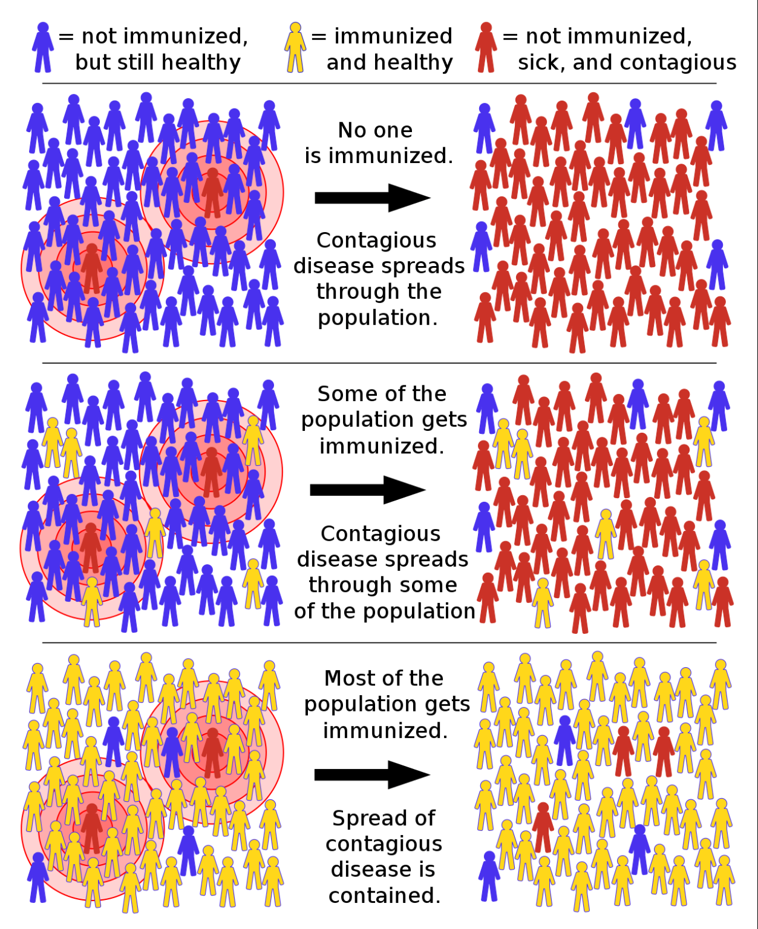
How high immunization coverage protects the population
https://en.wikipedia.org/wiki/Herd_immunity

Slide 24
VoICE is an excellent source of information on the value of immunization
https://immunizationevidence.org/
Easy to use and regularly updated

