Slide 1
Telling the Story- Why Investing In Immunization Is A Priority For Our Country
Part 1: Examples of key messages and supporting data for different investment needs
Note: this presentation draws heavily on materials from the WHO Euro Immunization Advocacy Library as well as other work. Copies of materials from the Immunization Advocacy Library are available at this meeting.

Slide 2
Purpose Of Slide Set
Purpose: to give LNCT members a set of ideas for arguments for increasing (or at least maintaining) investment in immunization
Some material is intentionally repeated because it can be used for different arguments
Slides are intended to be picked out and adapted for different audiences (for example, MOF, Parliamentarians, others) and contexts
Your input needed: is this helpful? Can it be improved to be more useful to your needs and your work?

Slide 3

Why Is Immunization An Important Investment?
Platform for pandemic preparedness
Reduced future burden on health system
Entry point for health service delivery
Productivity gains
Improved health, reduced mortality
Better cognition, educational attainment, nutrition
Best buy for health
Pro-poor intervention
Adapted from Palu, T. (2016).
Sustainable Immunization Through Universal Health Coverage. World Bank SAGE Meeting.

Slide 4
Why Might Immunization Requirements Increase Over Time?
Rapid increase in vaccine co-financing during Gavi transition
Upgrading supply chain
New vaccine introductions
Other measures to improve coverage, reach special populations
Growing birth cohort
Greater attention to adequate funding of operating costs

Slide 5
Slides 6-32 present examples of key messages and data to support investments in immunization from three perspectives:
HEALTH, ECONOMIC GROWTH, AND EFFICIENCY

Slide 6
If your decision makers are most interested in improving HEALTH AND CHILD SURVIVAL

Slide 7
Immunization Leads To Improved Health And Reduced Mortality
Key Message
Today, immunization against deadly diseases already prevents between 2 and 3 million deaths each year. Even more lives could be saved with higher coverage of existing vaccines. Most of these lives saved are children.
New, lifesaving vaccines will continue to be developed that will be important for our country.
Immunization can make possible the complete elimination of feared diseases.
For example, it led to the eradication of smallpox in 1979 and has brought polio eradication within our sight—in 1988 there were 350,000 new cases annually, this fell to 37 in 2016 and to 16 in 2017 (as of December 4, 2017).
http://polioeradication.org/polio-today/polio-now/
http://www.who.int/campaigns/immunization-week/2017/infographic/en/
http://www.who.int/csr/disease/smallpox/en/

Slide 8
Immunization Is An Entry Point For Health Service Delivery
Key Message
The immunization schedule requires multiple contact points between the mother and child especially in the first year of life
For example, vaccines as soon as possible after birth, at 6 weeks of life, 8 weeks, 10 weeks, 14 weeks, 6 months, 9 months, 12 months
Immunization is a platform for integrating other health services, including for example Vitamin A, deworming, family planning
Immunization services rely on strong primary health care services

Slide 9
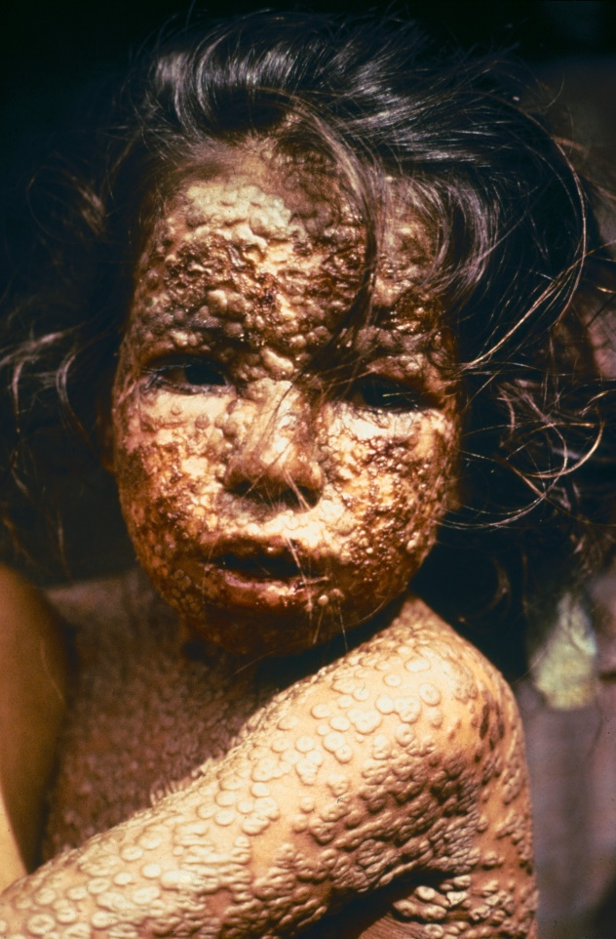
Example- Immunization Led To The Eradication of Small Pox
Smallpox is a devastating disease. On average, 3 out of every 10 people who contracted smallpox died. Smallpox may have been responsible for 300m deaths in the 20th century.
The last known natural case of smallpox occurred in Somalia in 1977. The disease was declared eradicated in 1980, following a lengthy global eradication program.
Eradication of disease is not always possible, but when it is, it has the added benefit that countries no longer have to spend resources on controlling it.
Photo: Young girl in Bangladesh infected with smallpox in 1973
Photo Credit: CDC/James Hicks, public domain, via Wikimedia Commons: http://www.who.int/csr/disease/smallpox/en/

Slide 10
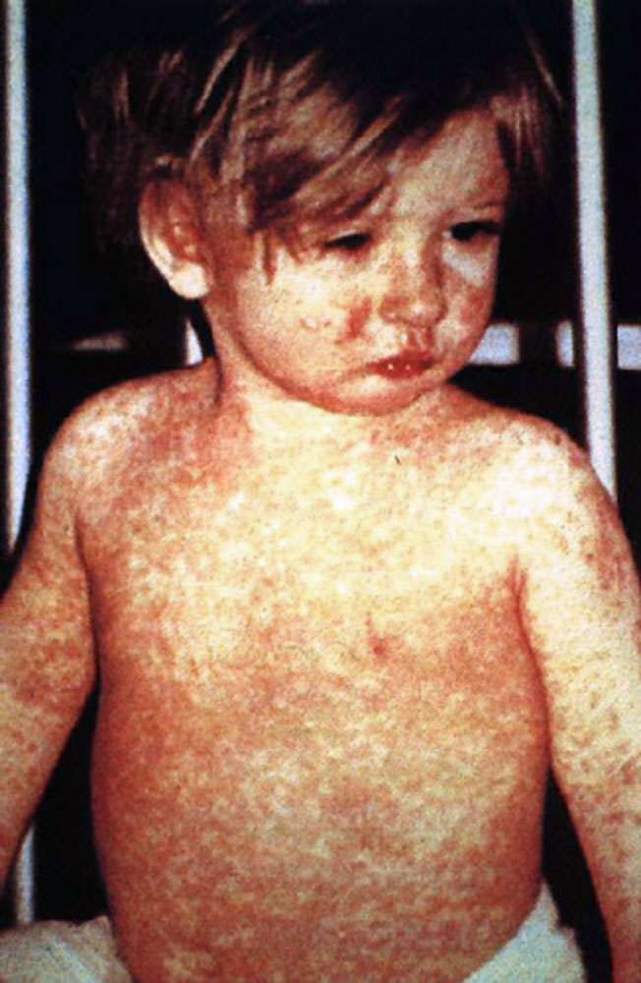
Example- Measles Vaccine Has Led To A 99% Reduction In Measles Cases Compared With The Pre-vaccine Era
Measles is a highly contagious and serious disease.
Before the introduction of the measles vaccine in 1963 and widespread vaccination, measles caused approximately 2.6m deaths a year.
The measles vaccine is safe, effective, and inexpensive.
Despite the vaccine, low coverage in some countries means that measles is still one of the leading causes of death in young children globally.
Photo: Child with measles rash
Photo Credit: CDC/NIP/Barbara Rice, public domain, via Wikimedia Commons: http://www.who.int/mediacentre/factsheets/fs286/en/

Slide 11
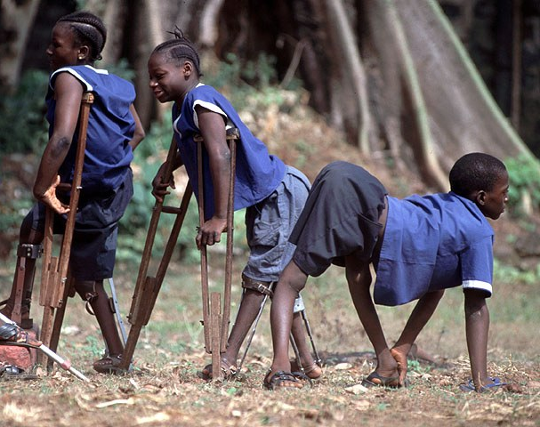
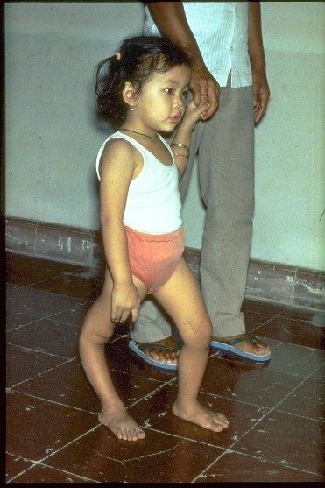
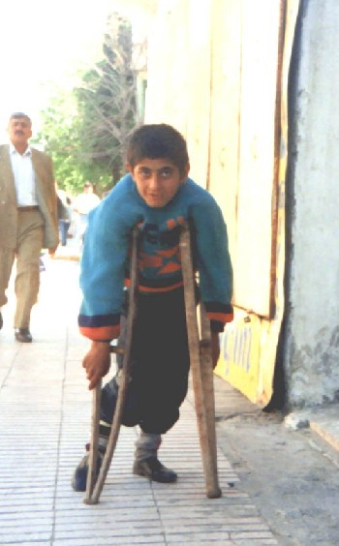
Example- Polio Cases Have Fallen By 99% Since 1988
Polio is a highly infectious disease caused by a virus. It mainly affects children under 5. One in 200 infectious cases leads to irreversible paralysis. There is no cure, only prevention. Partners and countries are working to eradicate polio.
Photo 1: Polio survivors in Freetown, Sierra Leone. Credit: WHO, via Immunization Action Coalition
Photo 2: Child with deformed leg due to polio. Credit: WHO, via Immunization Act
Photo 3: Boy with paralysis from polio infection. Credit: WHO Regional Office for Europe, via Immunization Action Coalition

Slide 12
Using Data To Support Prioritization Of Health Within The Government Budget And Prioritization Of PHC Within Health
Data
Country Data Requirements | Example Analysis
Share of total government expenditures to MOH from this year’s budget and previous years | Over time, is the figure growing, stable, declining? Does it approach the Abuja target of 15% of government spending to health?
Share of total MOH budget for PHC (how to measure this will depend on how your budget is organized) | Is this figure growing, stable, declining over time?
WHO database on health expenditure. http://apps.who.int/nha/database/Select/Indicators/en Download “General Government Health Expenditure (GGHE) as % of General Government Expenditures (GGE) for countries you wish to examine | How does our share of government spending on health compare to peer countries?

Slide 13
Illustration: “Our Country Is Lagging Behind In Investing In Health”
Data
Argument for investment: Our country’s government health spending as a percent of total government spending is low: almost half the average for all LMICs, and much less than our neighboring countries
Government health spending as percent of total government spending
Our country
Source: http://apps.who.int/nha/database/Home/Index/en

Slide 14
Illustration: “Our Country Is Lagging Behind In Investing In Health”
Data
Argument for investment- Public spending on health in our country is less than half of the lower middle income country average, and well under our key neighbors.
Public spending on health per capita, 2014
Source: http://apps.who.int/nha/database/Home/Index/en

Slide 15
Using Data To Show That Your Country’s Immunization Achieves Clear Health Results (and more needs to be done) (1/2)
Data
Data Requirements | Hypothetical Analysis Example:
Immunization coverage, number of surviving one year old, coverage by districts | Our country has made major gains in immunization, achieving 87% coverage. That translates to 1,035,000 fully immunized children*. But more needs to be done…there are 155,000 unimmunized children. There is also uneven coverage, with only 45% of children in XX district that are fully immunized. *measured by DTP3 coverage
Outpatient visits and hospitalization admissions for a vaccine-preventable disease over time, average costs for an outpatient visit and a hospitalization | Vaccination not only improves health but can generate large savings in health costs. For example, our introduction of rotavirus vaccine is estimated to have: Cut outpatient visits for diarrheal disease from 605,000 to 190,000 per year. At an estimated costs of $27 per outpatient visit, this is a large saving. Cut hospitalizations from 16,090 to 2,250 per year. At an estimated cost of $211 per visit, this generates further savings. Total savings in hospitalization and outpatient visits: US$15m annually.

Slide 16
Using Data To Show that Your Country’s Immunization Achieves Clear Health Results (and more needs to be done) (2/2)
Data
Data Requirements | Hypothetical Analysis Example:
Deaths from a vaccine-preventable disease over time | With our immunization program, deaths from measles have declined by 80% (deaths per 100,000 population) since 1990.
Deaths from a vaccine-preventable disease that has not yet been introduced, projected vaccine coverage, vaccine effectiveness | With the introduction of rotavirus vaccine, we estimate that we would cut the number of deaths due to diarrhea by XX, and the number of hospitalizations by YY. With the introduction of PCV, we estimate that we would cut the number of pneumonia and invasive disease cases and deaths by 33% and the related hospital cost by YY
Introductions by your country compared to peer countries | We have made solid progress in introducing lifesaving new vaccines, with the introduction of pentavalent and rotavirus vaccines. But more needs to be done. Our neighboring countries are progressing more rapidly. They have also introduced PCV and HPV vaccines, which are next on our priority list. But we need to increase our budget to deliver these important vaccines.

Slide 17
LNCT Country Examples of Using Data to Show That Their Immunization Program Achieves Clear Health Results
Data
Data Requirements | Evidence
Disease burden | Sri Lanka: Linked investment in immunization to the decrease in disease burden Ghana: In addition to quantitative evidence, showed compelling anecdotal evidence of decreased MenA burden
Hospitalization from vaccine preventable diseases | Georgia: Analyzed reduced hospitalization for vaccine-preventable conditions Armenia: Showed reduction of child hospitalization due to rotavirus infection after the vaccine was introduced

Slide 18
Supporting Messages From The Literature
Data
Note we could certainly add more examples. Are these most effective as country studies or global studies?
Intervention | Evidence
Hib vaccination | A study in Uzbekistan showed that Hib vaccination for one birth cohort is predicted to prevent about 350 deaths annually in children less than 5 years of age Citation: Griffiths UK, Clark A, Shimanovich V, Glinskaya I, Tursunova D, Kim L, et al. (2011) Comparative Economic Evaluation of Haemophilus influenzae Type b Vaccination in Belarus and Uzbekistan. PLoS ONE 6(6): e21472. doi:10.1371/journal.pone.0021472.
Immunization, prevented deaths | Worldwide, immunization saves approximately 2.5 million deaths each year Link to data: http://who.int/immunization/newsroom/global_immunization_data_july_2014.pdf

Slide 19
If your decision makers are most interested in ECONOMIC GROWTH AND POVERTY REDUCTION

Slide 20
Immunization Generates Large Economic Gains
Key Message
Return on investment analyses quantify the benefits of immunization in monetary terms.
Recent work shows that every $1 invested in immunization brings an estimated…
These returns on investment are made up of:
Savings in treatment costs
Savings in costs of seeking treatment
Averted losses in caretaker wages
Averted losses in productivity from illness and premature death
The largest gains are in productivity.
$16
in benefits
These analyses show that immunization is an excellent investment. Comparative analyses show that immunization is one of the development investments with the best value for money.
Source: Ozawa et al. Return on Investment from Childhood Immunizations in Low- and Middle-
Income Countries, 2011-20, Health Affairs, February 2016.

Slide 21
Immunization Leads To Better Cognition, Educational Attainment, and Nutrition
Key Message
Research has shown that the protection against diseases that immunization provides results in improved cognition and higher educational attainment, which translate to higher productivity and economic growth in the long term.
Immunization also improves nutritional status, which leads in turn to better health, improved educational outcomes, and better job prospects.

Slide 22
Immunization Is A Pro-poor Health Intervention
Key Message
Immunization reaches a larger share of poor households than most other health interventions.
Health expenditures and loss of wages from immunization-preventable diseases cause many households to fall into poverty.
By preventing these losses, immunization provides a kind of ﬁnancial risk protection, especially to the poor.

Slide 23
Immunization Is A Core Component of Progress Towards Universal Health Coverage (UHC)
Key Message
UHC means ensuring that everyone has access to quality health services without financial hardship or the risk of being forced into poverty
Immunization is one of the most cost-effective life-saving health interventions
Making immunization accessible and affordable by including it in the essential services package or the national health insurance system’s benefits package is a critical step towards achieving UHC
Source: Immunization Financing Resource Guide (2017). Available at: http://www.immunizationfinancing.org/en/immunization-fundamentals/universal-health-coverage-and-immunization-financing#!

Slide 24
Strong Immunization Programs Are A Platform For Pandemic Preparedness (1/2)
Key Message
Large disease outbreaks can severely damage the economy and slow growth by hurting trade, tourism, manufacturing, transport.
The 2003 SARS epidemic may have cost Hong Kong more than 1% of its GDP that year.*
Immunization can directly prevent outbreaks of some diseases, including yellow fever, cholera, meningitis, measles, and Japanese encephalitis, for which vaccines already exist.
*Brahmbhatt, Milan; Dutta, Arindam. 2008. On SARS Type Economic Effects During Infectious Disease Outbreaks. Policy Research Working Paper; No. 4466. World Bank, Washington, DC. © World Bank. https://openknowledge.worldbank.org/handle/10986/6440

Slide 25
Strong Immunization Programs Are A Platform For Pandemic Preparedness (2/2)
Key Message
Strong immunization programs allow countries to respond quickly when new vaccines against additional outbreak diseases become available.
Vaccines are being developed against Ebola, Zika, and several other potential epidemic diseases
Strong immunization programs can help countries respond to outbreaks in other ways, even outbreaks of diseases for which there is no vaccines.
For example, Nigeria’s polio infrastructure helped to prevent a serious Ebola outbreak in 2014.

Slide 26
Using Data To Show That Your Country’s Immunization Achieves Clear Economic Results (and more needs to be done)
Data
Data Requirements | Hypothetical Analysis Example:
Immunization coverage overall and by district or subgroups of the population | We have made solid progress in immunization coverage as a country, but children in _____ and ______ districts are at much higher risk of vaccine-preventable illnesses. Increased investment in immunization to reach these families could improve education attainment and cognition, which translates to higher productivity and economic growth in the long term.
OOP health spending by wealth quintile; immunization coverage by wealth quintile | Poor children are exposed to vaccine-preventable illnesses considerably more than the children of better off families. High out-of-pocket health spending and impoverishment from health spending also affects poor families more. Immunization provides financial risk protection by reducing expenditures associated with vaccine-preventable diseases

Slide 27
If your decision makers are most interested in increasing EFFICIENCY AND COST EFFECTIVENESS

Slide 28
Immunization Is A Best Buy For Health And Achieves Clear Results, Yet More Needs To Be Done (1 of 2)
Key Message
Immunization is one of the most cost-effective health interventions.
In other words, resources spent on immunization bring greater benefits than the same resources spent on most other interventions.
For example, a 2009 study modelling the cost-effectiveness of rotavirus vaccine introduction in Gavi countries found that the cost per disability adjusted life year (DALY) would be $43 over the period 2008 to 2025, making it very cost-effective.*
*Atherly et al. Rotavirus Vaccination: Cost-Effectiveness and Impact on Child Mortality in Developing Countries, The Journal of Infectious Diseases, Volume 200, Issue Supplement_1, 1 November 2009, Pages S28–S38, https://doi.org/10.1086/605033

Slide 29
Immunization Is A Best Buy For Health And Achieves Clear Results, Yet More Needs To Be Done (2/2)
Key Message
With the introduction of new suppliers and international efforts to shape markets, prices of many vaccines have fallen, making them even more cost-effective.
For example, the five-in-one vaccine “pentavalent” cost US$3.60 per dose through UNICEF Procurement Services in 2005. In 2017, it is available for $0.85 per dose.
More competition and choices are expected in the years to come.
Manufacturers have made price agreements to continue affordable prices after Gavi transition.

Slide 30
Immunization Leads To Reduced Future Burden On Health System
Key Message
By preventing infectious disease, immunization can free up scarce health resources to address other priorities, including noncommunicable diseases.

Slide 31
Immunization programs are more than funding vaccines—we need to fully fund the operational costs of programs and delivery strategies
Key Message
Programs depend not only on vaccines but all the program elements to effectively deliver them and monitor progress:
  suppy chain systems
  monitoring and surveillance
  planning and supportive supervision
  staff training
  outreach
Immunization programs depend on strong primary health care systems

Slide 32
Using Data to Show that Your Country’s Immunization Achieves Efficient Results (and more needs to be done)
Data
Data Requirements | Hypothetical Analysis Example:
EPI vaccine expenditures, total population | Vaccines are a powerful investment, and they are inexpensive. Our country spends $0.76 per capita on EPI vaccines. This has allowed us to achieve large health gains. Modest increases in costs will allow even more gains.
Saved hospitalization costs and other examples of health system savings | PCV prevents hospitalization costs of treating pneumonia and invasive diseases HepB vaccination prevents treatment costs of cirrhosis and liver cancer cases
You may want to consider undertaking costing studies of national programs to better understand variation in costs and the cost of delivering vaccines through different strategies

Slide 33
Key messages to support specific investment requirements for immunization in different scenarios

Slide 34
Scenarios That May Benefit From Specific Messages To Support Investment
Presenting Gavi transition requirements to decision makers
Presenting cold chain investment requirements to decision makers
Presenting evidence for a new vaccine introduction to decision makers
Presenting evidence for release of budget for vaccine procurement in a timely way
Presenting evidence to decision makers on the need for increased funding to improve coverage/ equity
Presenting evidence to decision makers on vaccine safety

Slide 35
Presenting Gavi Transition Requirements to Decision Makers
Key Message
Gavi transition requires a rapid increase in government co-financing {modify as appropriate for your country situation}
Transition is determined by Gavi’s eligibility policy: timeline not negotiable
Gavi support has helped country introduce X life-saving vaccines
These vaccines have a high return on investment
Dropping a vaccine from the current schedule would have negative, potentially more costly, health and economic consequences
Coverage and equity needs to be maintained or increased, which will require additional resources
Show projected budget requirements over the next few years

Slide 36
Presenting Cold Chain Investment Requirements to Decision Makers
Key Message
We have requested $$ in 2018 and $$ in 2019 for investments in cold chain. Modernizing our cold chain with high performing equipment will:
Reduce the running costs, by reducing reliance on kerosene, replaceable solar batteries, and ice packs
Safeguard our investment in immunization by reducing vaccine wastage (unreliable cold chain equipment exposes vaccines to excessive heat/ freezing leading to costly wastage)
Help improve coverage and equity. New passive cooling technologies will extend the geographic reach of our cold chain, enabling remote facilities to store vaccines safely.

Slide 37
Presenting Evidence For A New Vaccine Introduction To Decision Makers
Key Message
XX vaccine will reduce morbidity and mortality by YY and ZZ
XX vaccine will save $$$ annually in terms of reduced outpatient visits and hospitalizations
Our analysis indicates that the vaccine is highly cost-effective
XX vaccine will boost economic growth by improving productivity
XX vaccine is recommended by our National Immunization Technical Advisory Group and WHO
Our neighboring countries ____ and ____ have already introduced this vaccine

Slide 38
Presenting Evidence For Release Of Budget For Vaccine Procurement In A Timely Way
Key Message
Vaccine procurement needs to be planned well in advance.
UNICEF Procurement Services requires prepayment before orders will be placed.
Delays in the release of funds can lead to interruptions in supply, putting children at risk of vaccine-preventable diseases.
Releasing most of the funds for vaccine procurement by the end of the 1st quarter of the fiscal year is best practice

Slide 39
Presenting Evidence To Decision Makers On The Need For Increased Funding To Improve Coverage/ Equity
Key Message
We have pockets of low immunized groups in urban slums, among nomadic groups {insert country specific details…}
To reach these populations we need: (approach will be country specific…)
  More overall funding for primary health care?
  More funding for new community based interventions in certain areas?
  Cold chain upgrade…?
  Social mobilization measures to increase demand?
  Etc.

Slide 40
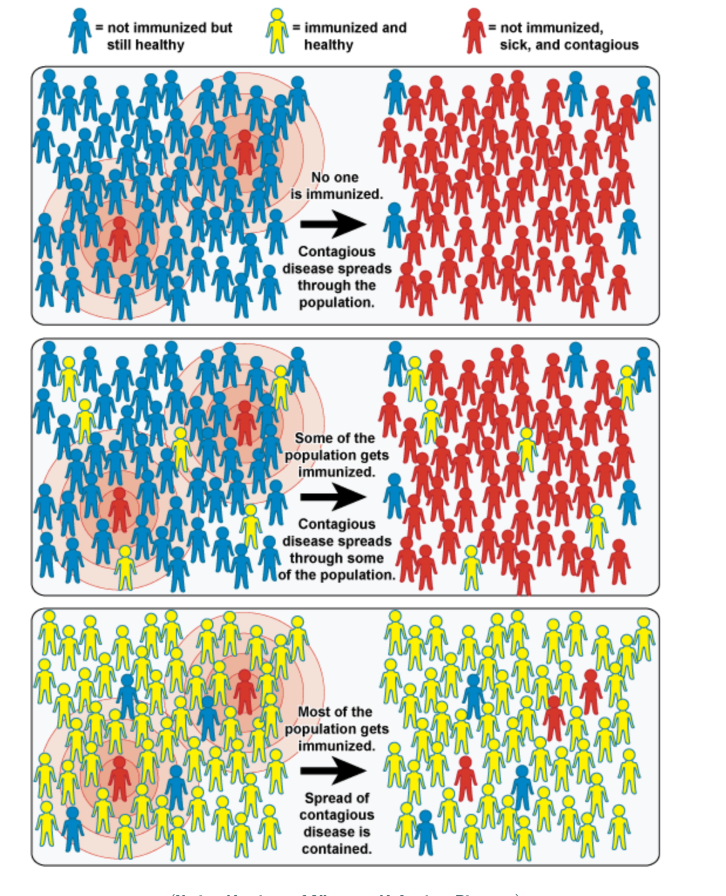
We Need To Achieve High Coverage To Contain The Spread Of Contagious Disease: How Vaccines Protect Our Population
Key Message
Source: National Institute of Allergy and Infectious Diseases

Slide 41
Low Coverage Means Contagious Disease Can Spread Rapidly In The Population
Key Message
Source: National Institute of Allergy and Infectious Diseases

Slide 42
Presenting Evidence For Sustaining Commitment And Funding Over Time…
Data
When programs falter, there have been dire consequences…
Japan, 1979, Pertussis*
Immunization rates fell from 80% in 1974 to 10% in 1976
Result: 13,000 cases / 41 deaths
Former USSR, 1990-1999, Diphtheria**
Breakdown of public health services
Result: 150,000 cases / 5,000 deaths
Sweden, 1979-1996, Pertussis***
Government lapse in vaccination
Result: 60% infected before age 10
Ireland, 2000, Measles†
Vaccine refusal
Result: 300 cases / 3 child deaths
Vietnam, 2013, HepB‡
Coverage drop following publicity surrounding Adverse Events Following Immunization for the pentavalent vaccine
Expected result from the one year drop in coverage: In the 2013 birth cohort, more than 17,000 future deaths from chronic hepatitis B infection (liver cancer, liver cirrhosis) and more than 90,000 chronic infections.
* https://www.cdc.gov/vaccines/vac-gen/why.htm
** https://wwwnc.cdc.gov/eid/article/4/4/98-0404_article
***https://www.ncbi.nlm.nih.gov/pubmed/8483621
† https://www.ncbi.nlm.nih.gov/pubmed/12867830
‡ https://www.ncbi.nlm.nih.gov/pubmed/26055296

Slide 43
Presenting Evidence To Decision Makers On Vaccine Safety
Key Message
Vaccines are safe.
  Licensing of a vaccine requires exhaustive evaluation and testing to make sure that it is both safe and effective.
  Following prequaliﬁcation and licensing, WHO continues to monitor the vaccine, and any serious side effect reported is thoroughly investigated.
Vaccines are still needed, even if the diseases have become uncommon.
Combined vaccines:
  Save time and money through fewer clinic visits;
  Reduce discomfort for the child through fewer injections;
  Increase the probability that the child will receive the complete set of vaccinations according to the national schedule.
Quoted from documents in WHO EURO’s Vaccination and Trust Library, where much more useful material is available. See: http://www.euro.who.int/en/health-topics/disease-prevention/vaccines-and-immunization/publications/vaccination-and-trust-library-1

Slide 44
Group work

Slide 45
Country teams work amongst themselves to develop a slide deck to make the case for an investment
Your program is in need of additional funding for a specific purpose (YOU DECIDE THE SPECIFIC NEED)
The Minister of Health asked you to deliver a presentation at an Inter-sectoral Meeting chaired by the Deputy Prime Minister, where Government’s priorities for the next three years will be discussed.
Great opportunity to present your program targets and needs (all key decision makers will be there, such as, Ministry of Planning, Ministry of Finance and others)
10 minutes for presentation
Prepare the presentation (or an outline) that highlights achievements, challenges, future targets and needs, bearing in mind the types of key messages that are likely to succeed with this audience.

Slide 46
Remember!
Cite program accomplishments
Outline investment needs
Use evidence to support investment needs
Be clear, use simple language, elicit emotion, tailor messages that will resonate with decisionmakers

Slide 47
Additional slides

Slide 48
Low coverage- How vaccines protect our population
Source: National Institute of Allergy and Infectious Diseases

